Slide 1
The rural school as a place for sustainable community development.
Nischolan Pillay – University of Johannesburg
Yashaen Luckan - University of Kwa-Zulu Natal
SASUF 2019

Slide 2
Key Question
Can a Rural School act as a Quasi-Community Centre for sustainable community development?

Slide 3
Aim of the Paper
To understand the Socio-Economic challenges affecting rural areas.
To analyse the value of the rural school as a Quasi socio-economic community facility.
To define Architectural design principles for the adaptive use of the rural school.

Slide 4
Introduction
Human Rights
Freedom
Democracy
Majority
Interest
Minority Interest
Lack of Involvement
Equality
NOT Democracy
Exploitation
Inequality

Slide 5
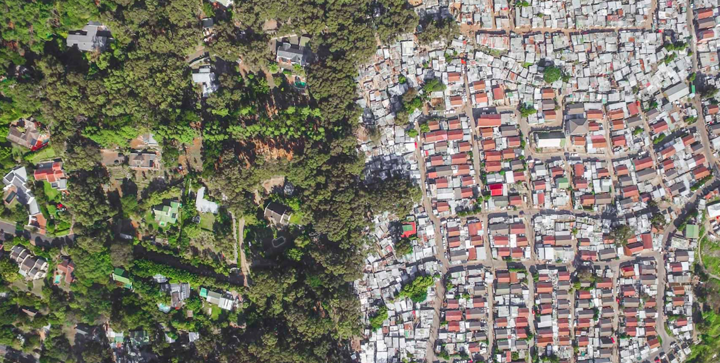
Consequences of the past
Urban
Rural
Privileged
Poor

Slide 6
Spatial Justice
Space
Social
Justice
Space
Space
Space
Spatial Justice must inextricably be linked to physical geography
and the term will not suffice using other formats
(Soja, 2009; pp.1)

Slide 7
Spatial Justice
Social
(In)Justice
Space
Marcuse (2009; pp.3) locates the term Spatial Justice as a derivative to Social Justice which is placed in a physical location. He further argues that Social (In)Justice occurs before space is involved steering the theory into a social agenda (Marcuse, 2009; pp.3).

Slide 8
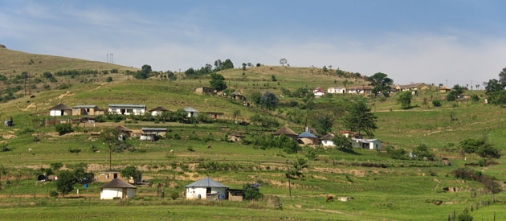
Defining Rural

Slide 9
The word “Rural” has a stubborn reference to geography that is used in common definitions; A place or space located outside a developed city, or a view of the countryside (Hoggart, 1988; Halfacree, 1993; Cromartie and Bucholtz, 2008).
A place located outside an Urban area which shows resilience to various challenges that it encounters.

Slide 10
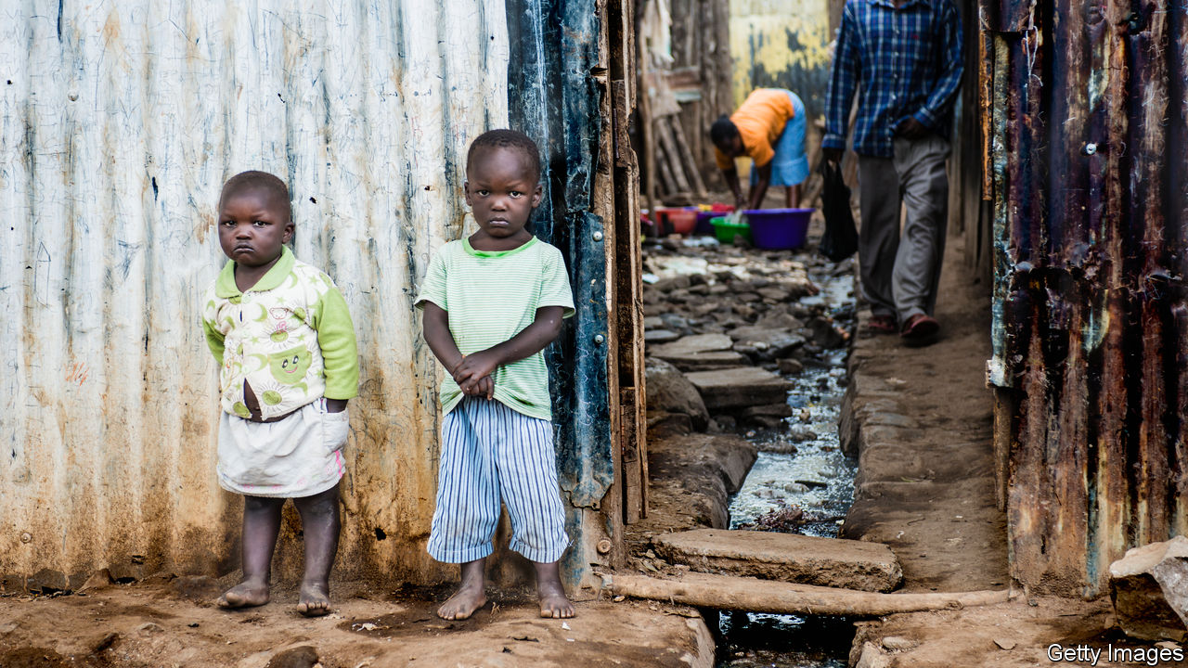
Poverty

Slide 11
One of the most stand-out complications of rurality in South Africa is poverty. According to Fransman et al (2019; pp.50) one key objective of the South African government after the end of apartheid was the alleviation of poverty, disparities and imbalances of the past.

Slide 12
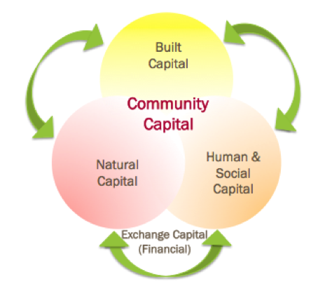
Social and Community Capital

Slide 13
“Social capital is the aggregate of the actual or potential resources which are linked to possession of a durable network of more or less institutionalized relationships of mutual acquaintance and recognition-or in other words, to membership in a group-which provides each of its members with the backing of the collectively-owned capital, a ‘credential’ which entitles them to credit, in the various senses of the word.”
Bourdieu (2018; pp.51)

Slide 14
Intellectual capital migration

Slide 15
Malhoit (2005; pp.11) states that rural communities are rapidly losing their population size and in return the economy of that rural community suffers.

Slide 16
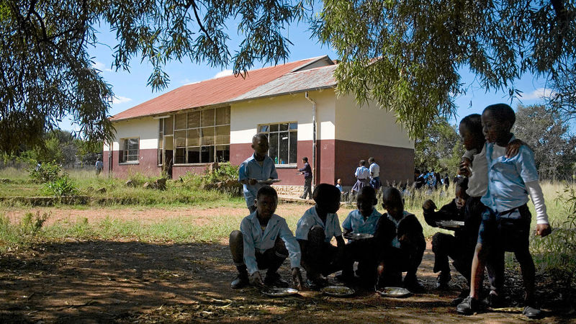
The Rural School

Slide 17
“The school is the most important public institution in a rural community, a rallying point for services to poor families and children, a polling place, the library, and the community centre. Rural schools also represent the economic lifeblood of the community.”
Malhoit (2005, pp.10)

Slide 18
Rural School - Policy
“The Special case of Rural and Farm Schools” the ANC government raises an important point; “Where possible, schools will operate as Community Learning Centres with a range of after-school activities linked to the social, educational, health and recreational needs of the community, linked to rural development projects”
(ANC Education Department, 1994).

Slide 19
Rural School - Policy
A high quality of education in line with the democratic principles of the constitution of South Africa and the 2030 National Development Plan initiative.
A detailed financial implementation plan for rural schools
The Department of Basic Education is to monitor and evaluate the implementation of the Rural school Policy.
The improvement of rural education by providing support services including but not limited to health, social development, transport and economic development.
Interlinking the various levels of education into a holistic view of transformation where education mediates development.
(Department of Education, 2018; pp.23)

Slide 20
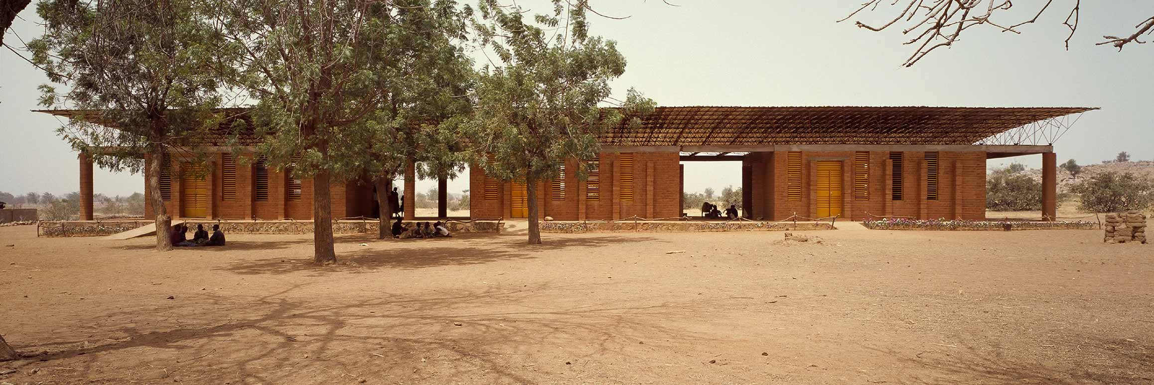
Precedent
Gando Primary School – Francis Kere

Slide 21
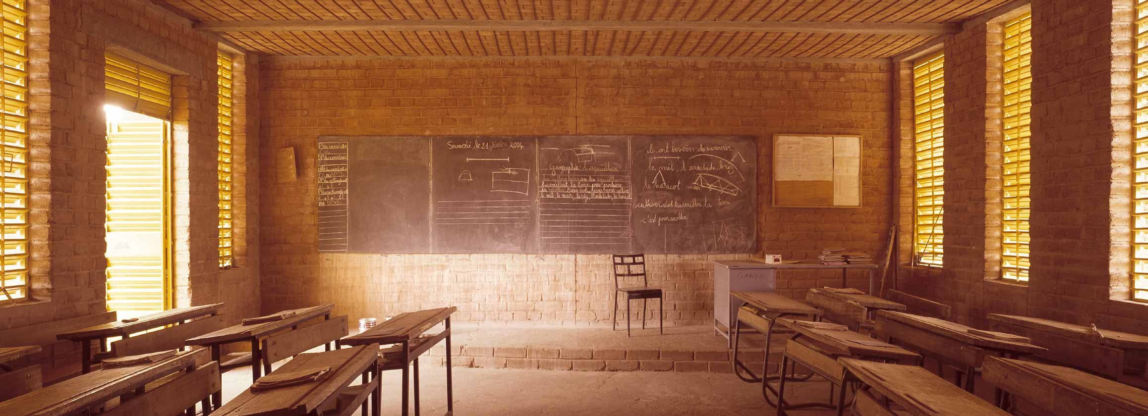
Precedent
Gando Primary School – Francis Kere

Slide 22
“The process has had other rewards, too. Many of the workers who have been trained on site have since found work as skilled labourers on construction sites beyond Gando”.
(Kéré, 2012; pp.68)

Slide 23
Discussion and Proposition
Potential of a School to act as a quasi-community centre.
Flexible spaces to allow for various activities.
Technology enabled spaces for access to resources – 4IR.
Community led/participatory design process.
Rural School as an Economic Driver.
Rural School as a Community Assest.

Slide 24
Thank You

