Slide 1
SASUF 2019 RESEARCH AND INNOVATION WEEK Theme - Urban economy and business development

Slide 2
Title - Creation of knowledge cities for South Africa.
A case of Nelson Mandela Bay.
Authors - Karambakuwa Roseline and Ncwadi Ronney
Department of Economics, Nelson Mandela University
Presenter - Karambakuwa Roseline T

Slide 3
Presentation outline
Introduction
Knowledge-based urban development (KBUD)
Research Problem
Research Objective
Research Methodology
Common strategies for building successful creative urban regions and knowledge cities
The KBUD Framework
Lessons from the international best KBUD practices
KBUD application - Knowledge city for Nelson Mandela Bay

Slide 4
Introduction
Knowledge-based urban development (KBUD) concept
A new perspective for the development of creative urban regions.
Cities are the engines of economic growth, as a large share of the innovations and entrepreneurship takes place in cities.
KBUD framework enables cities to compete nationally and internationally.
Approach is based on the concepts of both sustainable urban development and economic prosperity.
Aimed at promoting smart and sustainable cities through the operationalisation of a knowledge management integrated approach.

Slide 5
Knowledge-based urban development (KBUD)
Includes the following;
provision and development of infrastructures,
improved financial systems,
investments in social and human capital,
the adoption of new state-of-the-art technologies,
catering for the quality of life of city residents and
the creation of attractive living places.
Main advantage of KBUD is that the intangible asset that is managed, knowledge, does not depreciate the way material resources do through use, but rather becomes more valuable as it is used .

Slide 6
Research Problem
In South Africa
Low Gross Domestic Product (GDP) growth (0,5% in 2016 and 1,3% in 2017.
Falling Foreign Direct Investment (FDI) (0,7% of GDP in 2016 to 0,4% in 2017 (World Bank 2019).
Cities are the engines of economic growth, as a large share of the innovations and entrepreneurship takes place in cities
One way to achieve high GDP growth and increased FDI is development of creative urban regions.

Slide 7
SA GDP Growth rate

Slide 8
Research Objective
To apply the Knowledge-based urban development (KBUD) concept in coming up with development approaches for creative urban regions in South Africa, with a case on Nelson Mandela Bay.

Slide 9
Research Methodology
A review of literature and examination of global best practice experiences, to determine how other cities are engineering their creative urban regions so as to establish a base for knowledge city formation in South Africa.
Following Yigitcanlar, et al., (2015), the KBUD framework is applied qualitatively to assess the different development approaches for creative urban regions in South Africa with a case on Nelson Mandela Bay.

Slide 10
Common strategies for building successful creative urban regions and knowledge cities
political and societal will and good governance.
strategic vision and dynamic log-term development plan.
setting-up of agencies to promote KBUD.
knowledge infrastructures, research excellence (universities, R&D institutes).
strong ﬁnancial support, partnership and strategic investments.
international and multi-cultural character of the city.
creation of urban innovativeness engines.

Slide 11
Common strategies for building successful creative urban regions and knowledge cities
metropolitan web-portal – E-government, E-democracy.
value creation to citizens – skill development, employment, social outcomes.
quality of place, life and affordable housing and urban services.
low-cost access to advanced communication networks.
a concentration of well-educated people.
technological, mainly electronic, infrastructure.
connections to global economy.

Slide 12
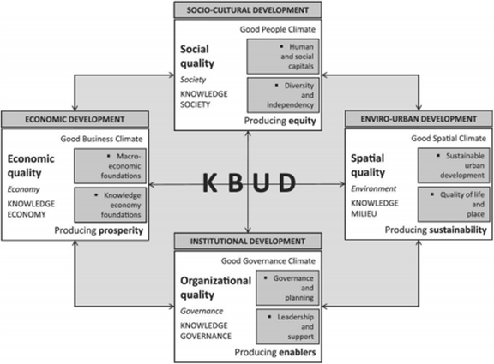
The KBUD Framework

Slide 13
The KBUD Framework
Diagram shows the following four development domains of knowledge;
Economic development
knowledge economy where knowledge is the key to production hence prosperity.
Socio-cultural development
equity attained through educational and cultural strategies aimed at enhancing human and social capital.
creating opportunities for people to develop their skills.

Slide 14
The KBUD Framework
Enviro-urban development
aims to meet human needs while preserving the environment.
ensures that these needs can be met by both the present and future generations.
hence sustainable urban development.
Institutional development
produces enablers of a knowledge governance that creates a good governance climate.
eventually generates organisational quality.

Slide 15
Lessons from the international best KBUD practices
Austin in Texas, USA, led by business organisations attracted large corporations by offering the relatively low cost of living and the quality of university graduates.
Barcelona in Spain undertook a profound technological and cultural regeneration in order to position itself among the major metropolises of the global knowledge society
In Finland, Helsinki’s success originated from strength in ICT, safe and well-functioning living environment, highly skilled people, strong R&D, and a high level of social equality.

Slide 16
Lessons from the international best KBUD practices
Singapore’s success rests on its science and technology parks and knowledge precincts
Brainport Eindhoven, Netherlands has created a successful creative urban region and knowledge city by offering a complete high tech infrastructure on a very small scale.
Montreal, Canada succeeded by concentration of sector-specific expertise, innovation, education and research, development of metropolitan industrial ‘clusters’.

Slide 17
KBUD application - Knowledge city for Nelson Mandela Bay
Nelson Mandela Bay can collaborate with universities and other learning institutions in the city;
To promote research and development.
To promote knowledge economy by developing diverse and highly skilled workforce.
To enhance development of technical knowledge, market knowledge, financial knowledge and human knowledge.

Slide 18
KBUD application - knowledge city for Nelson Mandela Bay
ensure sustainable urban development.
create a better quality of life and place, ensure spatial quality is achieved.
develop metropolitan industrial ‘clusters’ for innovation and competitiveness.
market city as a gateway to Southern African trade and business.
conduct outbound ‘investment missions’ to foreign cities.
provide regulatory and logistical support to investors.
further diversify the economy in the city.

Slide 19
KBUD application - knowledge city for Nelson Mandela Bay
harness enormous potential for the ocean economy in the city.
provide support for start-up and entrepreneurial activities.
Utilise mineral and energy resources sustainably.
Use industrial development zones to promote investment.
Utilise existing efficient urban and transport system.
Use quality infrastructure to create a position as a knowledge city.
Actively negotiate agreements around investment and job creation.

Slide 20
Conclusion
This research provides important insights and discussion on the vital role of planning for knowledge-based development of creative urban regions.
The paper comes up with recommendations for urban administrations planning for knowledge-based development of creative urban regions in Nelson Mandela Bay and rest of South Africa.

Slide 21
END OF PRESENTATION
THANK YOU

