Slide 1
SASUF Symposium 2019
Considering healthy indoor environments in the development of human settlements by characterising the building indoor microbiome
Contents
Dr. Jako Nice
jnice@csir.co.za

Slide 2
Contents
Human settlements and urbanisation
Healthy buildings, Healthy people
Microbiology of the Built Environments (MoBE)
MoBE Healthcare case study
MoBE applied to Human settlement development
Conclusion

Slide 3
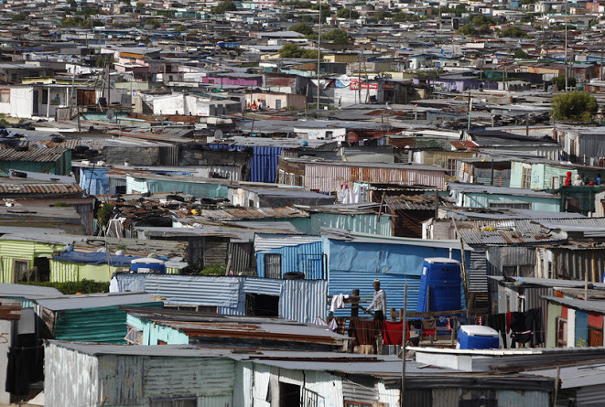
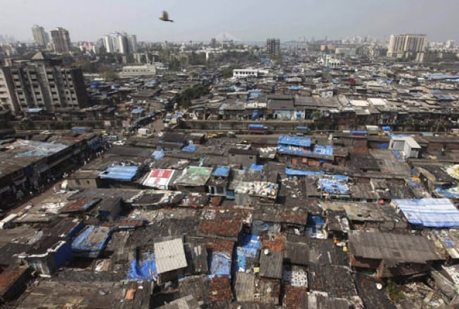
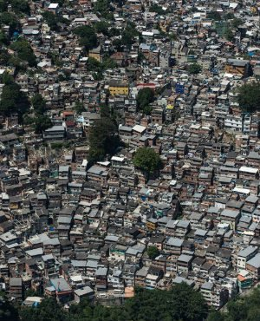
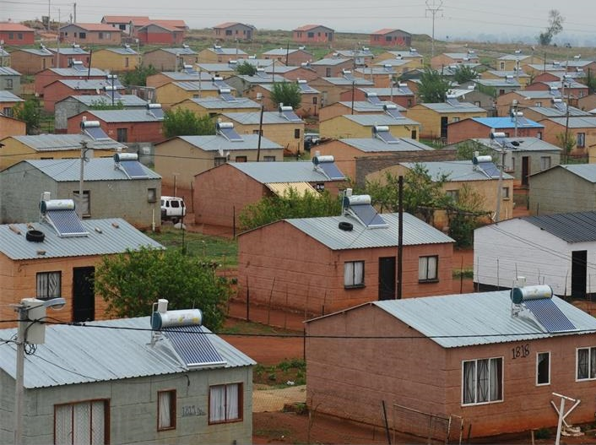
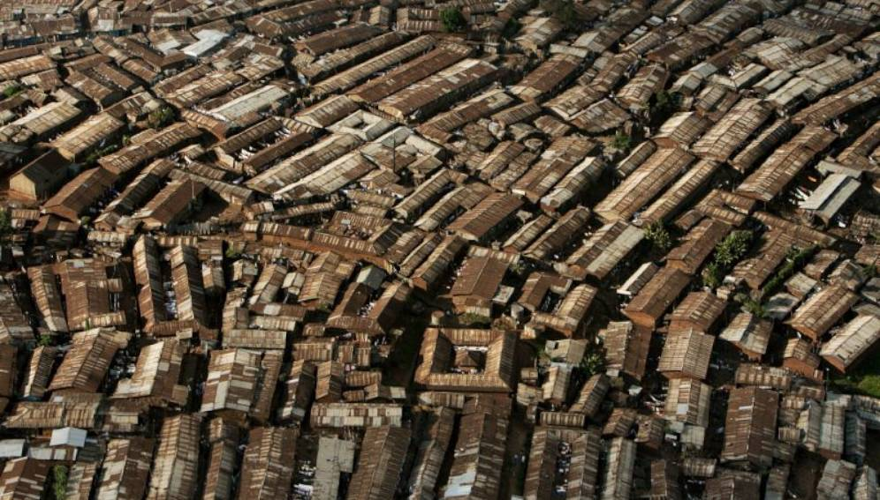
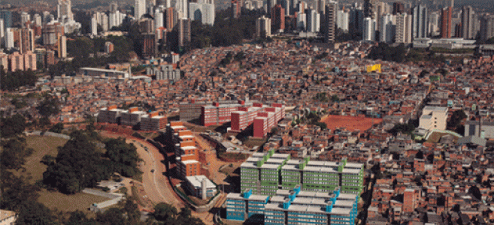
1
2
3
South Africa India Brazil
Reference: Images: 1_DHS South Africa, 2_ Rafiq Maqbool/Associated Press & Christian Als/Panos, 3_Cities Alliance & News 24

Slide 4
78.7 70 50 25 5
* Life expectancy
* Indoors
* at home
* sleeping (bedroom)
* outside
BUILDING HEALTH MATTERS
BUILDING DESIGN MATTERS

Slide 5
(1) Human settlements and urbanisation
85-90% of our life are spent indoors
15% of all people entering healthcare environments acquire healthcare acquired infection (HAI)
60% die of the acquired infection
300% projected rate of of urbanisation over the next 40 years for Africa
+- 1.3billion people will be living un urban environments
77% of South Africa in urban environments by 2050
Health…epidemics?
Social infrastructure?
Quality housing?
Built Environment?

Slide 6
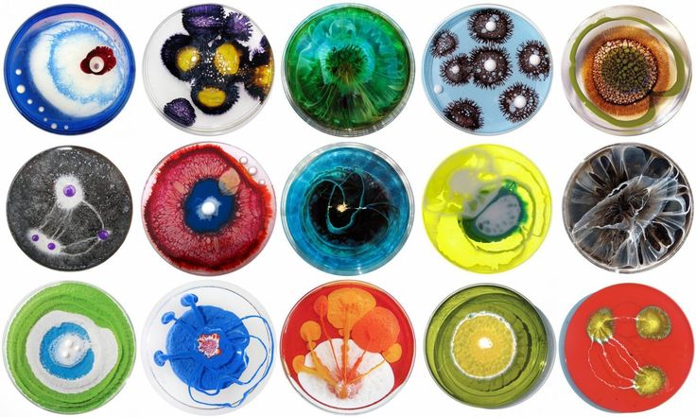
A new perspective on human settlements & the built environment
Reference: https://biobe.uoregon.edu/files/2016/08/petridishart-182rj3x.jpg

Slide 7
(2) Healthy Buildings, Healthy People
Transmission pathways
Age
Chronic illness
Nutrition
Chemotherapy
Radiation
Surgery
Bacteria
Fungi
Parasites
Viruses
Prion
  Causative agent - sufficient numbers, virulent, to destroy normal tissue
  Reservoirs - where organism can reproduce, body tissue, waste of humans, animals, insects, contaminated food & water….FAVOURABLE CONDITIONS
  Exit portal - where pathogens can leave the host, respiratory tract, or intestinal tract….EVEN THE ENVIRONMENT
  Mode of transfer – hands, air, SURFACES, vomit where pathogens move from one place to the other
  Portal of entry – where pathogens can enter the body open wounds, respiratory, intestinal & reproductive tracts etc.
  Susceptible host - no immunity lack of adequate resistance, LTI ETC.
1
2
3
4
5
6
Blood
Skin
Mucosa
Respiratory tract
Intestinal tract
Human beings
Animals
Inanimate objects
Blood
Skin
Mucosa
Respiratory tract
Intestinal tract
Airborne
Contact
Surface
CSIR. 2013

Slide 8
(2) Healthy Buildings, Healthy People
TB infection control & HAI and buildings
SOUTH AFRICA
2015 – 55.00 MILLION POPULATION
DEVELOPED WORLD COUNTRIES ESTIMATE HAI RATES: 9.8 PER 100 PEOPLE
DEVELOPING WORLD COUNTRIES ESTIMATED HAI RATES: 15.5 PER 100 PEOPLE
(Durlach et al. 2012; Alvarez-Moreno et al. 2014 and Brink et al. 2006)
HAI in South Africa indicates a lack of policy and no implementation of any policy.
A gap in standard methodology for HAI reporting and measuring.
Only three studies between 1995 and 2008 have been published in Africa through the WHO, and none in South Africa, until 2017.
(Whitelaw & Dramowski, 2017)
LOCAL HEALTH IMPACT SOUTH AFRICA_TB
2015 – TB PREVALENCE RSA 696 / 100 000
2015 – TB PREVELANCE (in high incidence areas) 1165 / 100 000
2015 - 5.5 MILLION HIV AIDS INFECTION (61% TB Co-infection)

Slide 9
(2) Healthy Buildings, Healthy People
Infection risk factors
Determinants in settings with limited resources
inadequate environmental hygienic conditions and waste disposal;
poor infrastructure;
insufficient equipment;
understaffing;
overcrowding;
poor knowledge and application of basic infection control measures;
lack of procedure/protocol;
lack of knowledge of injection and blood transfusion safety;
absence of local and national guidelines and policies.
Reference: WHO

Slide 10
(2) Healthy Buildings, Healthy People
Built environment
Contamination occurs by airborne, droplet and touch, it is accepted that ‘the spread of infectious bacteria, fungi, viruses and single cell organisms (prokaryotic & eukaryotic) are first by human contamination (Hospodsky et al. 2012) and secondly dependent on environmental conditions (Basu. et al. 2007);
Mycobacterium Tuberculosis (Mtb) transmitted by airborne is difficult to control, not limited to, but, environmental controls are critical to reduce and manage airborne contagion (Yates, Tanser & Abubakar 2016).
Application of architectural space modelling to predict social interactions aimed at HAI risk management.
Associating microbial characterisation with space planning provides the premise for evidence based design decision making in infection control.

Slide 11
(2) Healthy Buildings, Healthy People
Evidence base design
    ‘the concept of evidence-based design … moves beyond the general idea that the physical environment affects occupants: It seeks to gauge the impact of specific designs on productivity, employee and patient morale, and patient outcome. ’ Karen Kroll, 2005
    The Center for Health Design (CHD) defines EBD as “the deliberate attempt to base building decisions on the best available research evidence with the goal of improving outcomes and of continuing to monitor the success or failure for subsequent decision-making.”
    The premise: One can measure the impact of the physical design on its users.
Texas A&M and Georgia Institute of Technology identified more than 600 studies demonstrating the impact of hospital design on outcome measures
Two-fold conclusion: 1) There is more than sufficient evidence from the scientific literature to guide current hospital design; and 2) Utilizing that information to improve hospital design does have a significant impact upon patient and staff outcomes (Ulrich et al., 2004)
For Human Settlement planning and Housing design…?
limited evidence exists !!!!!

Slide 12
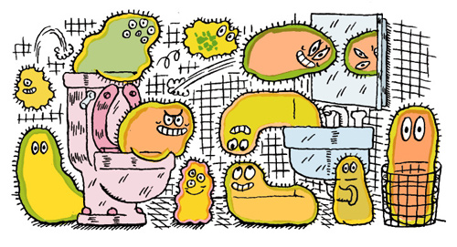
(3) Microbiology of the Built Environments (MoBE)
http://vjulily.files.wordpress.com/2010/11/germs.jpg

Slide 13
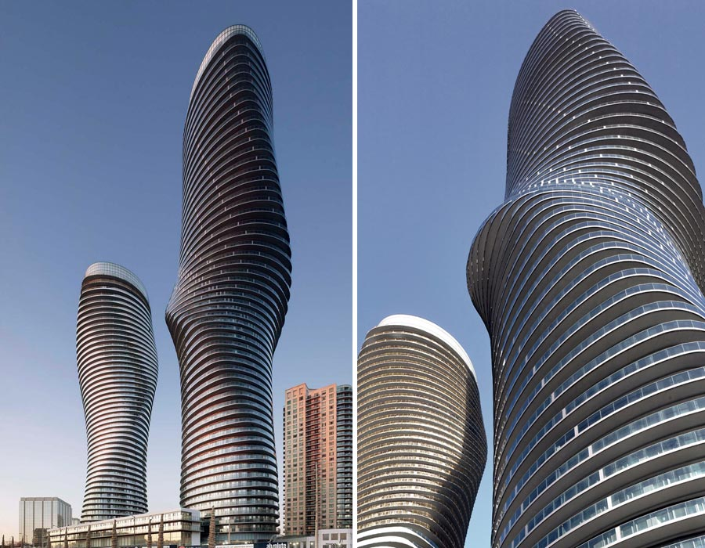
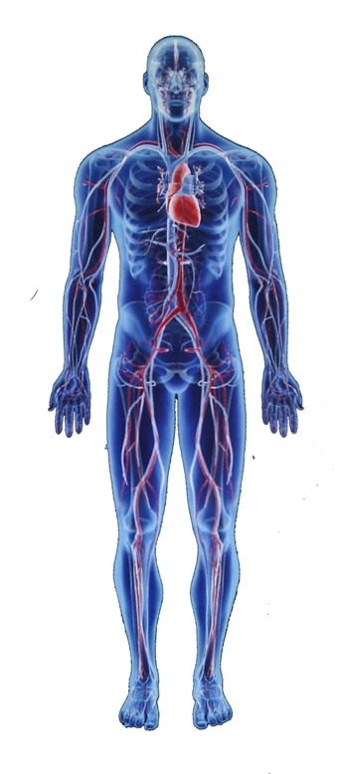
‘Marilyn Monroe building’, Mississaug, Toronto, Canada; Sigmund Soudack and Associates Inc,
The Human body http//.www.endoszkop.comwp-contentuploads201404the-human-body-and-bones.jpg
Concept: courtesy of Dr. Richard L Corsi

Slide 14
(3) Microbiology of the Built Environments (MoBE)
MoBE research provides insight into the living environments, public indoor spaces that built environment practitioners create. It provides the missing link and platform for health associated data collection in BE studies.
The built environment needs to be considered and approached as an ecosystem; not in the conventional manner of parts such as: services, roof, walls etc., but much fluid and integrated as an organism of spaces within walls, plaster, air gaps, interconnecting spaces, ceiling voids, rooms with variant temperature and humidity zones, areas of lighting that vary room temperature and microbial condition.
Smart sensing and Smart interdisciplinary approaches will construct and drive the emerging architectural microbial paradigm.

Slide 15
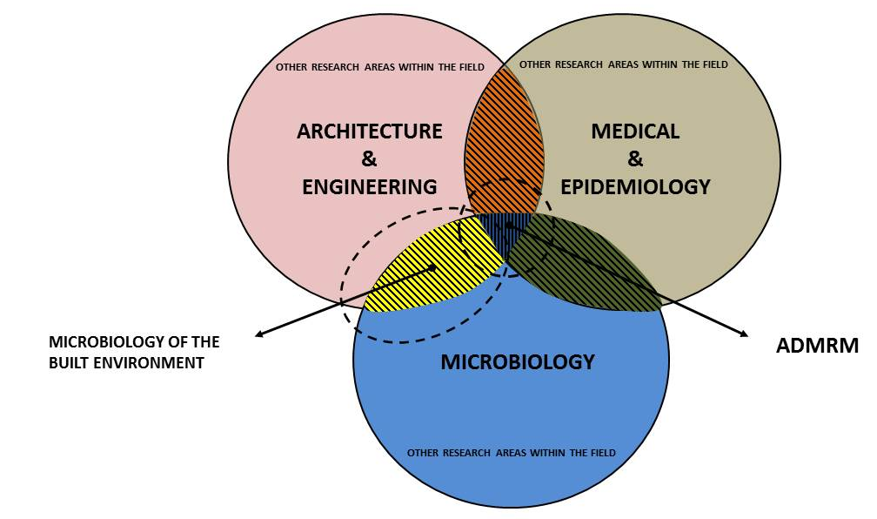
Reference: (Nice 2014,2019)

Slide 16
(3) Microbiology of the Built Environments (MoBE)
‘Architectural design is poised to undergo a revolution over the next few decades in response to climate change, urbanization, and population growth.’…… and the microorganisms encountered there can impact public health.’….
Bio-informed design.
Brown et.al (2016)_ University of Oregon
’I am optimistic that well before 2034 we will be collectively designing and managing buildings with intention, to promote healthy indoor ecosystems’
J. Green (2014)
Interdisciplinary research……. The combination of architectural spatial analytics, environmental data and microbial ecology knowledge and theory, collectively provide inputs for design tools towards developing real world health guidelines in building design and potential for all building typologies.

Slide 17
(3) Microbiology of the Built Environments (MoBE)
Microbial factors and the built environment
MICROBES (3 CATEGORIES)
ESTIMATE THAT ONLY 1% OF MICROBES HAVE BEEN IDENTIFIED
ONLY 0.1% OF MICROORGANISM ARE CULTURABLE
AND ONLY 1%-5% OF MICROBIAL SPECIES HAVE BEEN ISOLATED.
AND ONLY 1% OF MICROBES ARE PATHOGENIC
INDOOR ENVIRONMENTS
HOSPITALS, SCHOOLS, HOMES, SUBWAYS, SPACE STATION, CLEAN ROOM, PUBLIC SPACES, URBAN ENVIRONMENTS…
SAMPLING THE MICROBES
METHODOLOGY, TECHNIQUES, EQUIPMENT, AIR, SURFACE, VACUUM, SWAB, CULTURE PLATES…
ANALYSIS OF THE ORGANISM
BEFORE: STAINING..TO VISUALISE, MICROSCOPY AND THEN IMAGE ANALYSIS.
BUT NOW: DNA GENE SEQUENCING: METAGENOMICS: FULL GENOME, PCR, 16S rRNA, 18S rRNA, 23rRNA, ITS, PYROSEQUENCING,
SHOT GUN GENOMICS, FLOURESCENT PARTICLE COUNTING…
DATA BASE SELECTION:
EMBL, ITS, QIIME, UPARSE, EPHCIT, PAMI, MIxS, MIxS-BE
‘accepted metadata MIxS (MIGS, MIMS, MIMARKS; Yilmaz et al. (2011) standards for genomic, metagenomic and amplicon (for example, 16S rRNA) sequence data sets. These standards have been developed within a framework that is both modular and extensible. The MIxS-BE, as a minimal metadata standard, represents a unique extension to the GSC’s MIxS standard as a rigorous and structured tool for the analysis of microbial sequences and ecosystems of the indoor environment. The MIxS-BE package provides the BE community with a suggested list of parameters to record and report for each sequenced sample ‘to compare data across studies. ’ Glass et al. (2014)

Slide 18






Slide 19
(3) Microbiology of the Built Environments (MoBE)
Home microbiome
The inhabitants leave a distinct microbial signature
Relationships between people can be identified through common microbes.
Hands reveal common shared ID ...but noses present most defined microbial ID
Microbial tracking enabled tracing of pathogens between inhabitants.
Social context (personal immune system health) linked to likelihood of infection.
With high level of accuracy one can predict who has lived and until how recent.
Gilbert et.al (2014)
Limited data exist on the built environment factors associated to dwellings and settlements.
No research in South Africa or Africa on the home/dwelling or settlement typology microbiome….
Yet the built environment plays a significant role in human health

Slide 20
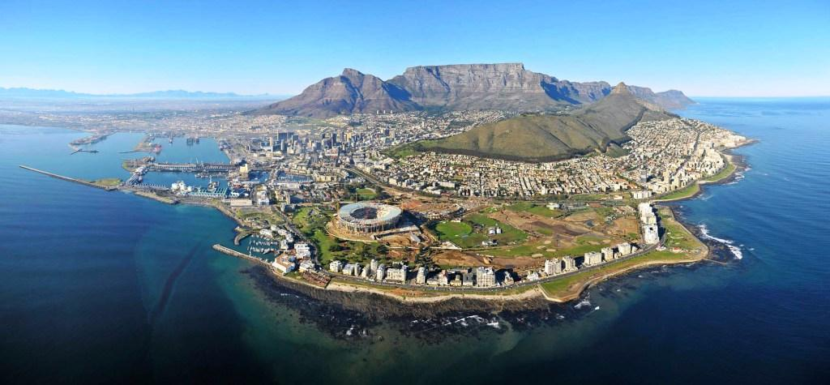
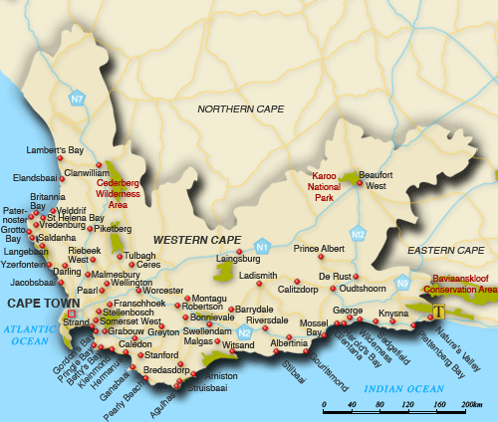
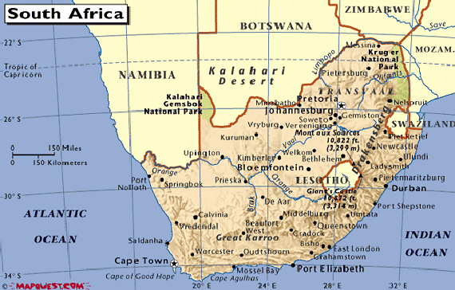
(4) MoBE Healthcare case study
The investigation studies two hospitals in the Western Cape (WC) South Africa (SA)
Investigate

Slide 21
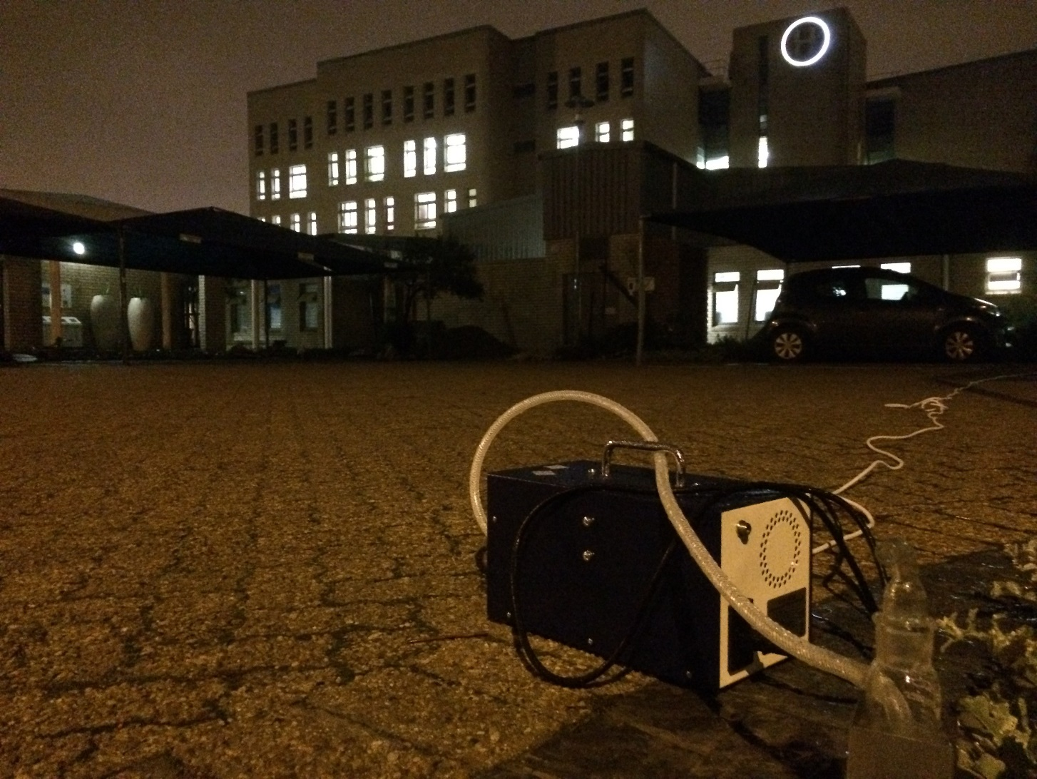
(4) MoBE Healthcare case study

Slide 22
(4) MoBE Healthcare case study
Methodology Spatial analytics
Two sites, two seasons, simultaneously measure, minimum 4 days per season 12 hrs per day. The study zones: Accident and Emergency (A&E) departments
Perform real time occupancy and flow observations
Task 1: “Mental snap shot” A fixed route was covered hourly with 3-4 minutes observations per zone. noting people and actions by coding.
Task 2: “Movement tracer” A fixed route was covered hourly with 3-4 minutes observations per zone. noting people and flow by coding.
Coding include: user type, activity and occupancy
Perform theoretical spatial analysis by modelling, predict potential social interactions and space use. (Computer Aided modelling through: DepthmapX v0.5b, ArcGIS 10.3, and AutoCAD, 2015 software)
Compare design potential suggested flow planning to actual building use.
Correlate and analyse with environmental and microbial data sets.
Reference: Nice, 2019

Slide 23
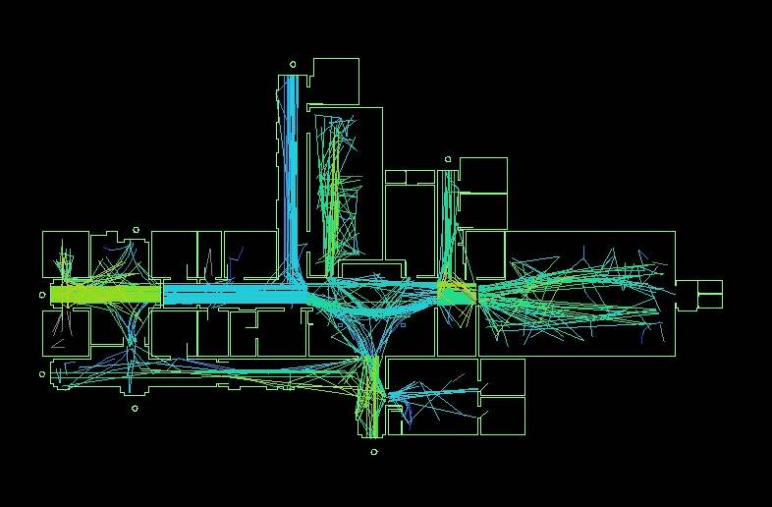
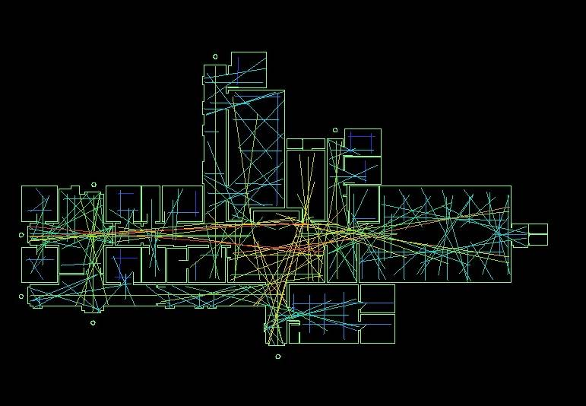
(4) MoBE Healthcare case study
Methodology Spatial analytics
Axial Map: MP as-built planning (b) Axial Map: MP observational flow.
Winter Summer
Notes:
Previously captured observation data will in future be used for predictive modelling (Agent based modelling – Depthmap) for microbial association and potential risk environment identification. Applying microbial data with spatial analytics will assist in determining relationships of microorganisms to the movement patterns distribution.

Slide 24
(4) MoBE Healthcare case study
Methodology Environmental & engineering
Sensor data: CO2, temperature and humidity.
lighting (LUX)
Continuous sensing and sampling of.
Ventilation source identified
Full characterisation of the mechanical system prior to study:
  air source,
  airflow,
  direction flow and
  pressure differential between spaces within the various facilities.
Reference: Nice, 2019

Slide 25
(4) MoBE Healthcare case study
Methodology Microbiology
Developed from a broad literature review that included sampling, equipment, analysis, sequencing techniques, database selection and the selection of bioinformatics platforms.
Air and surface sampling
Sampling once per room daily and seasonally (winter and summer)
External sampling twice per day
Culture analysis with selected media to detect growth of identified HAI indicator organisms, i.e. Staphylococcus aureus & Pseudomonas aeruginosa (from surfaces), Pneumocystis carinii pneumonia (PCP) & Mycobacteria tuberculosis (air).
DNA-extraction and PCR (using 16S rRNA gene V3-V4 primers) were performed on both the air and surface samples.
6493 sequences per sample (175).
It is important to note that both culture and 16S Rrna sequencing or pyrosequencing is required, to determine both presence and viability of organisms.
Reference: Nice, 2019

Slide 26
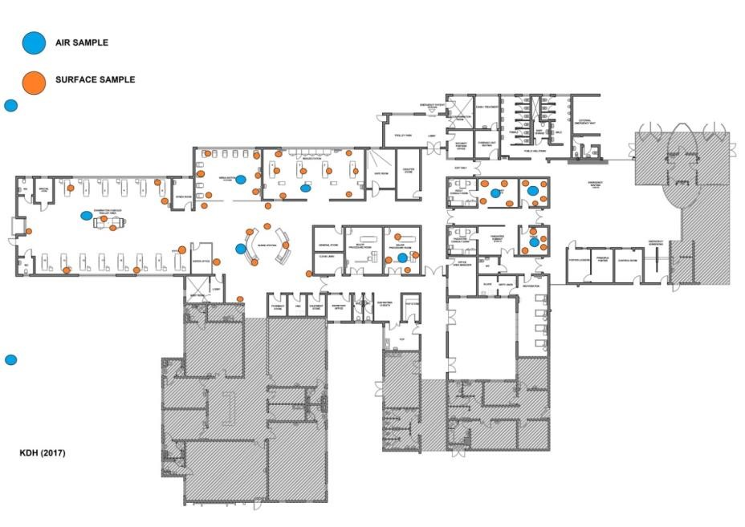
(4) MoBE Healthcare case study
Microbiology

Slide 27
(5) MoBE applied to Human settlement development
Applying the Healthcare case study findings
Key findings
Spatial analysis enabled identification of integration of design and clustering. Comparing the global user flow patterns of both facilities seasonally, higher correlations were achieved in one facility over the other seasonally
Functional use variations and planning have a direct impact on the utilisation. Reveals hidden social logic in use patterns.
Higher occupied spaces indicated an increase in the number of Operational Taxonomic Units (OTU), i.e. a larger number of identified microorganisms compared to other rooms for both facilities.
The data indicated that there is a correlation with the change in flow patterns, occupancy and the quanta of organisms.

Slide 28
(5) MoBE applied to Human settlement development
Applying the Healthcare case study findings
When considering occupancy rates and the variation in summer and winter in the microbial sampling of surface and air total OTU’s, an increase was observed in indicator species related to an air source.
Seasonal microbiome variations infers variable indoor environment conditions and a variation microbial communities (specie presence and abundance.) Room types are relevant (functional use), a 60% biome variation in most zones/rooms when grading activity rates.
Building systems and planning layout play a significant role in the microbial communities composition. Ie. Ventilation is a key driver in microbial community composition
Unique air and surface communities were observed
The two facilities were invariant (notes a similar biome composition)… postulating that similar typologies might present similar biomes (yet unique)… the verdict is still out

Slide 29
(5) MoBE applied to Human settlement development
Home & urban microbiome for South Africa
South Africa…??
Matching methodology as applied in the healthcare settings.
Seasonal investigations, in similar housing typologies in different regions within a metropole.
Compare high-rise housing typologies (urban environments) to low rise typologies (free standing dwelling in suburban environments).
Time related investigation, (considering both occupancy and in unoccupied)
Room comparison between typologies
Increased number of microbial samples per space due to potential low biomass

Slide 30
(5) MoBE applied to Human settlement development
Home microbiome for South Africa
The findings will enable the development of a methodology for grading zones according to actions and movement patterns
Various design methodologies assessments: by function, by grading, by occupancy, by clustering, actual and potential social interaction etc.
Support the development of design matrix for Health, Risk and contamination in human settlements towards a:
  Health Design decision tool:
  Architectural Design Microbial Risk Model (ADMRM)
  for
  Public Health, Public Spaces, Human Settlements, The Built Environment
  Informed design = Smart design

Slide 31
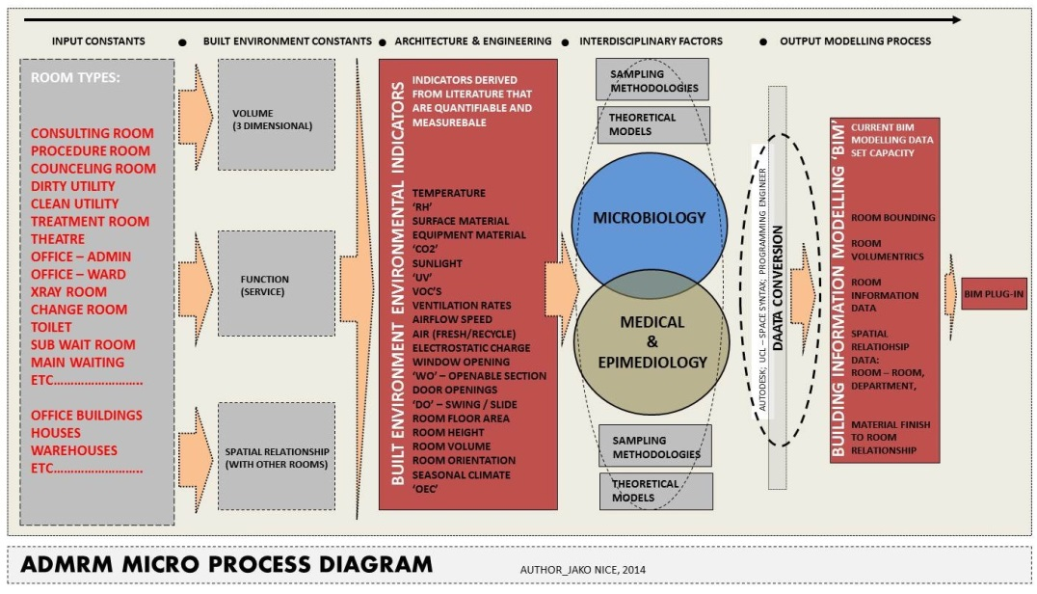
(5) MoBE applied to Human settlement development
MoBE research roadmap ADMRM tool

Slide 32
(6) Conclusion & Findings
MoBE research provides insight into the living environments, public indoor spaces that built environment practitioners create. It provides the missing link and platform for health associated data collection in BE studies.
Spatial analytics and indoor microbiome dependencies (common sources, ventilation etc.) demonstrated that the modelling techniques can be applied for risk grading in hospital environments and postulate towards other typologies
Developing a microbial design matrix will support planning selections, environmental awareness, material selection, user health, the characterisation of building typologies and appropriate building system selection.
The relevance to architecture and human settleemnts lies in the development of an architectural design microbial risk model ‘ADMRM’ for the built environment, that incorporates various data sets and translates them for the built environment practitioner to apply in every day design and build planning
Applying MoBE research methodologies to human settlement investigation will provide empirical data that can support decision-making tools and policies in the human settlement domain for health.

Slide 33

THANK YOU
Jnice@csir.co.za

