Slide 1
IMPLICATIONS OF THE COUNTER URBANISATION TREND IN PERI- URBAN AND RURAL AREAS FOR SPATIAL PLANNING POLICY AND HUMAN SETTLEMENT DEVELOPMENT

Slide 2
STUDY AREA
Dutywa and Surrounding Areas:
Dhoti & Moer-moer
Ngonyama & Upper Mputhi
Butterworth and Surrounding Areas:
Sasulwana & WSU area
Ndabakasi
Mthatha and Surrounding Areas:
KwaPayne
Mt Ayliff and Surrounding Areas:
Lugelweni
Areas abutt the 2nd National Road (N2) ; Upper Mputhi area is along the R405 to Engcobo
Characterised by new settlements; rental accommodation and large urban type dwellings

Slide 3
SOCIO-PHYSICAL FORM AND ECONOMIC STATUS OF EAST EASTERN CAPE TOWNS
Town foot print has not grown – growth inward densification
Housing Subsidy developments on urban edges
Towns bordered by peri-urban settlements on Traditional Authority land
Some informal settlements within urban edge – high density
Peri-urban settlements mainly characterised by - medium density
Populated by mixed socio-economic class – mostly middle income
Mainly residential with number of rental residences

Slide 4
SOCIO-ECONOMIC CHARACTER OF PERI-URBAN SETTLEMENTS
Formed out of residential land pressure – from towns; rural settlements and from cities
Counter-urbanisation together with rural-urban movements settles in peri-urban spaces
Triggers: urban opportunities; convenience; rural-urban mix; financial affordability; cultural-traditional nuance
Mixed class, predominantly middle income, retired and younger professional, civil servant
Also urban property owner planning retirement near ancestral home – second home
Lower income and unemployed settle in informal areas, retain strong links with rural ancestral area
Mainly residential and small scale gardening activity, town or city employment base

Slide 5
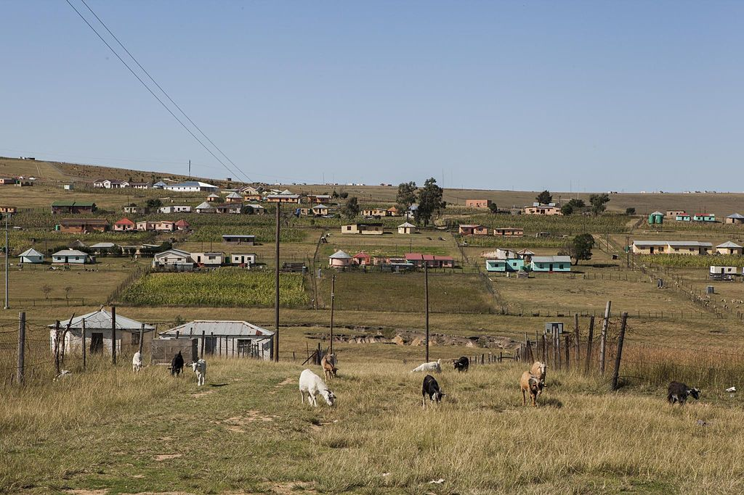
SPATIAL IMPLICATIONS

Slide 6
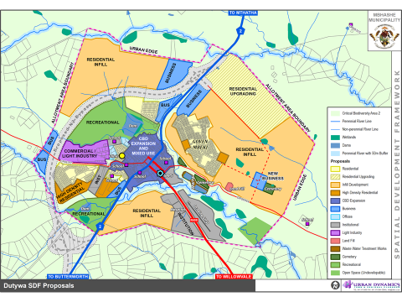

Slide 7
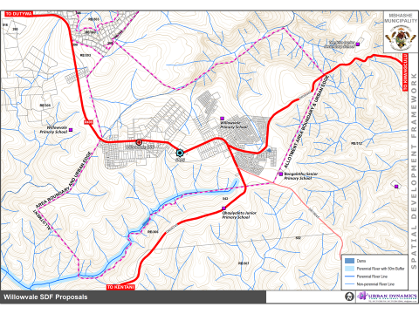

Slide 8
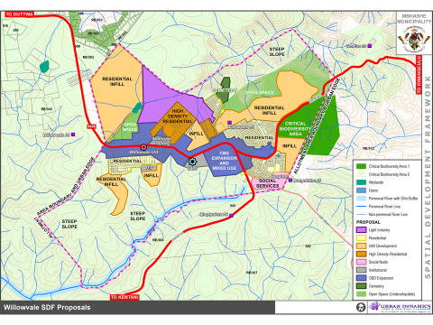

Slide 10
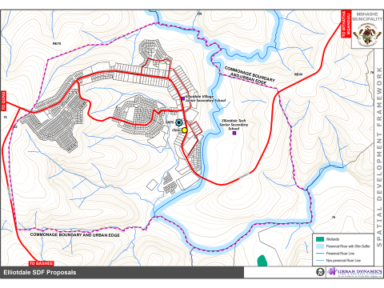

Slide 11
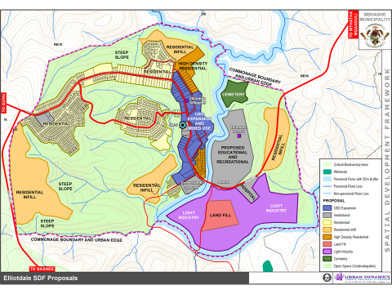

Slide 12
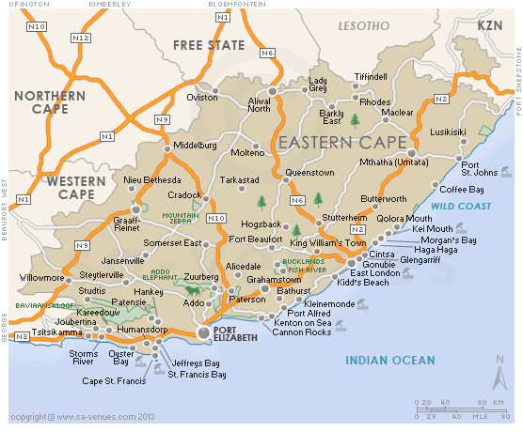

Slide 13
