Slide 1
Ship recycling as a viable option for enhancing business, employment and inclusive economic growth and sustainable development: A case of South Africa.

Slide 2
Table of Contents
Introduction and Background
Research objectives
Regulating bodies
Recycling methods
Economic value
Research Approach and Method
Research findings
Recommendations and Conclusion

Slide 3
Introduction
Maritime industry plays a critical role in respect of economic growth and social development through employment and business opportunities in various sectors.
South African government introduced the oceans economy strategy - Operation Phakisa Oceans Economy in 2014 - in order to leverage on lucrative economic opportunities in order to address its triple challenges of poverty, unemployment and inequality;
Sustainable social and economic development
This strategy estimated that oceans economy would contribute in GDP approximately R177 billion and 1 million jobs by 2033 (Operation Phakisa, 2014).
OP has 6 focus areas with 2 enablers;
Focus Areas(Labs) | Enablers( Cut across all labs)
Marine transport and Manufacturing | Skills development and Capacity Building
Aquaculture | Research, Technology and Innovation
Offshore oil and gas exploration
Marine Protection and Ocean Governance
Small harbour development
Coastal and marine tourism

Slide 4
The objectives are as follows:
To explore the potential of green ship recycling and its sustainability in relation to socio-economic and environmental impact in South Africa;
To explore and describe the impact of ship recycling in the value chain of the shipping industry;
To explore the health, safety and environmental issues that are associated with ship recycling;
To explore safety, health, and environmentally sound measures of practicing ship recycling;
To investigate and recommend appropriate, sustainable and responsible ship recycling practices for South Africa.

Slide 5
Background
Ship recycling is an activity of partial or complete dismantling of a vessel with an intent of recovering material or components of it for re-use or reprocessing purposes (International Maritime Organization, 2009: Article, 2).
It is estimated that 97% of the ship's contents are re-cycleable.
Steel is not the only recyclable part, there are so many other things which can be sold off such as electric appliances, furniture, machinery etc.
Under normal circumstances, old vessels are sent for scrapping in ship recycling yards by the owners and this period normally is when vessels are between 22-25 years of existence (Anand, Atit and Shyam (2015: 521).
Asian countries such as Bangladesh, Pakistan, China, Turkey and India account for about 70-80% in terms of practicing in this industry while 20% is accounted for by other European countries.

Slide 6


Operation Phakisa V.S NDP Objectives 2030
Current reality: South Africa!!!
Unemployment Rate: 27.1%
Youth unemployment: 52%
Poverty rate high
High inequality

Slide 7
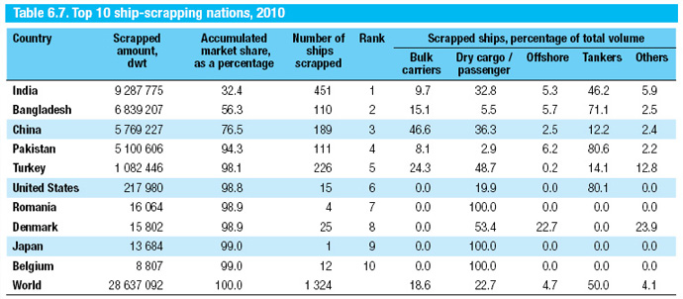
Ship recycling countries

Slide 8

International institutions and Regulations
International Maritime Organization
Hong Kong convention
International labour Organization
Basel convention
European convection

Slide 9
Improper practice leads to setbacks
Set backs resulting from improper and irresponsible practice of this industry(beach scrapping):
Health and safety for workers issues
Environmental issues(Pollution)
Labour issues( exploitation, safety matters etc).
Dry-docks- Proper and responsible scrapping of vessels

Slide 10
Dry-Dock method-Responsible method
In Dry Dock method or Berth method, old ship is taken to dry dock facility in a ship recycling yard.
The major difference between dry dock method and beach
method is the presence of a concrete barrier between the dismantled vessel and sea water.
Progressive sliding for transporting the vessel within the yard premises is absent in the latter(beaching method).
Western European countries and United States practice this
Method(Dry-dock method).

Slide 11
Economic value of this industry
Employment opportunities- 1 vessel more than 200 tons employ approximately 200 people. Ship recycling or scrapping is labour intensive( cutting, transporting, lifting, cleaning etc.)
Business opportunities- cleaning, steel production and fabrication companies ect.
Environmental sustainability- reduce mining and preservation of natural resources such as Iron Ore, Coal and water usage.

Slide 12
Research approach and Method
The qualitative method was used in this study and twelve participants were recruited and interviewed from both the public and private sector.
Criterion and snowball sampling technique was used to recruit participants.
They were selected according to the following criteria; work within the maritime sector in South Africa; knowledgeable about the marine environment; knowledgeable about environmental protection and preservation; knowledgeable about the maritime economy and business opportunities; non-racial, and able to speak English and/or Xhosa.
The data was analysed through thematic and coding technique. All participants gave consent to participate voluntary and throughout the research study, ethics were observed.

Slide 13
Capacity to practice
Capacity:
South African government has got capacity to establish and run an effective green ship recycling industry. It has various institution, organizations and regulations that can keep the checks and balances in terms of practising the industry from all angles; Environmental, Health and Safety, labour issues.
S.A Constitution
NEMA-National Environmental Management Act 2008.
Government Departments e.g. DEA
Labour Union for workers
Effective legal system(Labour court, environmental court etc.).
IMO member

Slide 14
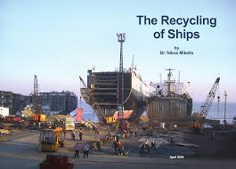
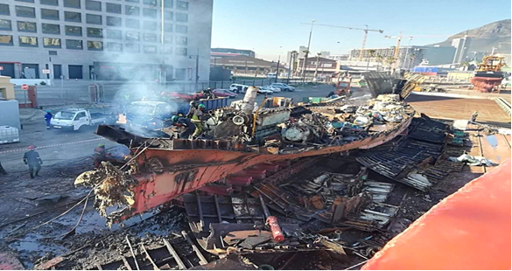
Job Opportunities V.S Green Ship Recycling
Job creation
Skills development
Business Opportunities

Slide 15
Conclusion and Recommendations
South African need to rectify the Hong Kong Convention, 2009, on the Safe and Environmentally Sound Recycling of Ships so as to enable the establishment and guided practice of this industry.
Transnet together with other critical and important stakeholders that have a role in the maritime industry, to conduct a thorough environmental impact assessment and environmental integrated management in the Port of Ngqurha, Port of Saldanha and Richards Bay in order to ascertain the best port to establish and build ship recycling facility. This assessment will further assist in ensuring the balance of economic and environmental interest.
Transnet as a state-owned entity that has authority over the ports in South Africa, should allocate a suitable site for the green ship recycling industry in South Africa. In doing so, it would be guided by the outcomes or results of the EIA and environmental integrated management (EIM).
Upon rectification of the Hong Kong Convention, legislation that domesticates the Hong Kong Convention should be created. These legislation should contain processes and procedures that regulate the operations of recycling facilities, owners and workers in the industry.
A private-public partnership between government and private sector- interested parties in the industry should be established.
Alternatively, government through Transnet make space for private companies to open recycling facility in the port land.

Slide 16
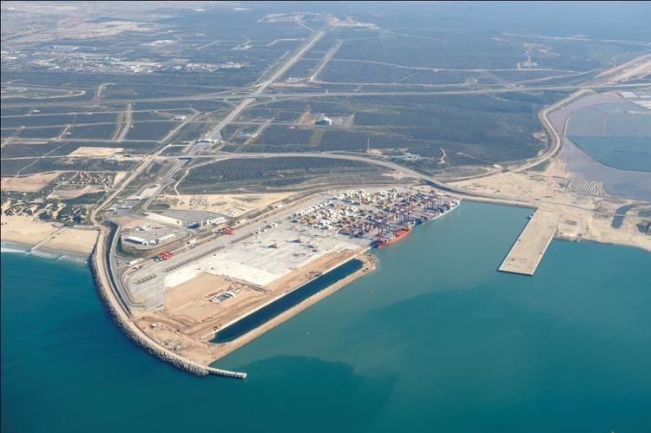
Suitable and potential site: Recycling Yard
Operation Phakisa: Green Ship Recycling

Slide 17
THANK YOU!!!

