Slide 1
household expenditure as a indicator of human settlement performance
Lorato Motsati
&
Jeremy Gibberd
04.09.2018

Slide 2
Structure
Indicators of human settlement performance
  SDGs
  StatSA
Household expenditure benchmarks
Human settlement performance in relation to benchmarks
A proposal for comprehensive performance indicators for human settlement including affordability
Conclusions and recommendations

Slide 3
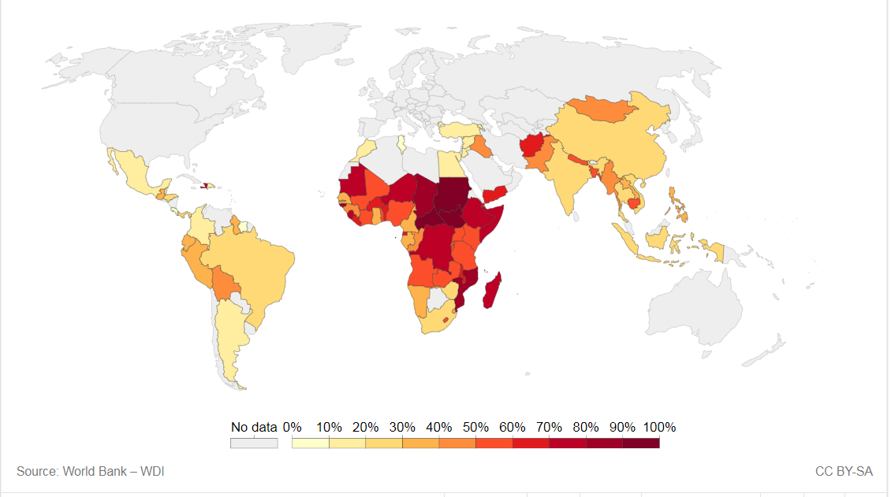
SDG 11.1.1 Proportion of population living in slums
Proportion of urban population living in slums, informal settlements or inadequate housing.
South Africa, 2017: 13.7% of households living in informal dwellings/tents/caravans
https://sdg-tracker.org/cities General Household Survey 2017

Slide 4
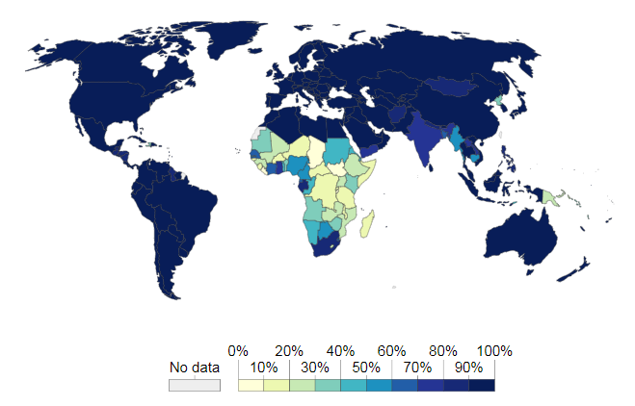
SDG 7.1.1 Access to electricity
SDG INDICATOR 6.1.1
Safe drinking water
Definition: Indicator 6.1.1 is the Proportion of population using safely managed drinking water services.
Proportion of population with access to electricity.
South Africa 2016: 84% of households had connection to mains electricity
16% do not have a connection
https://sdg-tracker.org/cities General Household Survey 2016

Slide 5
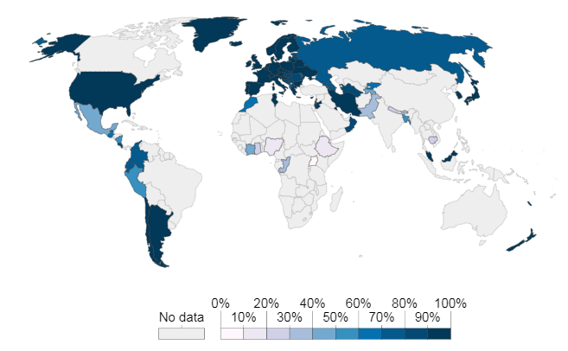
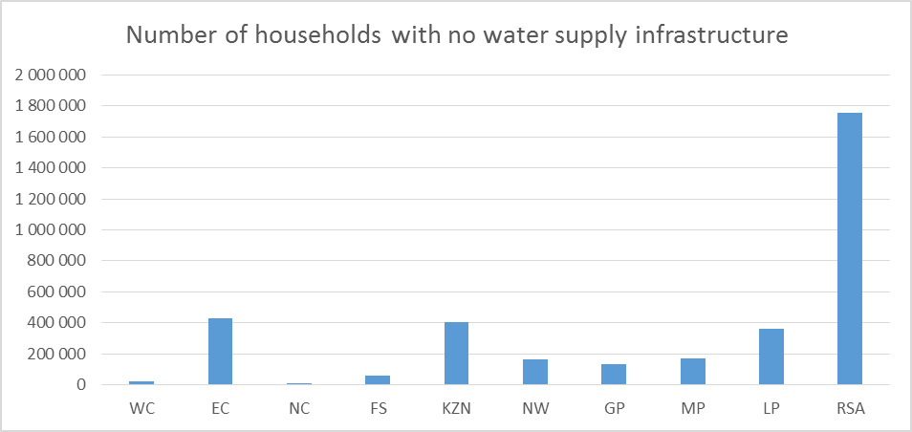
SDG 6.1.1 Safe drinking water
SDG INDICATOR 6.1.1
Safe drinking water
Definition: Indicator 6.1.1 is the Proportion of population using safely managed drinking water services.
Safe drinking water: Share of the total population using a safely managed drinking water service; that is, one located on premises, available when needed and free from contamination.
South Africa 2017: 1,755,000 households with no water supply infrastructure (3% of the total population)
https://sdg-tracker.org/cities General Household Survey 2017

Slide 6
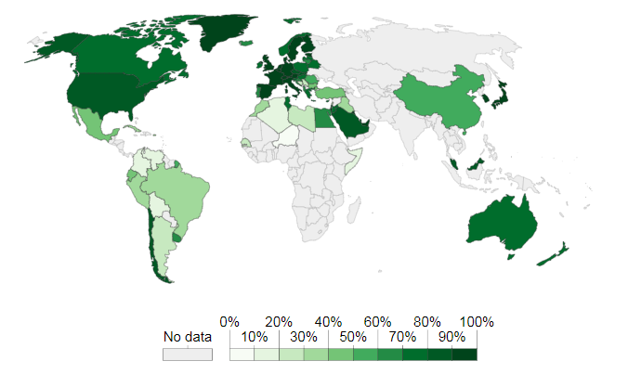
SDG 6.2.1 Safe sanitation and hygiene
SDG INDICATOR 6.1.1
Safe drinking water
Definition: Indicator 6.1.1 is the Proportion of population using safely managed drinking water services.
Proportion of Population using a safely managed sanitation service; that is, excreta safely disposed of in situ or treated off-site.
South Africa 2017: 15.8% of households had substandard toilet facility ie chemical, pit without vent, bucket or ecological sanitation
https://sdg-tracker.org/cities General Household Survey 2017

Slide 7
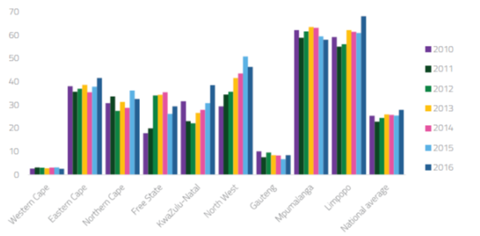
Water systems maintenance
Status of waste water treatment facilities 2014: 26% Critical, 31% High Risk, 26% Moderate, 16% Low Risk (Green Drop report, 2014)
Reliability of supply 20110 - 2016: 50% Limpopo, Mpumalanga households reported interruptions of greater than 2 days
Rapid increases in water outages in North West, gradual increase nationally
Green Drop report
http://www.wrc.org.za/News/Pages/DroughttoolkitdevelopedformunicipalitiesinSouthAfrica.aspx

Slide 8
The cost of transport
Percentage of household income spent on transport
Northern Cape 20%
Mpumalanga 20%
North West 18%
Urban informal households 18%
Urban formal 16%
http://www.statssa.gov.za/publications/P0310/P03102014.pdf

Slide 9
Expenditure on housing, water and energy
Percentage of household expenditure spent on housing, water, electricity, gas and other fuels (2006, 2011, 2015)
Gauteng increased from 24 to 37%
Mpumalanga from 17 to 27%
http://www.statssa.gov.za/publications/P03182/P031822017.pdf

Slide 10
Household expenditure benchmarks
The H+T Index: A neighborhood is considered affordable if a given household would spend less than 45% of its income on housing and transportation costs (Guerra & Kirschen, 2016).
Benchmark of “affordable” housing: Households that spends 30% or less of their pre-tax income on total housing costs. For households that rent, the total housing cost includes the cost of rent and utilities.
Other Necessities: If a household is paying more for housing than the 30% benchmark, the household will not have enough income leftover to afford other necessities (Stone, 2006).
Transport: The benchmark for transport in South Africa is suggested by the White Paper on National Transport Policy (1996) to be less than 10% of the household disposable income.
https://www.pwc.co.uk/issues/megatrends/rapid-urbanisation.html

Slide 11
Performance against benchmark
A neighborhood is considered affordable if a given household would spend less than 45% of its income on housing and transportation costs (Guerra & Kirschen, 2016).
Gauteng 37 + 15.5 = 52.5%,
Western Cape 34% +14.7 = 48.7%
Benchmark of “affordable” housing: household that spends 30% or less of their pre-tax income on total housing costs. For households that rent, the total housing cost includes the cost of rent and utilities. (Stone, 2006).
Gauteng 37%
Western Cape 34%
To ensure public transport is affordable with commuters spending less than 10% of disposable income on transport (Department of Transport 1996)
Northern Cape 20%, Mpumalanga 20%, North West 18%, Urban informal households 18%
https://www.pwc.co.uk/issues/megatrends/rapid-urbanisation.html

Slide 12
Comprehensive performance indicators for human settlement including affordability
Sufficient: The water supply for each person must be sufficient and continuously available for domestic use including drinking, washing and food preparation. The World Health Organisations indicates that between 50 and 100 litre per day per person are needed.
Safe: Water required for domestic use must be safe and free from micro-organisms and chemical substances that may constitute a threat to a person’s health. Standards for drinking water quality are defined by World Health Organisation (WHO)
Acceptable: The colour, odour and taste of water should be acceptable. Water facilities should also be culturally appropriate and sensitive to gender, and privacy requirements
Physically accessible: Water must be physically accessible within or near the household, education institution, work place or health institution. The WHO indicates that water should be available within 1000m of a households and collection time should not exceed 30 minutes.
Affordable: Water should be affordable and the UNDP indicate that costs of the water should not exceed 3% of household income.
United Nations, 2010, UN- Water Decade Programme on Advocacy and Communication retrieved from http://www.un.org/waterforlifedecade/human_right_to_water.shtml

Slide 13
Conclusions & Recommendations
The percentage of household expenditure spent on housing, water, electricity, gas and other fuels has rapidly increased.
Costs now breach international and local benchmarks for affordability.
Where this occurs household may not have sufficient income leftover to afford other necessities, materially affecting other aspects of life such as food, education and health (Stone, 2006).
There is a need for further research to understand relationship between human settlements and household affordability.
Household affordability should be included in human settlement performance indicators and standards.
Modelling of household costs should be carried out as an input into proposed human settlement developments.
Technological, design, organisational and management innovations may be required to achieve affordability benchmarks.

Slide 14
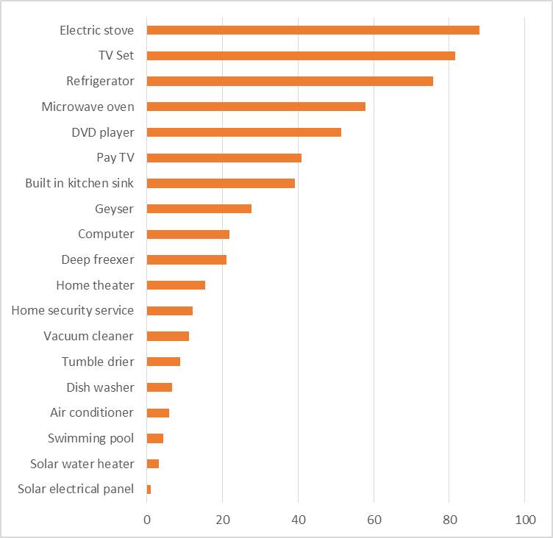
Technology ownership
Over 80% of households had electric stoves and TVs
40% have pay TV
Less than 3% had solar water heaters or PV systems
Internet access at home in South Africa is low (about 10%), however, most households (60%) have at least one member that has access to the internet.
http://www.statssa.gov.za/publications/P03182/P031822017.pdf

Slide 15
The cost of transport
Human settlements and housing are a part of people’s material living conditions and contribute directly to their life choices.
Human settlements that are poorly located, constructed and serviced force households to spend a larger proportion of their income on transport, energy and water and energy.
This leaves less for food, education and health and seeking employment or starting a business.
In poor families this limits access to education opportunities, increases susceptibility to ill health and disease and makes it more difficult to escape the cycle of poverty.
If a household is paying more for housing than the 30% benchmark, the household will not have enough income leftover to afford other necessities (Stone, 2006).
http://www.statssa.gov.za/publications/P0310/P03102014.pdf

Slide 16
Shared prosperity indicator
Between 2006 and 2011, bottom 40% registered growth in consumption (3.5%)
Between 2011 and 2015 bottom 40% registered reduction in consumption growth (-1.4% )
“Does not compare well with world median of 3.9%”
Growth is not inclusive
http://documents.worldbank.org/curated/en/530481521735906534/pdf/124521-REV-OUO-South-Africa-Poverty-and-Inequality-Assessment-Report-2018-FINAL-WEB.pdf

Slide 17
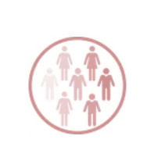
Social and demographic change
By 2030 the world’s population is projected to rise by more than 1 billion, bringing the total to over eight billion.
97% of this population growth will come from emerging or developing countries.
Africa’s population – the fastest growing – is set to double by 2050
Rapid increase in ageing populations
Need to develop responsive human settlement planning, design and operation
https://www.pwc.co.uk/issues/megatrends/rapid-urbanisation.html

Slide 18
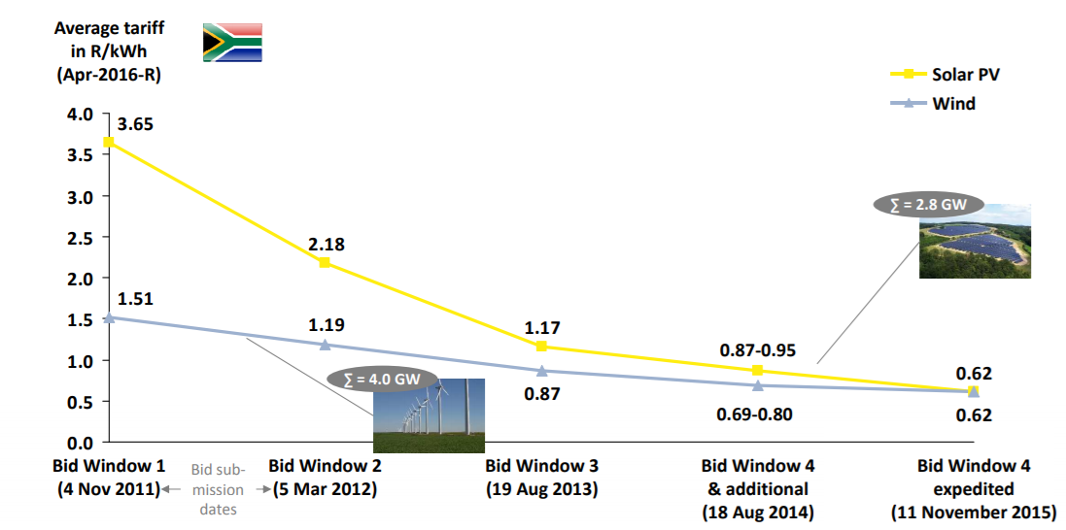
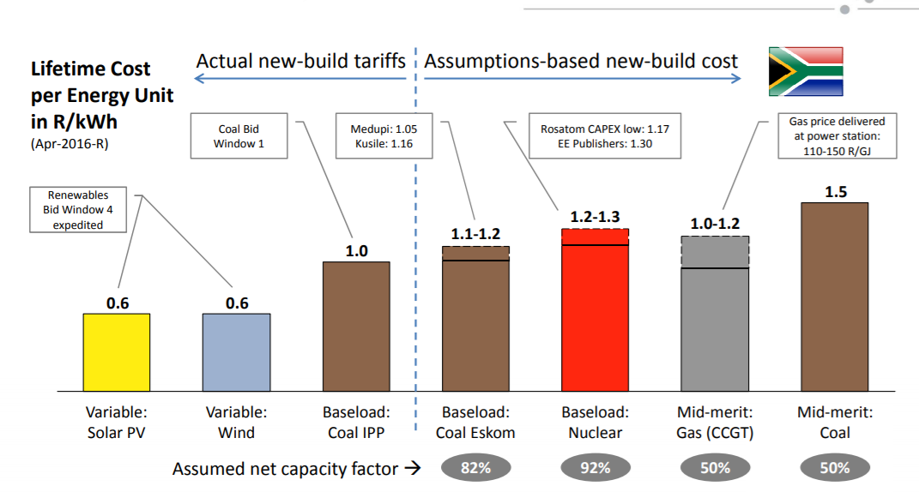
Rapid drop in the cost of renewable energy
2011
Solar PV R3.65/kWh,
Wind R1.51/kWh
2015
Solar PV R0.62/kWh,
Wind R0.62/kWh
Potential for micro grid generation and feed-in tariffs
CSIR

Slide 19
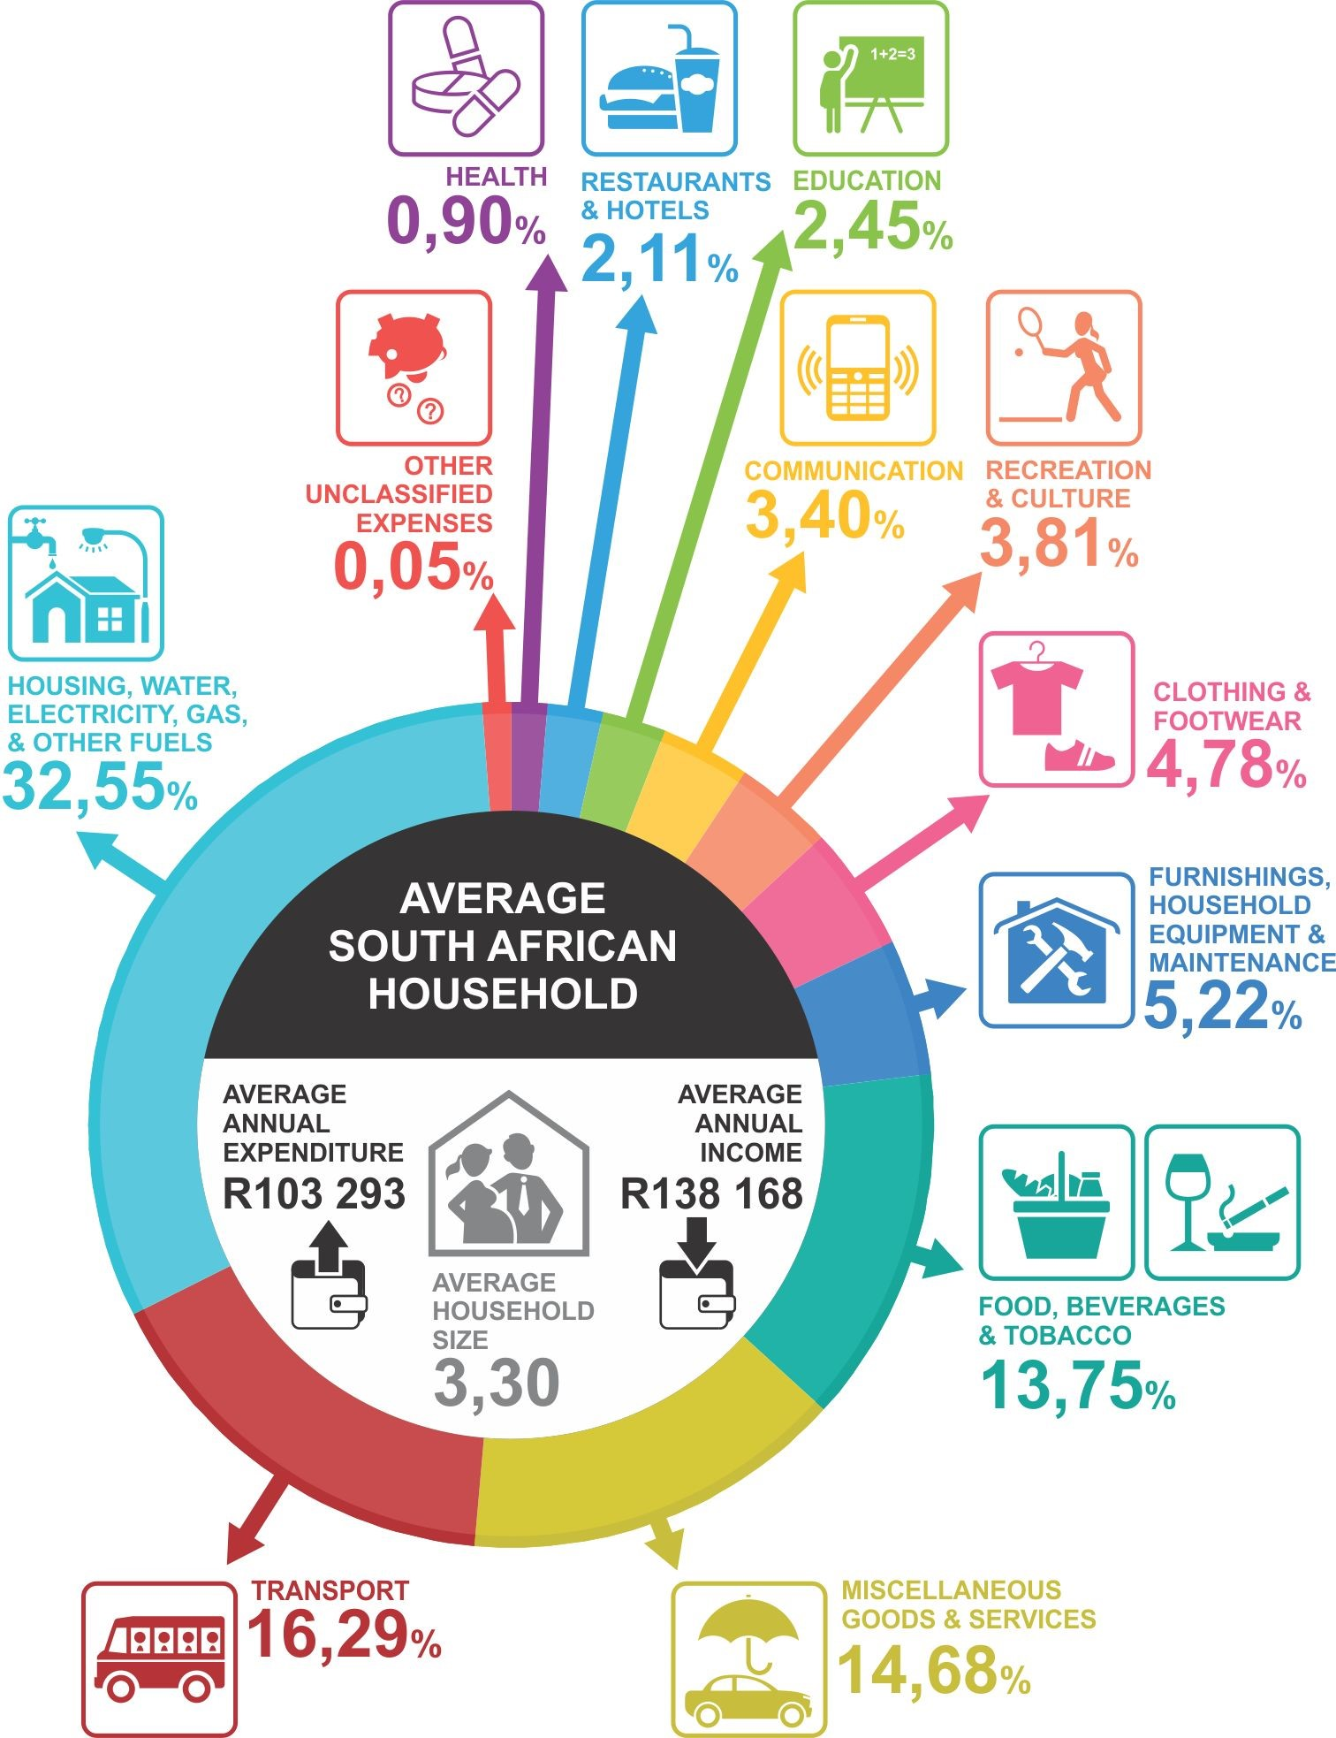
https://www.brandsouthafrica.com/south-africa-fast-facts/south-africans-spend-income

Slide 20
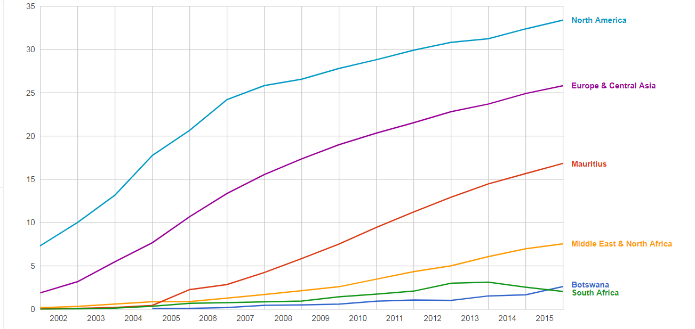
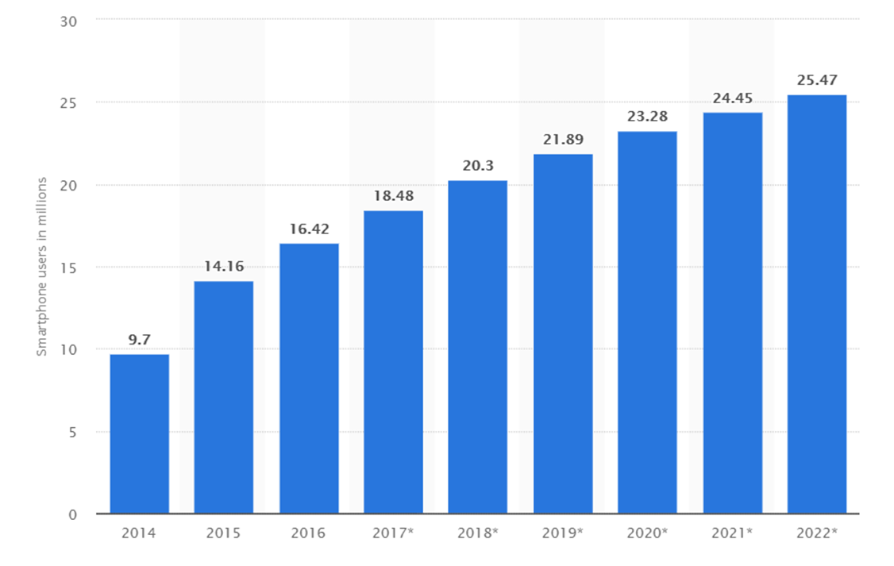
Fixed broadband subscribers and smartphones
Rapid uptake in broadband subscriptions in N America and Europe
Similar uptake in Mauritius
Increasing uptake in Botswana
South African uptake increases to 2013 and then reduces
Ongoing increase in smartphone users
World Bank
https://www.statista.com/statistics/488376/forecast-of-smartphone-users-in-south-africa/

Slide 21
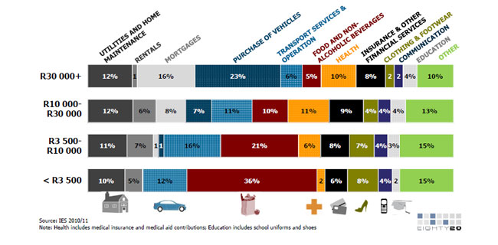
https://www.moneyweb.co.za/archive/how-south-africans-spend-their-money/
Notes:
To sum up some of the key points made in this report, the following diagram suggests a framework that views the application of innovative technologies and processes in the human settlement sector as a market system, sometimes also referred to as an ecosystem. As outlined above, there are policies, programmes and institutions that tend to create demand for innovation, and those that stimulate the supply of innovative technologies. As in conventional economics, when there is sufficient supply of a product to meet demand, a situation of equilibrium is said to exist (i.e. sufficient numbers of viable technology solutions are available on the market and buyers are able and willing to pay for these).
If, for example, new technologies that are being introduced into the market are too costly for what people can afford, or for what the state wishes to support through its programmes, then there will not be sufficient demand for the product. If contextual factors change, for example the cost of electricity rises, then the demand for a product may alter, as when solar water heaters and solar power generation became more viable (along with a range of other enabling factors such as subsidies, the lower costs of PV cells, etc.). New technologies tend to become mainstreamed when these factors come into balance, and the prior investment in innovation has been sufficient to have the technologies ready to go to market.
The following framework is based on the “making markets work for the poor” methodology (Springfield Centre, 2008).
While the actors or ‘players’ described in this diagram do not always neatly fit on the supply side or the demand side (some having dual roles to play), it is at least useful to broadly indicate their current predominant roles in stimulating the supply or demand for innovative technologies.

Slide 22
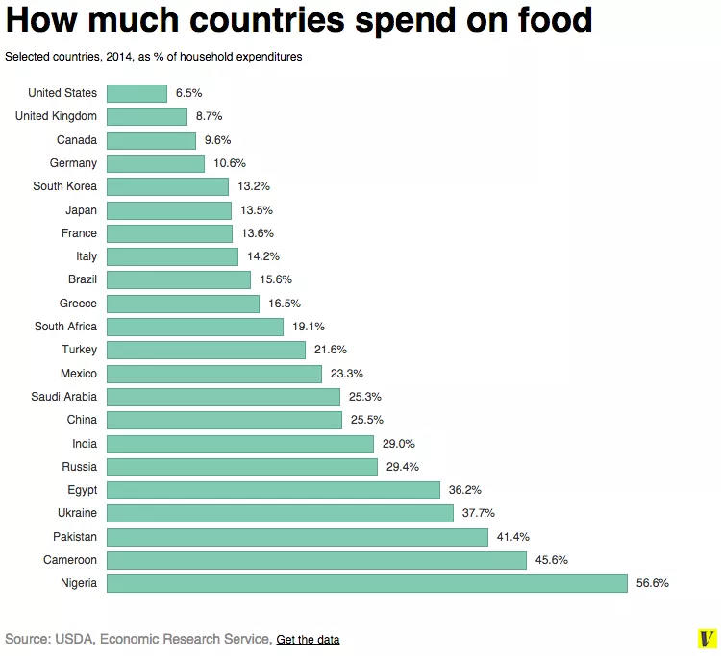

Slide 23
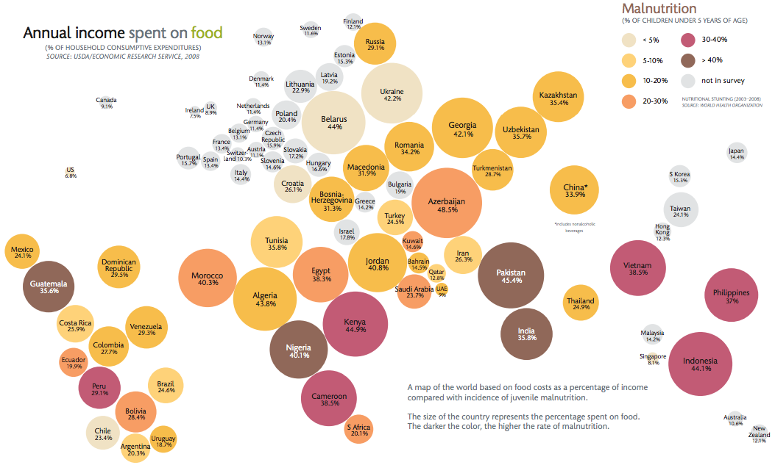
https://www.vox.com/2014/7/6/5874499/map-heres-how-much-every-country-spends-on-food

Slide 24
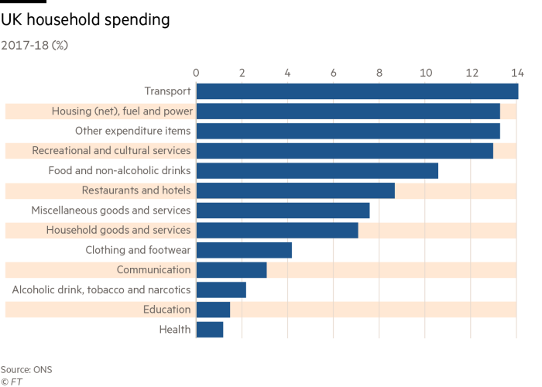

Slide 25
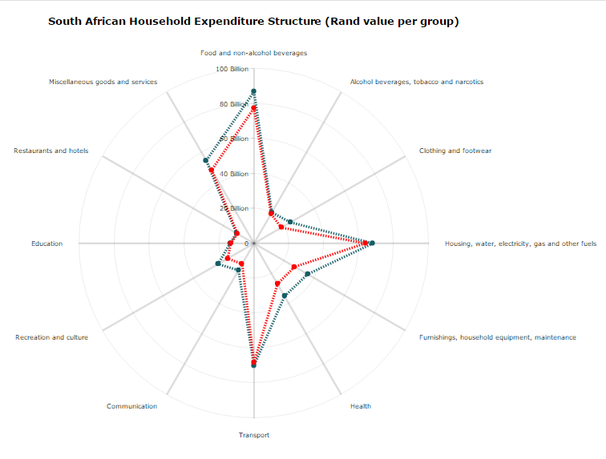
https://za.investing.com/analysis/blog:-south-african-household-spending-patterns-200169037

Slide 26
World bank

Slide 27
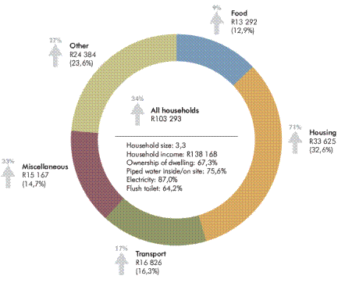
Figure 1 Average annual household consumption
expenditure in 2015 and change from 2006 by broad expenditure categories (STATS
SA (Statistics South Africa), 2017)

Slide 28
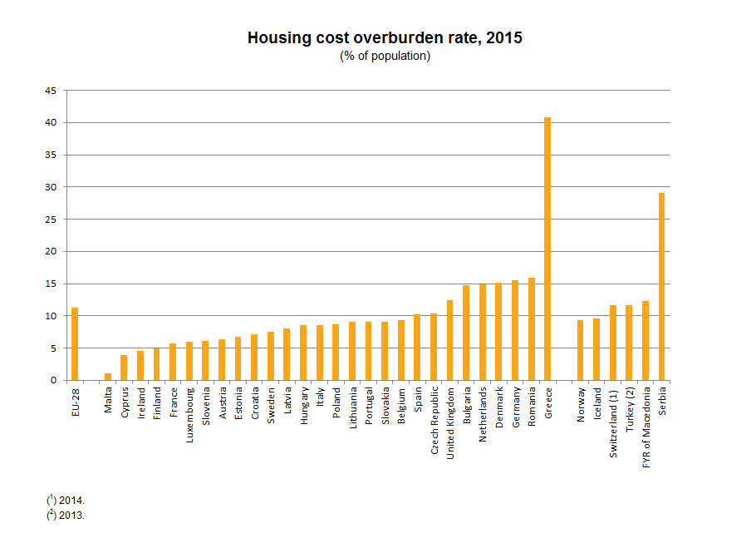
https://ec.europa.eu/eurostat/web/products-eurostat-news/-/DDN-20170309-1?inheritRedirect=true
https://www.saldru.uct.ac.za/income-comparison-tool/

