Slide 1
THE ROLE OF SMALL-SCALE SQUID FISHERS IN SUSTAINING LIVELIHOODS AND MAINTAINING MARINE RESOURCES IN THE CONTEXT OF CLIMATE CHANGE
Oyamangaye Mkaza and Dr Bernadette Snow
May 6, 2019

Slide 2
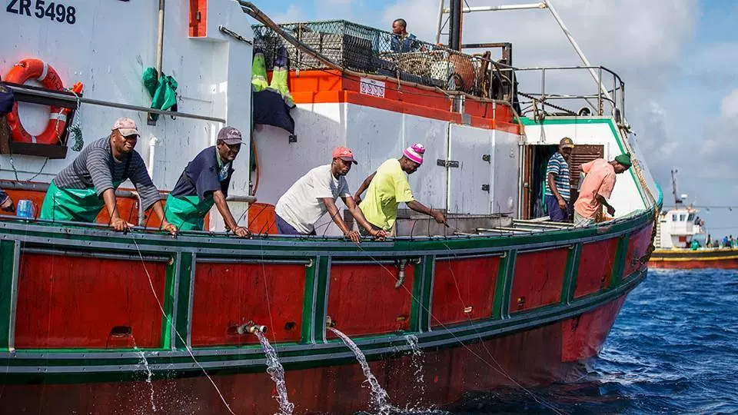
FOCUS OF THE STUDY
Small-scale squid fishers
Source:http://www.jbaynews.com/photo-of-the-day-chokka-fishermen-at-sea/

Slide 3
RATIONALE
Collapse of the small-scale squid fisheries in 2013 - 2014 in South Africa.
Fishing and its relation to climate-driven water dynamics are important for sustainability and livelihoods but, generally, are poorly understood and undervalued.
Requires a detailed knowledge of the living components of natural and managed systems because, as global climate changes, it affects the well-being of humans and the functions of ecosystems.
Notes:
The study was motivated by, and developed from, the collapse of the small-scale squid fisheries in 2013 - 2014 in South Africa that left thousands of small-scale fishers in the Eastern Cape in dire socio-economic circumstances.
In Africa, fishing and its relation to climate-driven water dynamics are important for sustainability and livelihoods but, generally, are poorly understood and undervalued, which might have a negative effect on people’s livelihoods.
Hence, the sustainability of human existence on earth requires a detailed knowledge of the living components of natural and managed systems because, as global climate changes, it affects the well-being of humans and the functions of ecosystems.

Slide 4
PRIMARY RESEARCH QUESTION & OBJECTIVE
Question
How do small-scale fishers become resilient in the face of climate change, shocks and risks in squid fisheries and build towards sustainable livelihoods and food security?
Objective
To analyse and assess the resilience of small-scale fishers to shocks such as climate change and variability in squid fisheries in order to achieve sustainable livelihoods, development and food security.

Slide 5
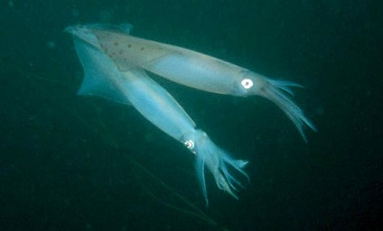
BACKGROUND AND CONTEXT
The South African chokka stock is harvested in the Eastern Cape Province
Between the 1960s to 1970s squid was caught by foreign vessels.
This phased out between the late 1970’s and early 1980’s and chokka was then continued to be harvested by South African fishers as a bycatch (between 200 and 600 tons)
Reference: Glazer & Butterworth, 2006; Roel et al, 1998; Sauer et al, 2003
https://www.sanbi.org/animal-of-the-week/cape-hope-squid/

Slide 6
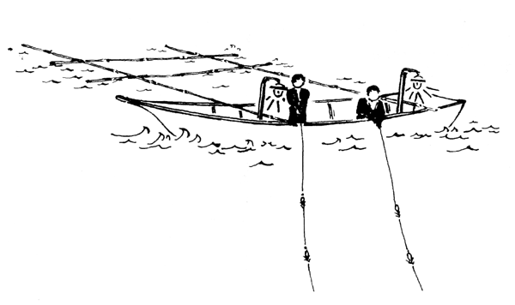
BACKGROUND AND CONTEXT
A formal jig fishery was then established in 1984.
The fishing method exploits squid on the spawning grounds.
This is an intensive form of fishing and raised concerns.
Licensing system was introduced in 1986 to help with managing the fish stock.
The management strategy further provided closed periods for fishing – seasonal fishery
http://www.fao.org/3/t0511e/T0511E76.gif
Reference: Sauer et al, 1992; Zansti, 2013

Slide 7
BACKGROUND AND CONTEXT
Before 1994 South Africa had no formal and clearly defining fishery policy
Each fishery sector had to develop strategies in order to combat the fluctuations in fish stock and size to meet their needs.
The sector employs more than 2500 fishermen and over 1000 land-based workers and other personnel.
The squid fishery is worth around R400 million a year and if the families of fishers or people directly involved in the fishery are included, the estimate of people directly dependent on squid fishery is around 25 000 people making the fishery a significant economic sector in the Eastern Cape Province.
Reference: Penxa, 1999; Augustyn et al, 1994; Cochrane et al, 2014

Slide 8
BACKGROUND AND CONTEXT
In 1998 the first assessment was done in this fishery, in trawl and jig catches and results showed that there was a 90% high risk of the squid resource collapsing and a 33% reduction of total allowable effort was suggested, however, only 10% reduction was implemented due to social implications and pressure from the industry.
However, the very first concern was in 2012 when squid catch was down to 50% - 60% from 2011 and this squid catch were similar for 2013.
The South African chokka fishery collapsed and a crisis response was a voluntarily closed season in 2014 to allow the stock to rebuild.
This affected the socio-economic stability of the region, it left more than 2000 fishers without a source of income.
Notes:
Squid fisheries are difficult to manage because they can change tremendously without warning and the instability of squid has been linked to natural variations and fishing pressures

Slide 9
RESEARCH METHOD
Qualitative research method was used in gathering preliminary data because the purpose of the research was to discover the views of fishers in squid fisheries and the meanings they attached to aspects of their lives.
This research approach gave fishers the opportunity to explain their views and provided a depth of understanding of their social phenomena.
Knowledge in this study is believed to be socially and historically constructed by fishers.

Slide 10
RESEARCH METHOD
Preliminary data presented is on a case study done on small-scale squid fishers in the Port Elizabeth area located in Zwide township.
15 preliminary interviews were conducted and used as a primary tool to collect data and these interviews were audio recorded.
Interview recordings were first transcribed in the original language in which the interview was conducted and later translated into English for interpretation and data coding.

Slide 11
RESEARCH METHOD
Emerging themes from the transcriptions through a process of concepts being identified were formulated.
The themes were analysed in response to understanding squid fishers livelihoods in the context of possible climate change impacts.

Slide 12
PRELIMINARY RESULTS
A total of 15 fishers were interviewed as part of the study. The results presented will reflect a basic preliminary narrative analysis with full analysis to be undertaken for the broader study. A total of six general themes are used to identify responses relevant to the study.

Slide 13
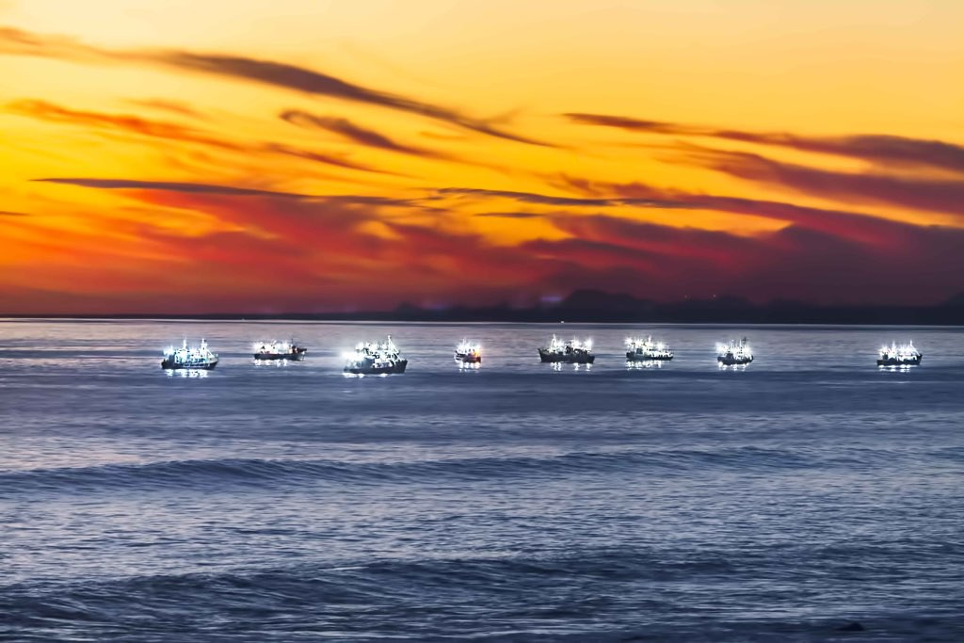
PRELIMINARY RESULTS
Theme 1: Squid fisher’s
  All participating fisher’s were male and 73% residing and originating from PE, with 13% respectively from other parts of the Eastern Cape and Namibia but now residing in PE.
  Ages between 35 and 67 with bias towards 50 and older, 33% relied on squid fishery as a source of income.
  None went to university and none finished high school.
  Fisher’s supported an average of 5.6 family members (1 min; 11 max & 5 median).
https://live.staticflickr.com/338/19473837184_ff1101b400_b.jpg

Slide 14
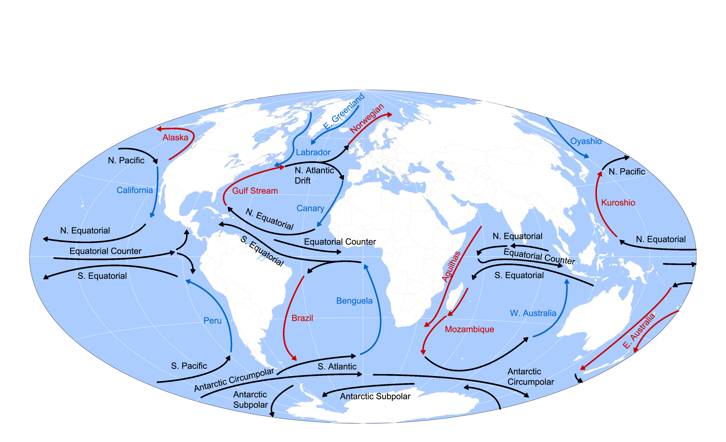
PRELIMINARY RESULTS
Theme 2: Climate change
  In the past 10 years fisher’s shared that they noticed certain winds that they were not used to at sea, normally they would be at sea for 21 days but when these big winds came they would stay at sea for 7 days.
  They also mentioned that the production of the squid is no longer the same like before because of the changing weather conditions.
  Fishers also understand that these changes in weather are natural but now have become consistent making the squid scarce and that it was better in the 80s, now the weather changes all the time.
http://www.ecn.ac.uk/what-we-do/education/tutorials-weather-climate/climate/oceancurrents.png

Slide 15
PRELIMINARY RESULTS
Theme 3: Squid collapse
  Fisher’s further explained that before 2013 things were a bit better, they could catch the squid but now catch size has decreased and they can be at sea but if the water is not “neutral” they will not be able to catch the fish.
  Some views were contrasting one fisher shared that in the early 2000 he noticed the squid becoming less at sea, yet another fisher mentioned that back in 2003, there was a lot of squid at sea to the extent some fisher’s become boat owners and stopped fishing, others made so much money and started their own business.
  Due to the squid collapse, squid can no longer be fished for the whole year not even trawlers can trawl squid as a bycatch as they use to.

Slide 16
PRELIMINARY RESULTS
Theme 4: Resilience
  The period of 2013-2014 was a difficult time for fishers, because they depend on the sea for their livelihoods and income.
  Due to the squid collapse fishers had to now depend on their wives for financial support and borrow money from loan sharks in order to survive.
  SASSA grant played a crucial role during this period by giving fishers groceries

Slide 17
PRELIMINARY RESULTS
Theme 5: Sustaining livelihoods
  Fisher’s shared that they teach each other to never throw things such as tins, bottles, fishing lines into the ocean during a fishing trip.
  They have learned to collect all those things and put them in a plastic bag when on the boat and throw into the drums when they on land.
  Fisher’s have become aware and understand that by throwing foreign object inside the ocean disturbs the natural life of the fish.
  However, fishers have noticed the increased use in anchors and their concern is that the anchors destroys the eggs of the squid, by observing how the eggs get pulled up with the anchors.

Slide 18
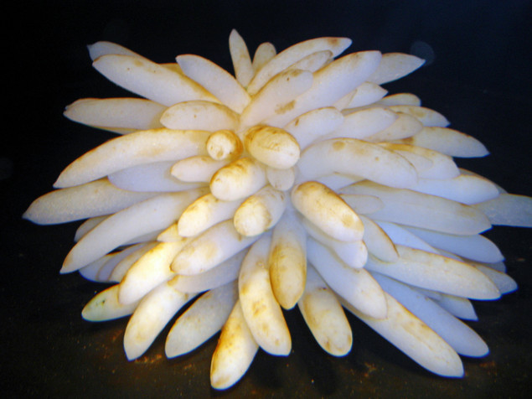
PRELIMINARY RESULTS
Theme 6: Future of the squid industry
  Squid fisher’s expressed that the future of the squid resource and industry looks bleak and there will come a time were there is no more squid because of the way it is treated.
  They believe some form of change is needed and it is up to the industry workers to protect the eggs of the squid in order for them to mature and produce more squid.
  Fisher’s also shared their views regarding the Small-Scale Fishing Policy and the majority of fisher's said they are very happy because the think they can benefit from it as fishers and “be able to eat”.
  Other fishers shared that they believe the policy is meant to better their lives, help them to be able to support their families and be acknowledge as workers in South Africa.

Slide 19

CONCLUSION
The preliminary results are to be fully analysed with the rest of data to be collected. However, the value of fishers knowledge becomes important when listening to their views on the climate, fishing practice and impacts on their livelihoods.
All interviewed fishers noticed the change of the squid stock and worry about the increased use of anchors and expressed that it hurts nature.
It is apparent that fishers are vulnerable to changes and shock in the industry as 14 of the 15 do not have an alternative skill and depend on government social grants, loaning from family and loan sharks.
Fishers highlighted the need to protect the squid that provides them with an income and sustaining their livelihoods.
Further interviews and in-depth analysis will reveal more fishers knowledge, important for managing fish stock.
[ Source ]

Slide 20

Thank you!
Any questions?
mandela.ac.za
GCRF project SOLSTICE-WIO (NERC grant NE/P021050/1)

