Slide 1
MULTI-PURPOSE COMMUNITY CENTRES AS A STIMULI FOR SUSTAINABLE DEVELOPMENT
SUPERVISORS: PROF S. MBANGA & PROF B. BOTHA
STUDENT NO: 201359014 (PHD IN CONSTRUCTION MANAGEMENT)
STUDENT NAMES: CYNTHIA BONGIWE NTOMBIKAYISE GOBE

Slide 2
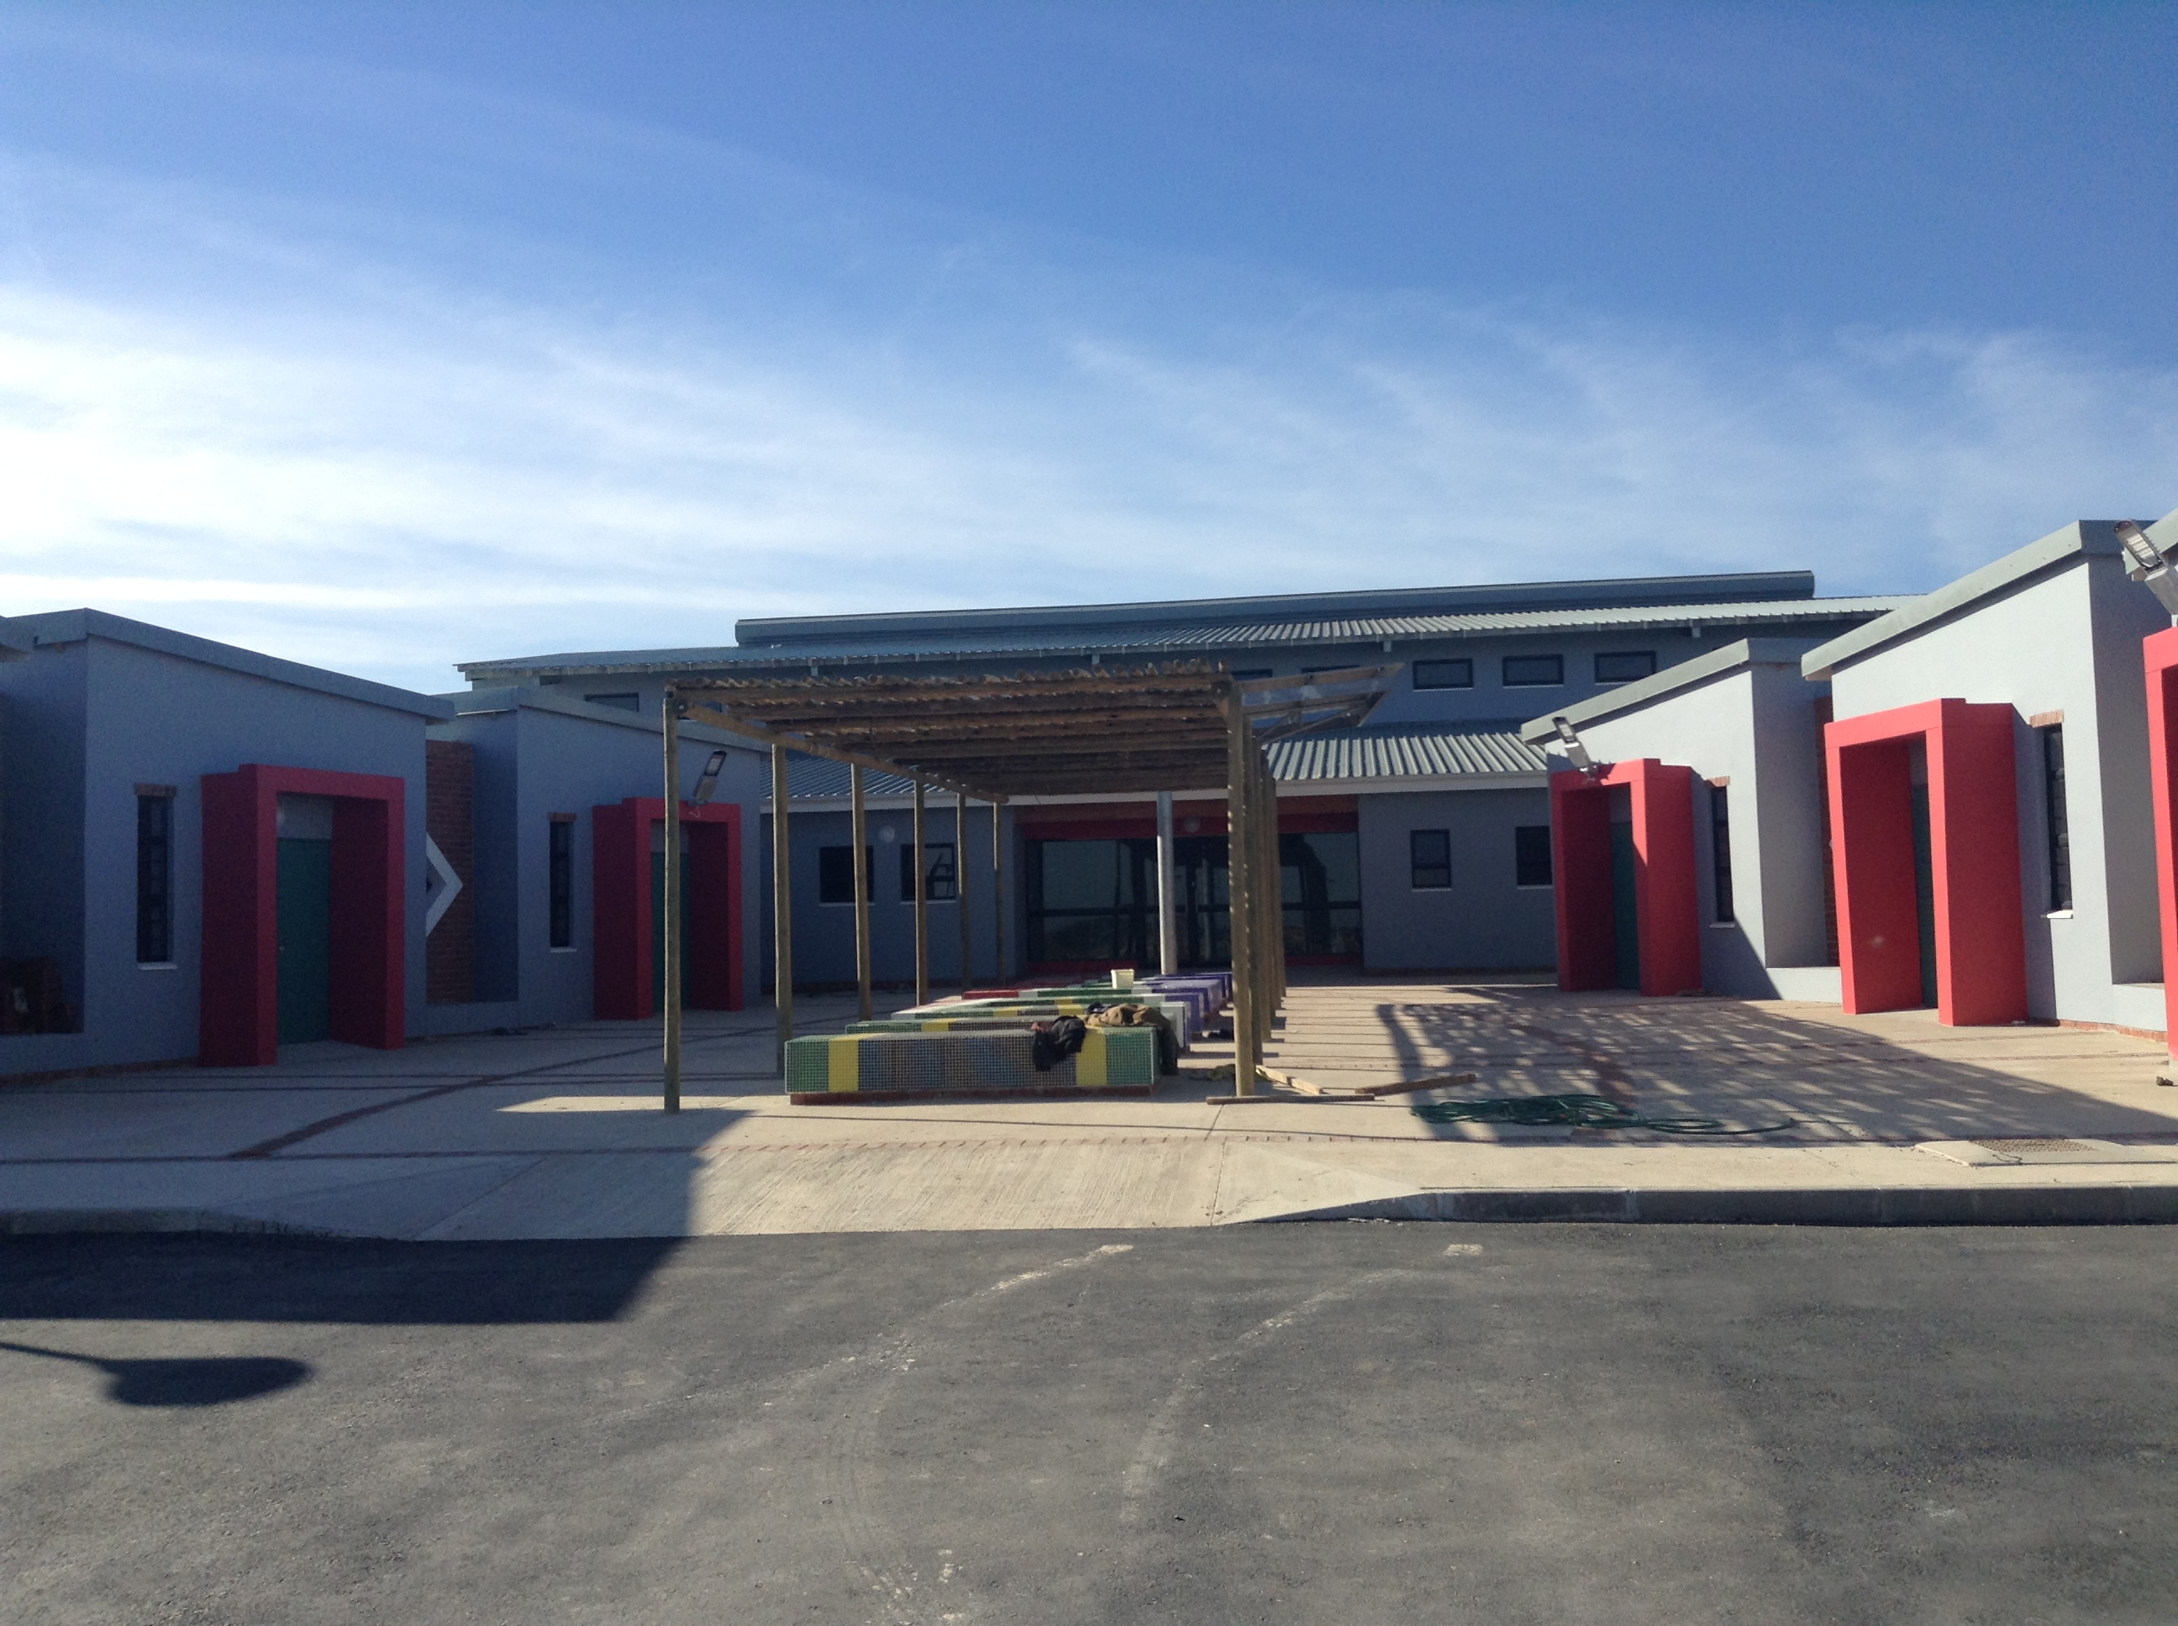
SOME MPCC’S CONSTRUCTED BY ECDoHS
ZANDISWA KILWA MPCC-CHRIS HANI

Slide 3
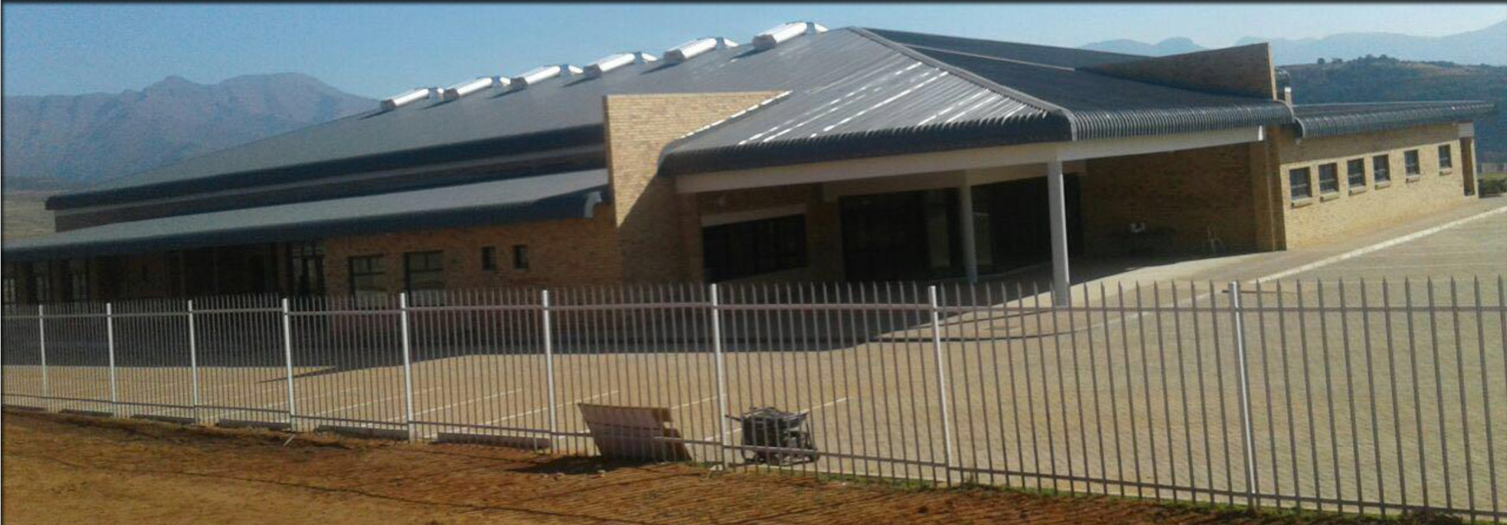
THABACHICHA MPCC-ALFRED NZO

Slide 4
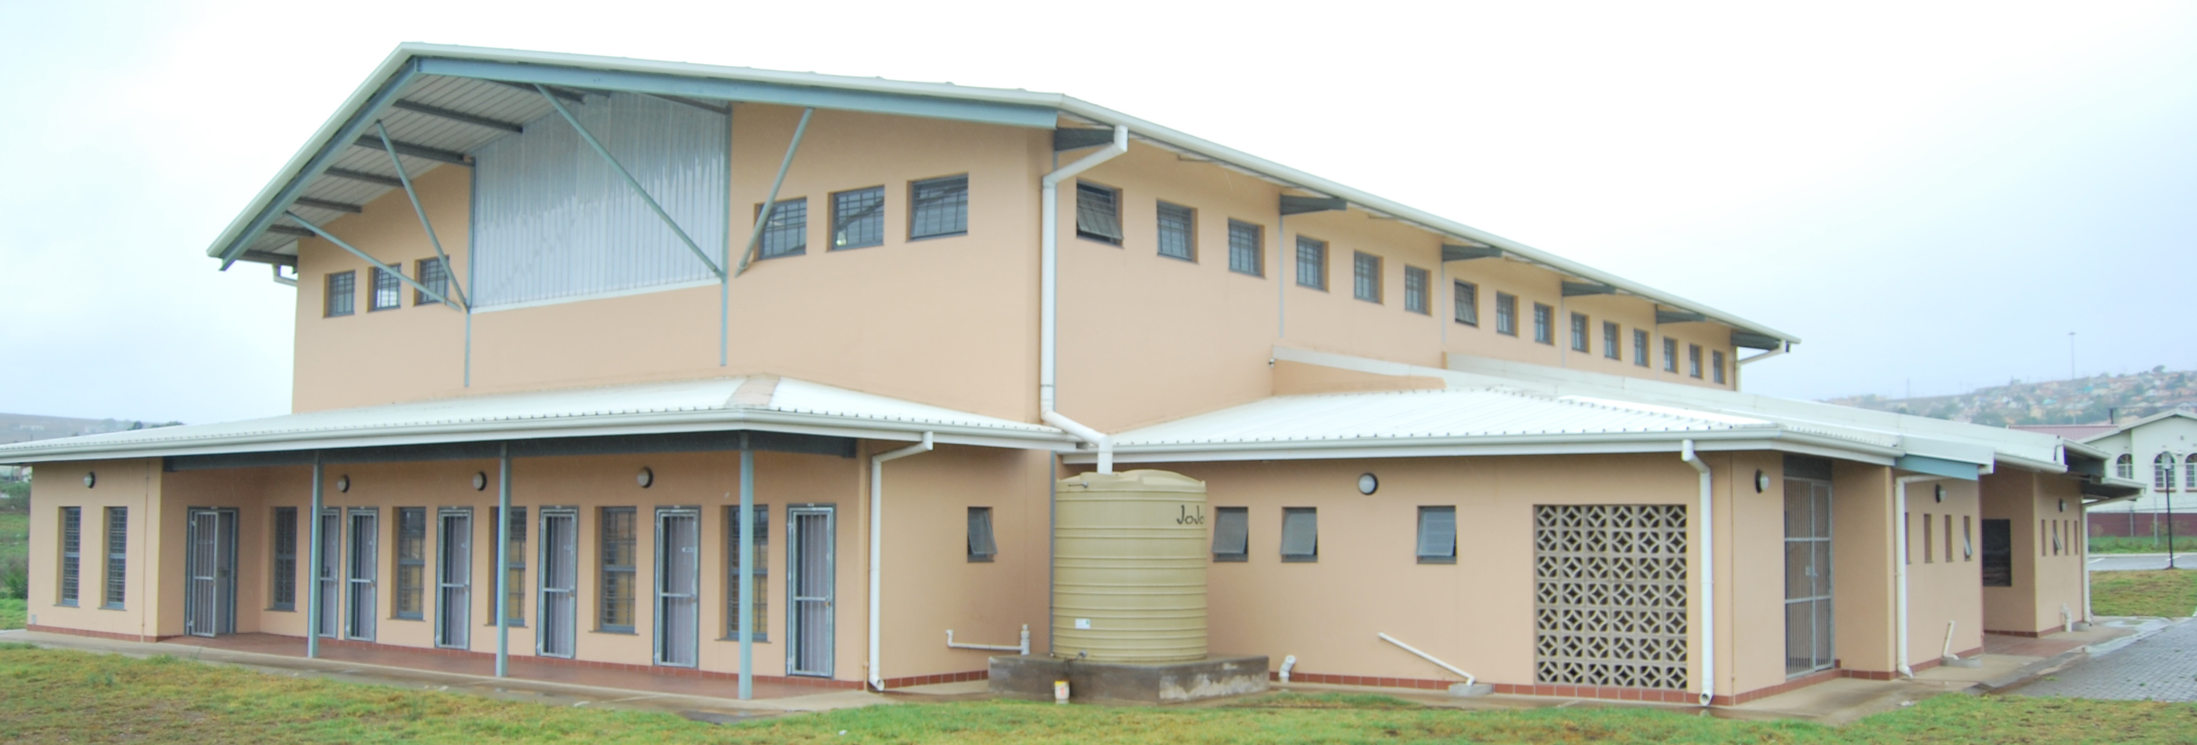
NGANGELIZWE MPCC-OR TAMBO

Slide 5
PRESENTATION LAYOUT
THE PURPOSE
THE PROBLEM
METHODOLOGY
4. LITERATURE STUDY
MPCC’s & SUSTAINABLE HUMAN SETTLEMENTS
INFRASTRUCTURE & SUSTAINABLE DEVELOPMENT
MPCC’s & BENEFITS
CHALLENGES
5. RECOMMENDATIONS
6. CONCLUSION

Slide 6
PURPOSE OF THE PAPER
The purpose of the paper is to theoretically analyse Multi-Purpose Community Centres as a stimuli for sustainable development
To suggest an inclusive human settlements strategy for the creation of well functioning MPCC’S within the already existing ,new housing projects and informal settlements

Slide 7
THE PROBLEMBSUB-COMPONENTS OF THE PROBLEM STATEMENT
SUB-COMPONENTS OF THE PROBLEM STATEMENT
ACKGROU
There is a growing concern that MPCC’s are not meeting their expected outcome of bringing sustainable development, integration and improved quality of life to communities where they are constructed
Some MPCC’s are complete, beautiful, but not functional
There is no clear plan for management and maintenance
MPCC’s are not fully utilised as public investments for improving quality of lives of residents in some of our Human Settlements spaces

Slide 8
METHODOLOGY
Relevant literature which supports the topic from local and international spheres were reviewed as part of secondary data.
The paper is an outcome of a critical review of literature on MPCC’s as a stimuli for sustainable development.
The following literature was studied and reviewed;
Books, articles, journals, policies, plans and programmes.

Slide 9
LITERATURE STUDY: MPCC’s A Global Context
The concept of MPCC’s is not new in global arena
Developed world countries are early adopters o
In different countries MPCC’s are known by different names but all having the same basic functions (Telecentres, Telecotages, Digital Clubhouses, Electronic Village Halls, Community Technology Centres and many more)
The success of the project depended on international donors like IDRC

Slide 10
MPCC’s :A South African Context
Socio-Economic Problems Persist
High Poverty and Unemployment
Low standards of living
Poor access to basic services
Remote settlement patterns
Lack of access to technology, health, education etc
Lack of infrastructure
Service delivery challenges

Slide 11
LEGISLATIVE MANDATE OF MPCC’s or TC’s
COMTASK Report
Act on Transformation of Public Service Delivery of 1997 -Batho-Pele
The Constitution of RSA, Act 108 of 1996
Integrated Sustainable Rural Development Strategy
South African Housing Policies

Slide 12
Housing Code, 2009
RRCH BACKGROUND
Government objective is to undertake housing development, which Section 1 of the Housing Act, No 107 of 1997 defines as being “the establishment and maintenance of habitable, stable and sustainable public and private residential environments to ensure viable households and communities in areas allowing convenient access to economic opportunities, health, educational and social amenities…”.

Slide 13
MPCC’S AND SUSTAINABLE HUMAN SETTLEMENTS
RRCH BACKGROUND
Section 3(4) (g) of the Housing Act 107 of 1997 enacted in terms of the Constitution of the Republic of South Africa, Act 108 of 1996 introduced a National Programme called the Provision of Social and Economic Facilities
The aim of the programme is to achieve sustainable human settlements by ensuring that communities have access to social and economic amenities such as medical care facility, community halls, community parks, playgrounds, taxi ranks, sport facilities, small businesses and basic ablution facilities

Slide 14
MPCC’S AND SUSTAINABLE HUMAN SETTLEMENTS
RESEARCH BACKGROUND
The Housing Code defines social and economic facilities as facilities that provide basic amenities to communities which cannot be supplied directly to the individual unit but are supplied in a collective manner within the community.
The Housing Code mentions that the above facilities are to be provided in a multi purpose cluster arrangement
This whole idea brought about the establishment of MPCC’s within the already existing housing areas, new housing areas and informal settlements meant to complete the mandate of providing sustainable human settlements to communities

Slide 15
MPCC’s OBJECTIVES
RESEARCH BACKGROUND
The Housing Code (2009) mention the following objectives of MPCC’s within housing areas and informal settlements;
Facilitate the provision of social services through the development of social and community facilities
Facilitate the development of basic economic infrastructure
Facilitate job creation through Expanded Public Works Programme
Encourage the development of social capital by supporting the active participation of communities in the design, implementation, management and evaluation of projects

Slide 16
INFRASTRUCTURE AND SUSTAINABLE DEVELOPMENT
RESEARCH BACKGROUND
Availability of infrastructure is globally accepted as significant in achieving socio-economic growth
Research shows that there is a relationship between infrastructure and improved quality of life
Connection between infrastructure & development
Khan & Bakar- provision of sound infrastructure facility leads to regional productivity growth and absence of it affects modern commerce and exchange across markets
They identify 2 categories of infrastructure- Economic (transport, communication ,energy) & Social (social services,housing, education ) (Int Journal of Ec Pers, 2017)

Slide 17
INFRASTRUCTURE AND SUSTAINABLE DEVELOPMENT
RESEARCH BACKGROUND
MPCC’s are a feature in bringing sustainable development in the communities
Swanepoel and De Beer (2012) defines sustainability as a development that meets the needs of the present without compromising the ability of future generations to meet their own needs.
They argue that the goal of development should be to eradicate poverty, not deal with some of its manifestations
Development is not supposed to bring about some relief to poor people, but instead it should break the shackles of poverty and free citizens from such bondage

Slide 18
INFRASTRUCTURE AND SUSTAINABLE DEVELOPMENT
RESEARCH BACKGROUND
Venter and Landsberg (2007)state that sustainability simply implies that, once the services to satisfy the needs of the people have commenced, they should not be abandoned
They argue that a service will be sustainable when it is affordable and addresses real needs of the people.
They differentiate between financial and environmental sustainability in relation to services rendered.
Financial sustainability- financing of that service is sufficient to cover all costs &
Environmental sustainability- risk of harm minimised and benefits maximised

Slide 19
INFRASTRUCTURE AND SUSTAINABLE DEVELOPMENT
RESEARCH BACKGROUND
Filani (2000) defines development as a process of sustained increase in total and per capita incomes accompanied by structural transformation and modernization of socio-economic environment.
Spacey defines infrastructure development as the construction and improvement of foundational services with the goal of sparking economic growth and improvements in quality of life (Article: What is Infrastructure, January12, 2018).

Slide 20
INFRASTRUCTURE AND SUSTAINABLE DEVELOPMENT
RESEARCH BACKGROUND
Snieska and Simkunaite confirm that, “availability of infrastructure services significantly influences development of regions and countries” (Inbternational Journal of Economic Perspective,2017).
For them level and quality of infrastructure play an important role to both households and firms, as it may influence investment, migration, business productivity and growth.
Mbanga also sees infrastructure as, “a programme for eradicating poverty, reducing income inequality and enabling employment creation”. According to him, “this approach to infrastructure prioritises the understanding of social, economic and human development linkages in infrastructure delivery”(Service Delivery Review Journal, 2006)

Slide 21
INFRASTRUCTURE AND SUSTAINABLE DEVELOPMENT
RESEARCH BACKGROUND
Ayesha declares that good quality infrastructure is important not only for increased economic growth, but also to achieve inclusive growth where the majority of the people benefit from growth leading to alleviation of poverty and reduction of income inequality.
She believes that the expansion of infrastructure facilities will ensure sustained growth and help prevent the influx of the rural people to urban areas where they experience challenges of urban congestion, growth of slums and serious housing shortage (Article on Infrastructure)

Slide 22
INFRASTRUCTURE AND SUSTAINABLE DEVELOPMENT
RESEARCH BACKGROUND
Local Government Association of South Australia (LGASA,2012) mention three broad categories of social infrastructure as follows;
Community facilities; the hard infrastructure component that includes buildings and grounds used for community purposes
Community development; the processes that assist community members to identify and address their needs
Human services; the formal services that provide support, advise, education and information to the community.

Slide 23
INFRASTRUCTURE AND SUSTAINABLE DEVELOPMENT
RESEARCH BACKGROUND
Community participation is key the sustainability of an infrastructural project
Filani (2000) views community development as “a process of social action in which people of the community organise themselves for the identification of their needs, planning and taking action to meet those needs with maximum reliance on their own initiative and resources, supplemented with assistance from government and non-governmental organizations”.

Slide 24
MPCC’s ROLE RESEARCH BACKGROUND
Respond to the local needs and interest of the local population.
Contribute to the health, well-being and quality of life of the members of the community through a range of services, activities and programs that support the lifestyle needs, foster social networks, social cohesion and social inclusion and build the skills and capacity of the local people.
Assist with integration and building connections between new and existing communities by sharing facilities and spaces (LGASA, February 2012).

Slide 25
MPCC’s & BENEFITS RESEARCH BACKGROUND
The whole country growing economically through increased involvement and participation by communities in economic activities;
Government partnering with other stakeholders in cost sharing initiatives in the development of infrastructure nationwide;
Communication channel between communities and relevant stakeholders and the Government;

Slide 26
MPCC’s CHALLENGESRESEARCH BACKGROUND
Sustainability
Funding
Lack of suitable land for development
Lack of integrated approach to service delivery
Lack integrated planning
Lack of community participation and involvement

Slide 27
RECOMMENDATIONSRESEARCH BACKGROUND
Inclusive human settlements strategy to relook into the provision of MPCC’s in the existing and new housing areas and informal settlements
A new approach to the roll out of MPCC’s programme
Policy shift may be required to guide the provision of MPCC’s in a sustainable manner
MPCC planning is key to its sustainability
LGASA (2012) provides five planning phases for social infrastructure that can be adopted as a strategy in MPCC planning for sustainability

Slide 28
FIVE PLANNING PHASESRESEARCH BACKGROUND
Existing situational analysis phase with aspects which include policy and document review, community profiling, facility audit and mapping, community and stakeholder engagement, existing levels of service, gaps and inefficiencies.
Future situation analysis phase which include amongst others development areas/projects, population projections, projected unmet demands and continuous community and stakeholder engagement.
Identification of likely requirements phase which talks to standards and threshold, comparative rates of provision, mapping future needs, initial assessment of the infrastructure and continuous stakeholder engagement

Slide 29
FIVE PLANNING PHASESRESEARCH BACKGROUND
Future plans phase with the aspects to develop models of provision, integration with land use planning, master planning, develop infrastructure plan, explore funding and delivery options and continuous community and stakeholder engagement
Funding and delivery phase which confirms and develop partnership opportunities, identify roles and responsibilities, link to statutory planning and other delivery mechanisms, identify funding options and finalise strategy and implementation plans.

Slide 30
R CONCLUSIONEARCH BACKGROUND
Well planned, implemented and managed MPCC’s are sure to become vehicles for sustainable development.
Three spheres of government ,National, Provincial and Local sphere have to work together to ensure integration and sustainability of infrastructure developments within communities

Slide 31
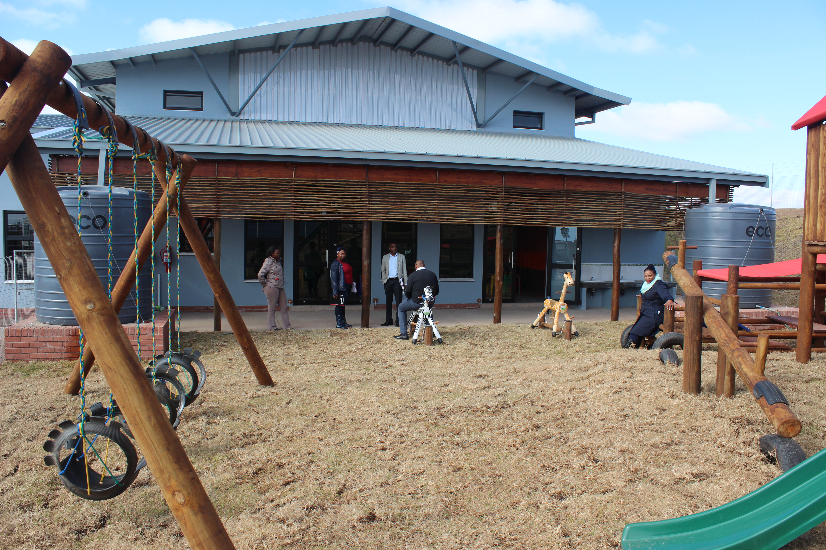
THANK YOU

Slide 32

mandela.ac.za

