Slide 1

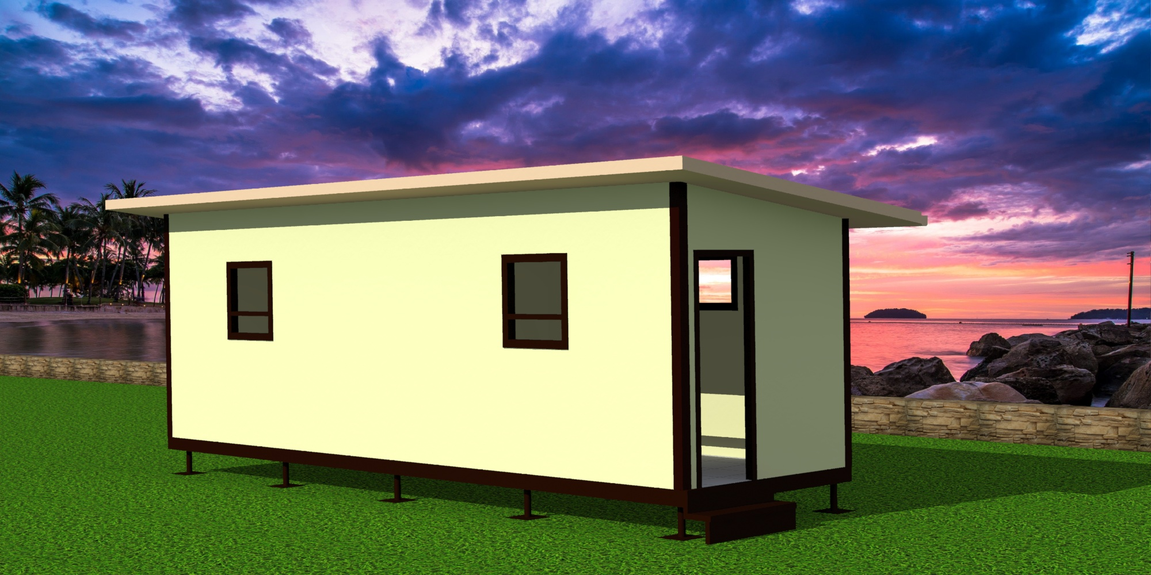
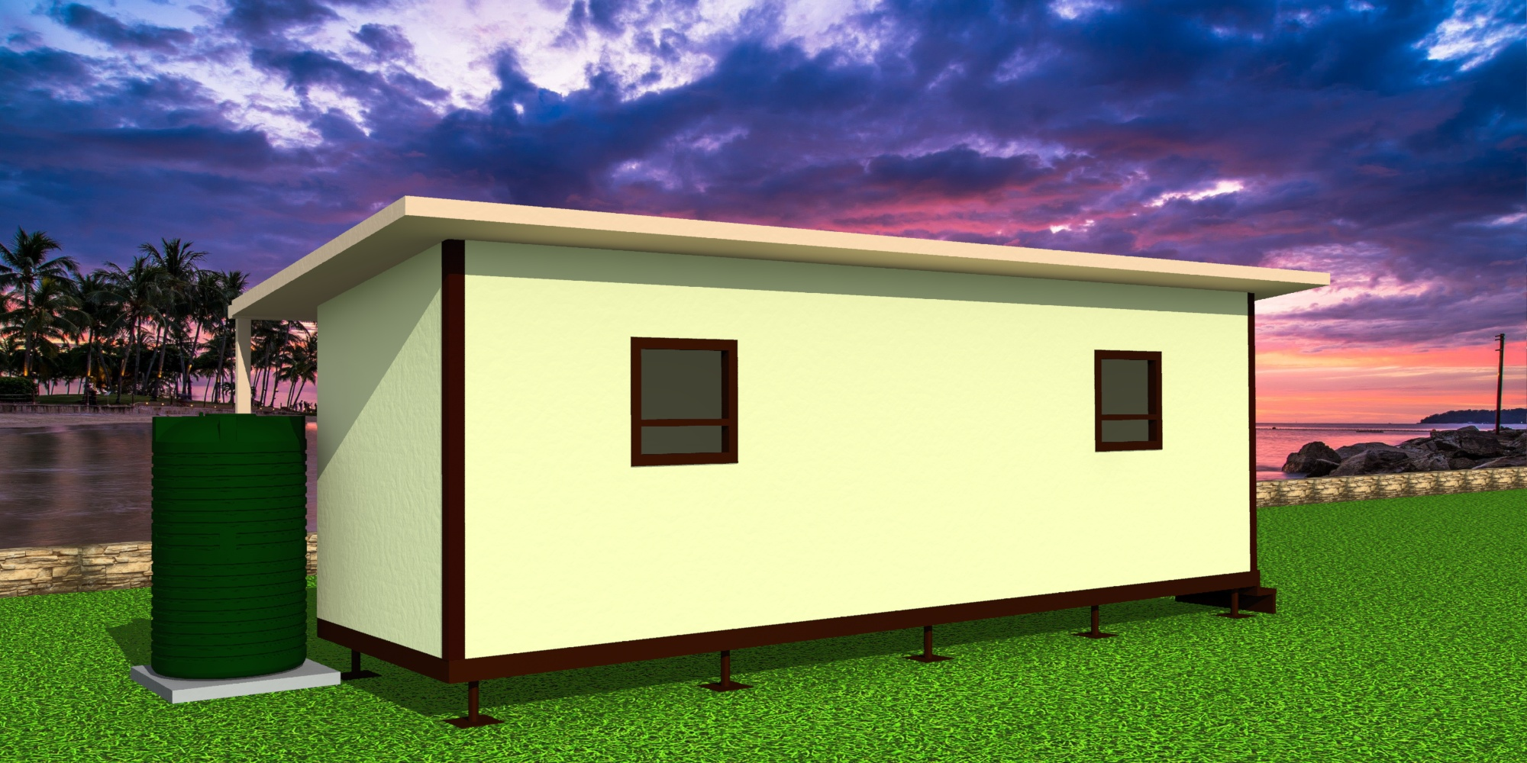
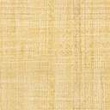
Sustainable disaster relief dwelling
By
Dr. Siviwe Shwababa

Slide 2
  JUSTIFICATION OF STUDY
The Eastern Cape Province is prone to severe convective natural hazards and disasters which over the years have been destructive and resulted into death, loss of property and livelihood (AgriSA, 2017). The following natural hazards: severe thunderstorms, hail, damaging winds flash flooding and lightning have been particularly apparent and have given rise to disaster events which have over the years left thousands of vulnerable rural populations homeless(PDMC,2019).

Slide 3
contextualisation
These disaster events have largely occurred in two districts within the Province, namely: Alfred Nzo and OR Tambo districts. The Department of Rural Development and Land Reform (DRDLR) in collaboration with the Department of Human Settlement(DOH) have over the years provided disaster victims throughout the province with some form of shelter either temporal or semi-permanent

Slide 4
Problem statement
In practice, the quality of relief shelters is often too different , unsuitable, time consuming, costly, with some shelters demonstrating lack of durability. The types of shelters provided by both departments have not evolved much overtime, consequently innovation has not been realised.
This is primarily due to the fact that government department’s major goal has been about providing emergency relief and not necessarily about innovation in materials and technology.

Slide 5
Aim
Propose a strategic disaster relief shelter which will serve as a model that assists responsible entities to provide housing to disaster victims within a short period of time.
There is currently no standardized disaster relief shelter which is most suitable for various real-life disaster circumstances.
There is knowledge a gap for creating innovative options whilst solving humanitarian problems relating to disaster relief sheltering.

Slide 6
Ideal to help those in Disasters and informal settlements

Slide 7
Life Span and Durability
Zincalume
Fibre Cement
Cannot crack or Warp ALUMINIUM coated material has excellent corrosion resistance even in coastal areas Hail Proof The material is pre-painted so no painting to take place on site. Paint will last in excess of 15 years Colourplus is rust free SABS approved No Maintenance Required Has a steel door that cant not swell , bend or warp
9mm Fibre-Cement is brittle and can crack and break during and after installation. Possible Hail Damage Risk Units are hand painted which does not last more than 5 years Fibre Cement is very susceptible to water damage and needs to be painted every three years to avoid water damage. The material is porous and absorbs moisture Has a wooden door that absorbs moisture causing it to swell and warp.

Slide 8
Shelter material

Slide 9
Security and dignity

Slide 11
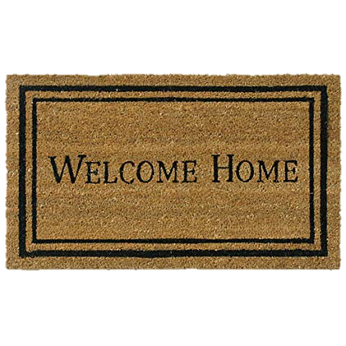
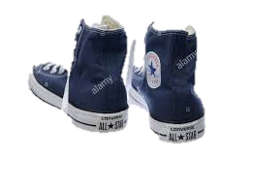
A SUSTAINABLE DWELLING
will be 6 x better insulated than a standard shack dwelling creating warmer winters and cooler summers
will be fire retardant due to the nature of insulation used
will be raised off the ground to avoid rain damage
will have no concrete foundation, therefor no environmental impact
will have a lockable alu-zinc entry door for you and your childrens safety
will have aluminium windows to ensure no maintenance is required and will create a well ventilated home
will be completely sealable against rodents and dust
will include solar lighting
will collect rain water in your storage tank
will include a portable cooker stove to enjoy a warm meal !

Slide 12

Each insulated home is pre-manufactured in kit form using a very unique tongue and groove joining method to ensure accurate sealing and stability. this includes all wall and roof sections, even the doors and windows are pre-fitted, making the installation time quick and easy.

Slide 13
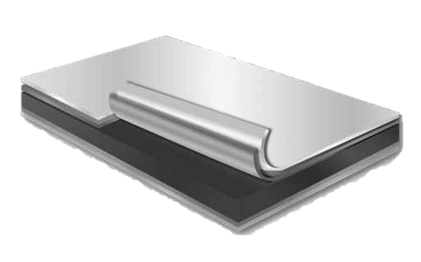
WALL AND ROOF SKINS
ALU-ZINC IS APPLIED TO BOTH SIDES OF THE INSULATION ON THE WALL AND ROOF PANELS
THE ALUMINIUM COMPONENT OF THE COATING PROVIDES A TOUGH PHYSICAL BARRIER BETWEEN THE EXTREME ATMOSPHERE CONDITIONS AND THE INNER CORE OF STEEL
THE ZINC IN THE COATING PROVIDES SACRIFICIAL PROTECTION AND ALSO PROTECTS THE STEEL AT THE CUT EDGES
ALU-ZINC IS ALSO MORE RUST RESISTANT THAN YOUR STANDARD GALVANISED STEEL
ALU-ZINC COMES IN VARIOUS COLOUR FINISHES
PASSIVATION
AZ COATING
LOW CARBON STEEL

Slide 15
SKILLS DEVELOPMENT OPPORTUNITY
Given the simplicity in manufacturing and assembling of the shelter. Community members can acquire skills and employment opportunities during the construction phase. This will further instill a sense of ownership for each shelter provided.

Slide 16
enkosi thank you

