Slide 1
A Foucauldian Analysis of Public Housing in Rural South Africa” A presentation by Danford Chibvongodze & Sithembiso Myeni SASUF SYMPOSIUM 2019 Nelson Mandela Metropolitan University, Port Elizabeth 06 May 2019

Slide 2
Profile of Study Area
Jozini is situated in the Northern part of KwaZulu-Natal province and is one of the four local municipalities administered by uMkhanyakude District Municipality and is divided into 20 Wards.
According to the 2011 National Census, Jozini has a population of 186 502.
It serves as a primary node/hub for surrounding areas such as Ingwavuma, Ubombo, Ndumo and Bhambanana.
Jozini’s population is largely rural and thus like most rural areas in South Africa it is characterised by high incidences of poverty, lack of service delivery, housing & underdevelopment.

Slide 3
Access of Housing in Jozini Source (Jozini Local Municipality Report, 2018:71)

Slide 4
Background to Jozini’s Low Cost Housing Scheme
Low-Cost Housing scheme comes in two form:
-Community Residual Units (CRUs): R0-R3500
-Financial Linked Individual Subsidy Programme (FLISP): R3501- R15000
Targets those considered poor, unemployed and susceptible to poverty shocks.
Selection of beneficiaries is done by Project Steering Committees (PSCs).
Traditional authorities ( Inkosi)are also actively involved in selecting beneficiaries.

Slide 5
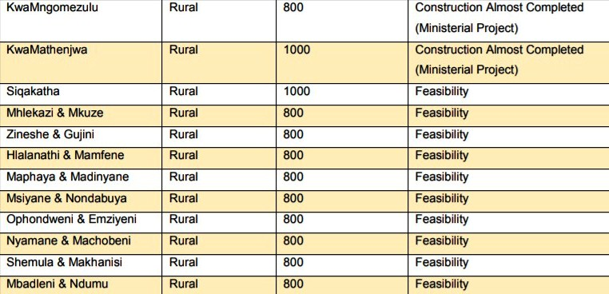
The Number of Units Built Under the Jozini Low Income Housing Scheme (Source: Jozini Local Municipality Report, 2018:72)

Slide 6
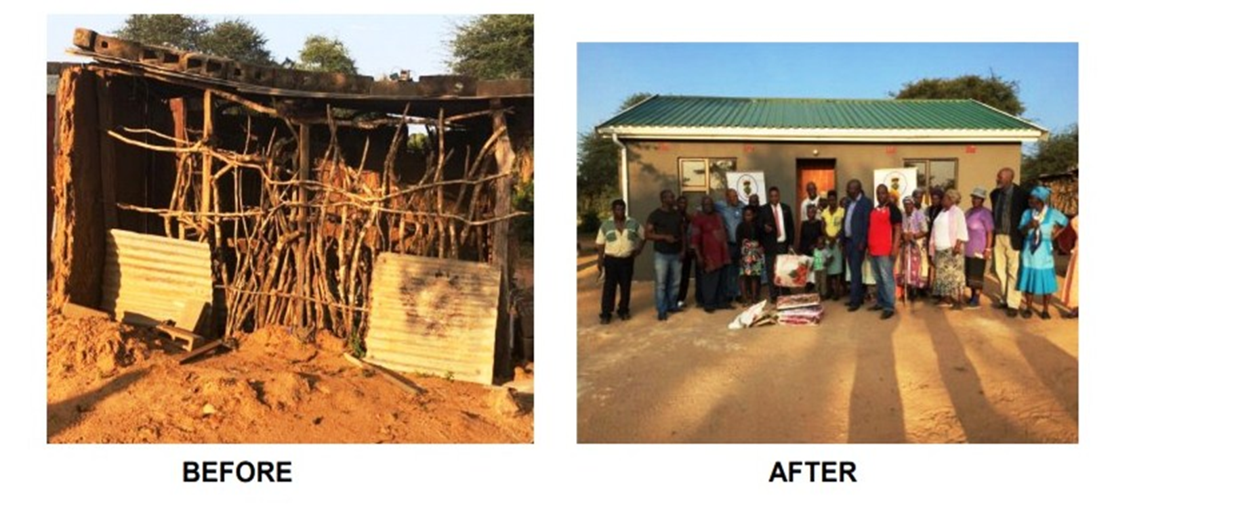
(Source: Jozini Local Municipality Report, 2018:39)

Slide 7
The provision of housing to South African citizens goes beyond achieving socio- democratic principles but serves to problematise poverty and seeking ways of to intervene in the everyday life of those characterised as “poor”.
Public housing should be understood in terms of governmentality.

Slide 8
According to Foucault (1995: 221) governmentality is an exercise of power “…by which, in our culture, human beings are made subjects”.
The production of governable subjects occurs simultaneously with the production of truth or knowledge which should stand as a rationality of regulating social behaviour.
We are subjected to the production of truth through power and we cannot exercise power except through the production of the truth” (Foucault, 1980:93).

Slide 9
The state has used objects such as public houses to institutionalise and entrench the biopolitics of power, governmentality and its discourses .
State-led public housing projects assists the state to emit its identity, norms, ideologies and “truths” to its subjects, allowing to shape how its citizen views it.
Public housing has enable the state to establish its presence, and relevance communities deemed “poor”.
Public houses become sites in which the state solidifies and claim its legitimacy of fulfilling its promise in providing housing to the so called poor.

Slide 10
Ghertner (2010:186) posits that public housing programmes “…are effective to the extent that they produce governable subjects…individuals who evaluate the social world through lenses provided by the government”.
They therefore become “…an essential component of guiding the interests of targets population groups is thus the joint exercise of crafting intelligible fields for governmental intervention and problematising such fields so as to make certain ‘deficiencies’ emerge as improvable” (ibid).

Slide 11
When one applies Ghertner’s (2010) assertion on Jozini Low-Income Housing programme case, it is become unsurprising that some of the participants referred to houses constructed under this project which have aesthetics that are different from normal houses as “Indlu zika Hulumeni” (Government houses).
This reference of “indlu zika Hulemeni” feeds into the panoptic presence of the State in the everyday language and people’s experience with housing in rural South Africa.
A Foucauldian would interpret the above reference by some participants as a culmination and entrenchment of the state’s hegemony over its citizens and an establishment of government’s visibility and surveillance on public spaces.

Slide 12
Parnell and Hart (1999) suggest that housing programmes initiated by pre and post democratic South African government were less to do with solving the housing crisis among the poor, but to serve the interests of capital and the state.
Parnell and Hart (1999:367) argue that public housing is “…a prevailing method of social engineering, whose acceptance or rejection reflects perceived political and economic advantages for the state and the private sector, and […] not a simple response to a shortage of affordable shelter among the poor”.
While the Jozini low income housing scheme has empowered its intended “beneficiaries”, the Jozini low income housing scheme like any of its nature in South Africa functions as instrument of amassing power and politico-social allegiances by political elites and traditional leaders.

Slide 13
The institutionalisation of governmentality and power in post-apartheid South Africa continues to rely on a colonial politicisation of ethnicity and space, to enforce the governance of rural citizens from a distance ( also see Mamdani, 1996).
PSCs are another form of indirect rule where the State, powerful political elites collaborate with traditional leaders to promote their political ideas and coalesce allegiances.
For instance, some of the project implemented under the Jozini low cost housing are identified using the names of traditional leaders e.g KwaMathenjwa Phase 1 Project which is named after iNkosi Mathenjwa and 1, we have Mngomezulu Phase 1 named after iNkosi Mngomezulu

Slide 14
“The MEC provided the houses directly to the traditional authorities (Chiefs) in the areas and they were not controlled by the municipality in any way. The Chiefs controlled housing provision and the municipality did not play any role during that people I guess all what happened for political reasons. Identifying beneficiaries during this period varied according to the different traditional authorities. It was largely depending on how politically active they were and who they were politically aligned to or with” (Research Participant).

Slide 15
Continued
“…many people did not get these houses because they did not support the dominant political party that lead the traditional council during that period. If you did not give support to the political party that a particular Headman dominated, the Headmen would be informed as a result you can be left out from receiving a house” (Research Participant)
There is an outcry from the people where you find for example a person that is known and can afford but you will find that he/she was able to receive a house. He works, he has a house but because he is politically active you will find that he will get a house from the scheme even though he is not poor at all. The people that are sincerely poor in the area will not get a house because they are not politically active and neither do they support the dominant political party (Research Participant).

Slide 16
“There is another person who is disabled, but because of their political alignment they are still living in poverty without a house. The house opposite where this person stays there is a big house belonging to Mr XXX who was an artisan. He has renovated his house, he has livestock, but he still has an additional house from the municipality within his homestead because he was politically aligned and active”. (Research Participant).

Slide 17
The Ambivalence of Participation
The Jozini Low Cost Housing project as animates what Gaventa (2005) refer to as an “invited space” where important decision-making in the development process is steered by those that are powerful and are considered technical experts.
The spaces that communities are invited to participate in are commonly circumscribes by essentialised stereotypes of communities concerns and capabilities, leaving little scope for rural communities particularly women to participate as citizens.
Cornwall and Coelho (2007:11) have asserted elsewhere that power relations permeate every dimension of the participatory sphere, where powerful technocrats lay the guidelines of how the intended beneficiaries are supposed to participate in their own development process.

Slide 18
Conclusion
The paper argues that while housing delivery in South Africa has been utilised by the state in the (re)production of socio-democratic citizenship, it has also been instrumental in shaping the politics of democratic participation and state-citizen relationship.

