Slide 1
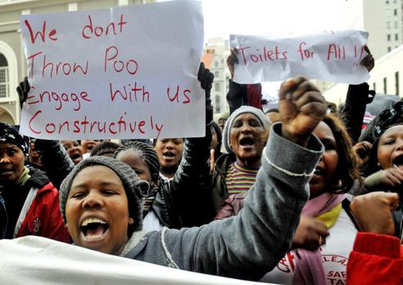
Research problem
The disturbing protest that took place in June 2013 on one of the Cape Town informal settlements, where residents dumped human waste on the stairs of the provincial legislature in Wale Street due to making their voices heard on the rejection of portable flush toilets that were delivered to them by the City of Cape Town Municipality. The rejection accusations by the residents include, local representatives that are making the Western Cape province ungovernable and a government that is denying them the right to participate in receiving adequate and proper sanitation Robins (2013) .

Slide 2
Research objectives
The main objective of this study is to determine the extent to which public participation was conducted prior to the installation of the potable flushable toilets in Khayelitsha, Makhaza area (2011-2015).
The following are specific objectives of the study:
To develop a sound theoretical framework focusing on theories of public participation and those of decision-making upon which this study is based.
To discuss legislative basis for understanding public participation importance in the South African context and its significance in informing sound decision making.
To analyse emerging trends from data collected in order to understand whether public participation was conducted prior to the erection of portable flushable toilets in Makhaza area. In doing so further, investigation to determine whether public participation result to informed decision making will be conducted.
To make conclusions and recommendations with regards to improved public participation in order to derive at informed decision-making.

Slide 3
Literature review
Public Participation Theories | Decision-making theories
Deliberate democracy (Miller, 1993) (Thompson, 1976) on Miller’s theory | Rational model (Earle,2007)
Representative democracy (Phillips, 1991) | Heuristic model (Gigerenzer, Hertwig and Pachur, 2011)

Slide 4
Research methodology
An application of both the qualitative and quantitative research methodology was used in the study, as follows:
Qualitative Research Methodology:
Structured In-depth interviews with individual residents.
Open-ended and close-ended questions
Quantitative Research Methodology:
Graphs, tables and diagrams in a form of percentages were used to present research findings.
Document analysis.
Sampling:
30 interviews were conducted from general Community members using the purposive sampling from the non-probability sampling because:
Respondents have dense information on the subject matter
Excluded individuals who are not related with the mission which could jeopardize the study with irrelevant information .
Research Methods:
Secondary data: Previous researches, Legislative frameworks , Reports , Departmental documents, Articles , Journals, Newspapers
Primary data: Face-to-face interviews
Within a months’ time all interviews were done. 100% of responses by respondents who were willing to participate.
The City of Cape Town Public Participation Unit , Ward 95 Councillor and the Sub-council were informed of the study but did not want to participate.

Slide 5
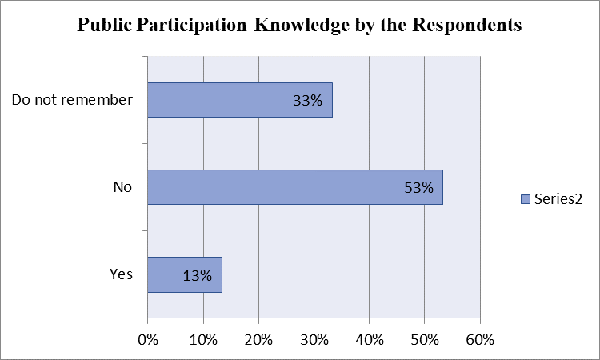
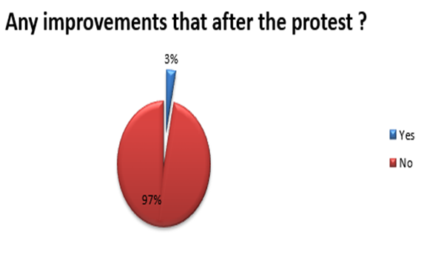
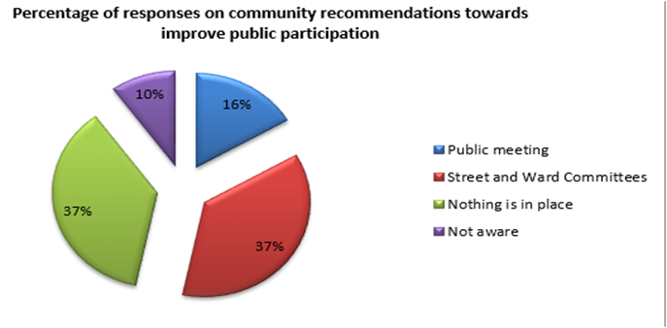
Research findings (graphs)

Slide 6
Conclusions and Recommendations
The concluding remarks of the study entails,: Thus, draw conclusions of the study as:
Misuse of power by community representatives,
Ineffective execution of duties by street and ward committee members,
Lack of co-ordination between community and government structures,
Lack of access and distribution of information.
Recommendations included:
Creation of a Public Participation Platform
Capacitation of Street Committee members and Ward Committee members
Roles and responsibilities of all structures involved in public participation
Communication
Co-ordination between community structures
Government should live up to its promises
Municipal visibility

