Slide 1
Urban regeneration and renewal in African cities in the light of the sustainable development goal for cities:
A case of Lagos, Nigeria.
Taiwo Afinowi
School of Architecture
University of Witwatersrand, South Africa
taiwo.afinowi1@students.wits.ac.za
South African Sweden Universities Forum Symposium 2019
Port Elizabeth, 6 May 2019

Slide 2
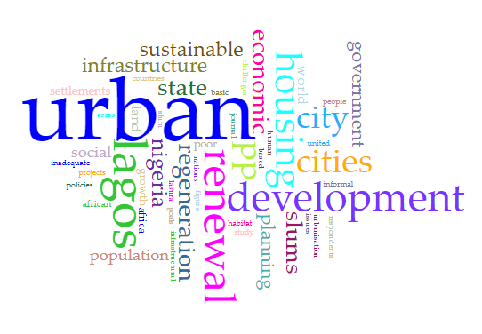
Outline
Introduction
The concept of urban regeneration and renewal
SDG for cities
Study area
Nature of Problem
Findings and discussion
Conclusion
Acknowledgement

Slide 3
Research Project
Main objective
to appraise the level of government’s responsiveness in the city of Lagos towards urban regeneration in line with SDGs to address urban housing and infrastructure towards the urban poor.
Research question
to what extent is the state’s government responsive to housing and infrastructural plight of the urban poor?
Qualitative research method
12 semi-structured interview, document analysis, and an empirical urban renewal intervention in Lagos.

Slide 4
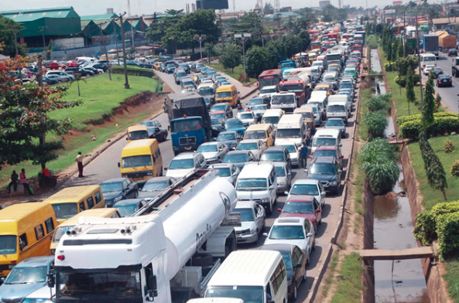
Introduction
The concept of urban regeneration and renewal have been applied in addressing the challenges that plague cities including:
Poverty
inadequate housing
inadequate infrastructures
urban decay
Traffic and transportation
Crime
inefficient cities

Slide 5
Introduction
…cities and urban centres have become places where the majority of people struggle, they scramble for
“for the most basic elements of life: for a room within reach of employment with an affordable rent, or vacant land on which a shelter can be erected; for places in schools; for medical treatment for health problems or injuries, or a bed in a hospital; for access to clean drinking water; for a place on a bus or train; quite apart from the enormous competition for jobs”
(Hardoy and Satterthwaite, 2014:301)
Urban centres become over burdened in the short and the long run.

Slide 6
Introduction
Table 1: World and Region Populations for 2017, 2030, 2050, 2100
Year / Region | 2017 Population (millions) | 2030 Population (millions) | 2050 Population (millions) | 2100 Population (millions) | Percentage increase by 2100
World | 7 550 | 8 551 | 9 772 | 11 184 | 48.1%
Africa | 1 256 | 1 704 | 2 528 | 4 468 | 255.7%
Asia | 4 504 | 4 947 | 5 257 | 4 780 | 6.1%
Europe | 742 | 739 | 716 | 653 | -12.0%
Latin America and the Caribbean | 646 | 718 | 780 | 712 | 10.2%
Northern America | 361 | 395 | 435 | 499 | 38.2%
Oceania | 41 | 48 | 57 | 72 | 43.1%
Source: Adapted from United Nation, 2017.

Slide 7
Literature ideas
African cities are experiencing a high level of urbanization.
Cities in industrialised and developed countries seem to have found a way of dealing with urban issues (Daramola and Ibem, 2010; UN-Habitat, 2013).
Urbanisation ought to be accompanied by economic prosperity.
City development before proper urban and regional planning (ibid).
Failure to apply modern planning techniques to address issues (Huchzermeyer, 2011).
Urban planning and practices still largely dominated by colonial policies (Mabogunje, 1990; Coquery-Vidrovitch, 1991).

Slide 8
The concept of urban regeneration and renewal
Urban regeneration, renewal, redevelopment, and revitalisation are urban cliché
Urban regeneration is the comprehensive and integrated vision which seeks to resolve urban problems and bring about a lasting improvement in the economic, physical, social and environmental condition of an area to improve opportunities (Granger, 2010; Roberts, 2000).

Slide 9
The concept of urban regeneration and renewal
Urban renewal is the process of clearing slums and replacing them with physical development with social, cultural and economic considerations
Urban renewal was used as a tool to address urban issues such as overcrowding and high-density challenges
it aids the rectification of urban decay
It also enhances the social network and the inclusion of vulnerable groups
It reduces the negative impacts of unwholesome and dilapidated living environments
It improves the quality of the environment within communities
(Zipp, 2013, Zheng et al., 2014).

Slide 10
The concept of urban regeneration and renewal
urban regeneration tends more towards complete redevelopment and economic improvement disregarding the social well-being of the people
while
urban renewal (in-situ upgrading)tends more towards improving the social well-being of the urban poor

Slide 11
SDG for cities
MDGs to SDGs
- normative agendas without systemic or procedural strategies
- MDG T7: “Cities without slums”;
- SDG 11: Make cities and human settlements inclusive, safe, resilient and sustainable.
- The SDG#11 Target 1 aims to achieve “access for all to adequate, safe and affordable housing and basic services, and upgrade slums by 2030” for all cities and communities (United Nations, 2015:18).

Slide 12
SDG for cities
-uncertainty about the adaptation and localisation of the urban SDG for cities at the local city level (Parnell, 2016; Klopp and Petretta, 2017; Valencia et al., 2019)
-many southern cities are still trying to localise the NUA
-urban renewal entails elements of sustainable development and it is in line with the SDG#11

Slide 13
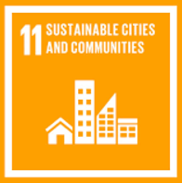
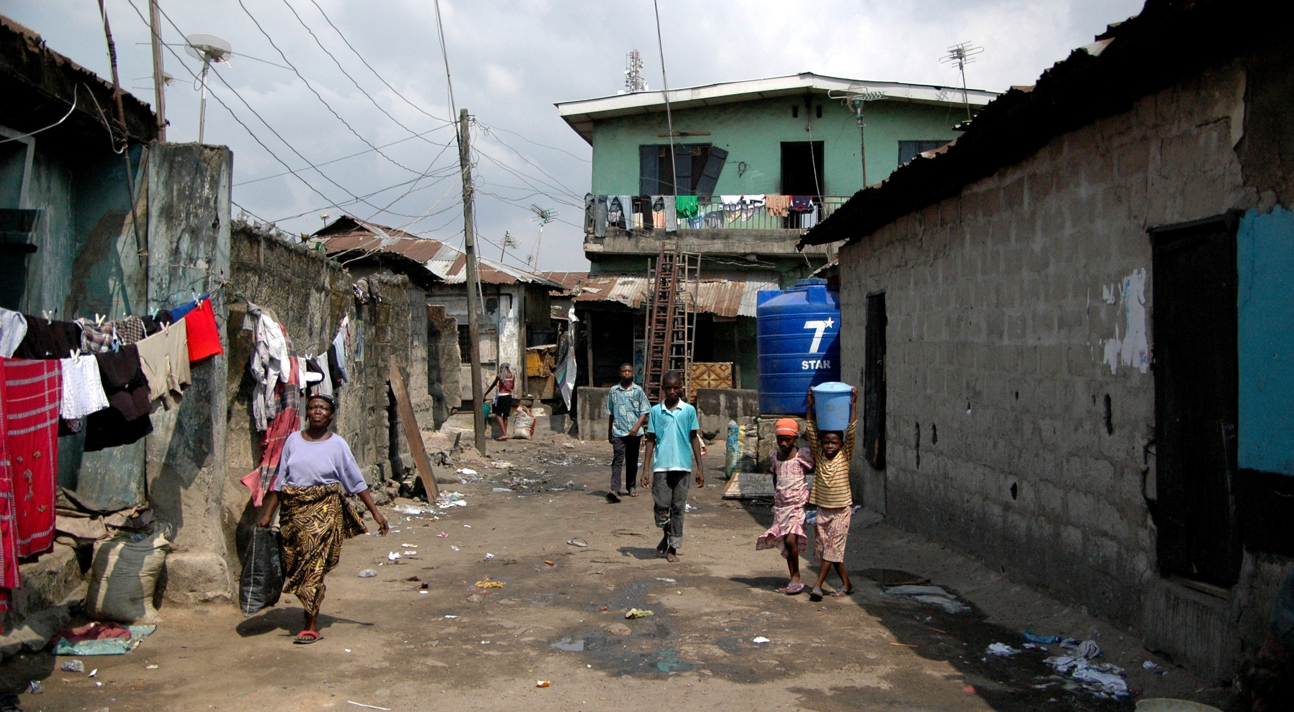
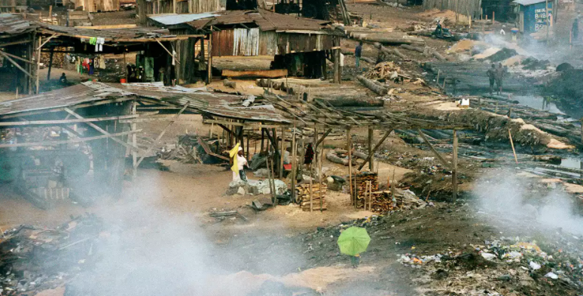
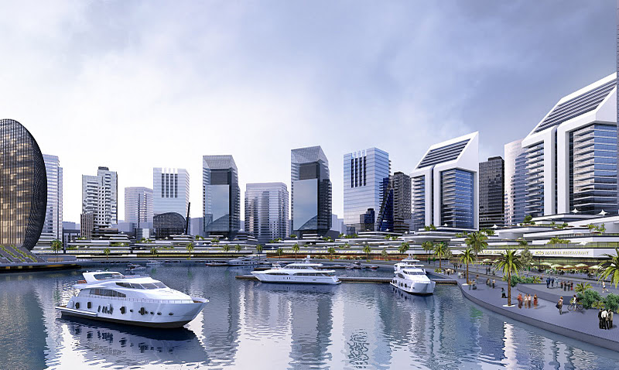
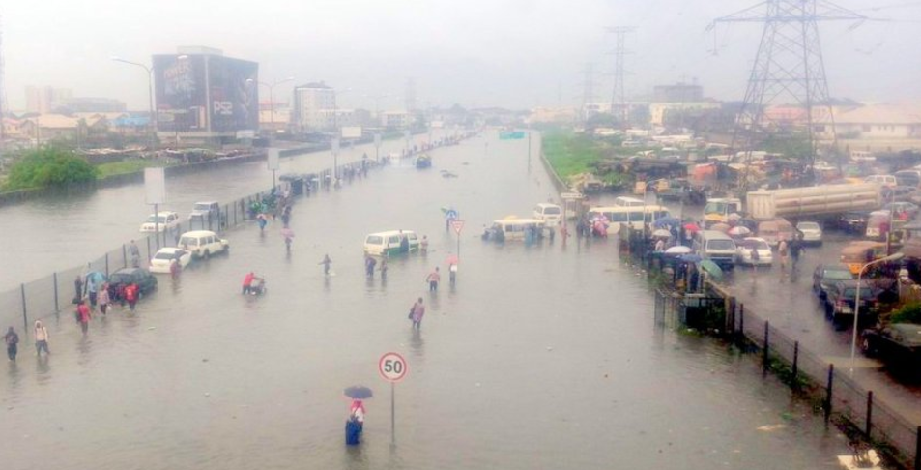
SDG and Lagos
Mismatch of perceptions or conflict of rationalities (normative vs reality)
Who’s reality really counts? Urban poor, the norm or the state?

Slide 14
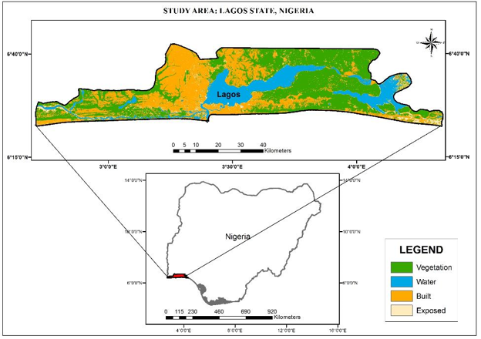
Study area: Lagos
3,577km2 space
0.4 % of Nigeria’s land mass
20 LGAs & 37 LCDAs
180km coastline
low lying (0-3m)
Population: 23million
27.4% of Nigeria’s urban population rapidly
Growing at 6%-8%
Highest economic activities;.
Very high population density (6,000 persons/km2).

Slide 15
Nature of the problem
7th most populous country now, to be the 3rd by 2050
As a developing country, faced with poverty, infrastructure, housing, and urbanization issues
Former capital yet …
Inadequate to accommodate future development
Lack of access to adequate and basic infrastructure
75% of Lagos populace live in substandard housing areas
70% of Nigerian populace living in unplanned settlements
The coastal nature of the city limits its expansion

Slide 16
Methodology
Qualitative approach
policy document analysis
12 semi-structured interviews
An empirical urban renewal intervention of Isale Gangan Towers and Gardens
Ethical considerations and anonymity of respondents.

Slide 17
Methodology
LASURA: Lagos State Urban Renewal Agency
-Implementation of government policies on urban renewal and of upgrading slums within the State” . Its objectives include “facilitating improved living conditions, the upgrade of infrastructure in slum areas and the provision of decent housing for slum dwellers”
MOH: Ministry of Housing – Lagos State
-Entrusted with the duty of delivering sufficient, affordable, and qualitative housing for all.
JEI-Justice and Empowerment Initiative
JEI is an NGO that is non-profit based in Lagos and Rivers state of Nigeria that supports a coalition of slums and informal settlements in Nigeria called Federation (JEI, 2017).
Urban practitioners and academics

Slide 18
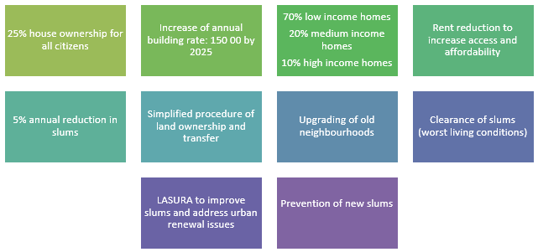
Findings and discussion
Chapter II of the Nigerian 1999 Constitution, Section 16(2) (d) stipulates that the “shall direct its policy towards ensuring that suitable and adequate shelter, are provided for all citizens”. - Vagueness of the Constitution and NHP
-The LSDP 2012-2025
-Lagos State Development Plan 2012-2025
-Lagos State Tenancy Law, 2011
-Lagos State Urban and Regional Planning and Development Laws, 2010
-Lagos State Mortgage and Property Law, 2010

Slide 19
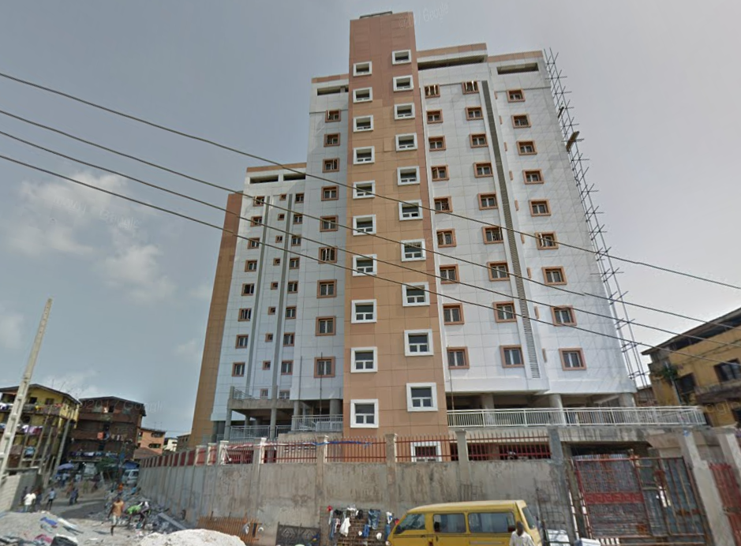
Findings and discussion
Empirical urban renewal intervention
: Isale Gangan Towers and Gardens
land pooling system from 12 land-owning families
48 luxury flats on 11 floors comprising of 2/3 bedrooms units
with facilities such as water, power and generators.
2-bedroom apartments each for resettlement and compensated
each of the families to be compensated with 1unit in the new project
2 and 3 bedrooms open for sale since February 2017 at N38, 000,000.00 ($105,260.00) and N50, 000,000.00 ($138,500.00) respectively

Slide 20
Findings and discussion
Disregard to the SNC Lavalin study /UNDP
1980-2000 Development guide and plans were not followed
military incursion with little or no regard for urban development and planning
Challenges of Urban renewal
Funding / Budget capture
Lack of trust in government based on previous experience
Land Tenure System
Level of responsiveness to urban regeneration drive
The government’s body-language is
anti-slum
has been towards making the city look attractive for investors.
Projects
Eko Atlantic City, Lekki Free Trade Zone, Bus Rapid Transport project
Housing projects, Ongoing construction of Blue and Red Rail lines

Slide 21
Findings and discussion
Level of responsiveness to urban regeneration drive
“until the city vision includes catering to the needs and the potentials within that demographic majority, then our processes and policies will continue to be skewed” because of our peculiarity and teeming population (Respondent C1).
“, the only approach we have seen government taking in Lagos when it comes to slums and informal settlements is to demolish or ignore them, even though there seem to be some changes in that regards” (Respondent D1).
“government’s policy reflection on the housing situation in Lagos State which is inadequate, as it were, consists more in unending stories of regeneration, lacks historical data on planning and development, lacks disaggregated data on communities in Lagos, regeneration is not based on the principles of integration and inclusion, …(which) lacks a housing delivery structure to accommodate the low-income groups” (Oshodi, 2016).

Slide 22
Conclusion
LASURA and MOH are overwhelmed in addressing the issues of slums & housing
The city’s regenerative approach is driven by the pursuit of economic interests as against ensuring inclusivity, access to affordable housing and basic infrastructure.
conflict in rationality between economic improvement vs social well-being
urban planning processes adopted in the global South sometimes “serve to promote social and spatial exclusion, are anti-poor, and are doing little to secure environmental sustainability”. Watson (2009:151).
…to make Lagos state “Africa’s Model Mega City and Global Economic and Financial Hub” (Lagos State Vision) … need for human face to align with the SDGs.
Need for co-production in solving urban-related issues to promote inclusivity and protection of livelihood for the urban poor.

Slide 23
List of references
Daramola, A. and Ibem, E.O., 2010. Urban environmental problems in Nigeria: Implications for sustainable development. Journal of Sustainable Development in Africa, 12(1), pp.124–145.
Granger, R., 2010. What now for urban regeneration? In: Proceedings of the ICE-Urban Design and Planning, 163,1. pp.9–16.
Hardoy, J. and Satterthwaite, D., 2014. Squatter citizen: life in the urban third world. Routledge.
Huchzermeyer, M., 2008. Housing in informal settlements: A disjuncture between policy and implementation. Risk and opportunity, pp.94–101.
Klopp, J.M. and Petretta, D.L., 2017. The urban sustainable development goal: Indicators, complexity and the politics of measuring cities. Cities, 63, pp.92–97.
Mabogunje, A.L., 1990. Urban Planning and the Post-Colonial State in Africa: A Research Overview 1. African Studies Review, 33(2), pp.121–203.
Parnell, S., 2016. Defining a Global Urban Development Agenda. World Development, 78, pp.529–540.
Population Prospects The 2017 Revision: The 2017 Revision, Key Findings and Advance Tables. Working Paper No. ESA/P/WP/248.
Roberts, P., 2000. The evolution, definition and purpose of urban regeneration. Urban regeneration, pp.9–36.
UN-Habitat, 2015. Transforming our world, the 2030 agenda for sustainable development.
Valencia, S.C., Simon, D., Croese, S., Nordqvist, J., Oloko, M., Sharma, T., Taylor Buck, N. and Versace, I., 2019. Adapting the Sustainable Development Goals and the New Urban Agenda to the city level: Initial reflections from a comparative research project. International Journal of Urban Sustainable Development, 11(1), pp.4–23.
Watson, V., 2009. ‘The planned city sweeps the poor away…’: Urban planning and 21st century urbanisation. Progress in Planning, 72(3), pp.151–193.
Zheng, H., Shen, G. and Wang, H., 2014. A review of recent studies on sustainable urban renewal. Habitat International, 41, pp.272–279.
Zipp, S., 2013. The Roots and Routes of Urban Renewal. Journal of Urban History, 39(3), pp.366–391.

Slide 24
Acknowledgement
-African Centre for Cities International Urban Conference, Cape Town
-Master of Built Environment in the field of Housing at the University of Witwatersrand Research Report
-Wits-TUB Urban Lab which was supported and funded by the German Academic Exchange Network (DAAD) and Federal Ministry for Economic Cooperation and Development (BMZ).
- Board and editors of African Studies Journal

Slide 25
Thank you for your attention
taiwo.afinowi1@students.wits.ac.za

