Slide 1
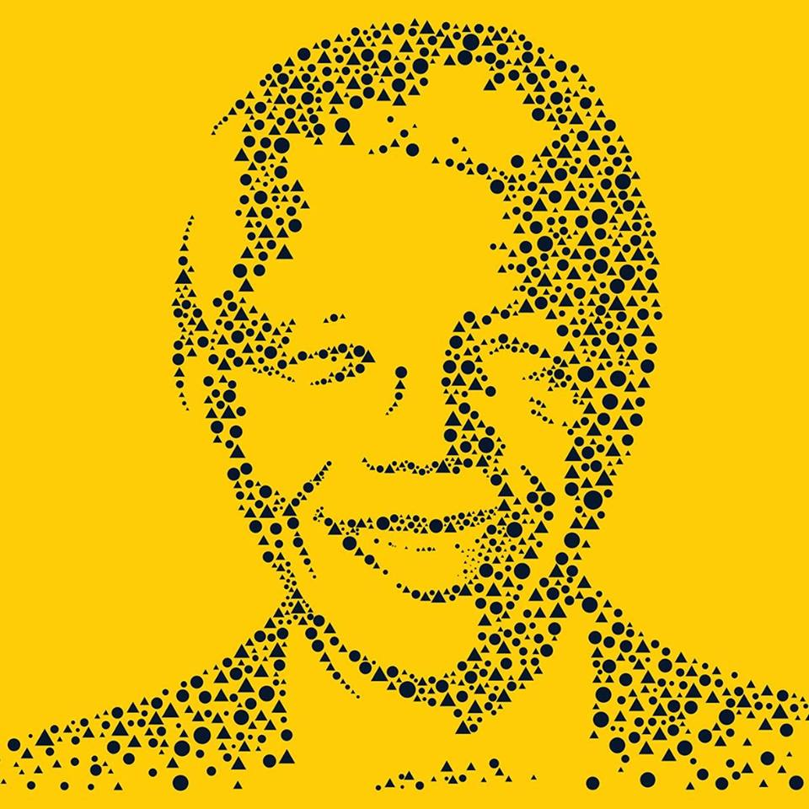
Nelson Mandela University, in collaboration with, South Africa Sweden Universities Forum (SASUF), Department of Science and Technology, and Department of Human Settlements HOSTING Sustainable Urbanisation Symposium SYMPOSIUM THEME: Sustainable urbanization through research, innovations and partnerships
South African Sweden University Forum (SASUF) 2019 Symposium
SENATE HALL– North Campus

Slide 2
South African Sweden University Forum (SASUF) 2019 Symposium

Slide 3
South African Sweden University Forum (SASUF) 2019 Symposium

Slide 4
South African Sweden University Forum (SASUF) 2019 Symposium

