Slide 1
URBAN RENEWAL AND DESIGN IN DURBAN “THE AEROTROPOLIS WAY” ONGEZWA G NTSHIQA PhD CANDIDATE: DhP in Science with Urban and Regional Planning UNIVERSITY OF NORTH WEST CANDIDATE TOWN PLANNER ETHEKWINI MUNICIPALITY

Slide 2
INSTITUTIONAL SUPPORT FOR AIRPORT RELOCATION.
The spheres of government in South Africa are National, Provincial and local government, they have an alignment of the plans for the same purpose of service delivery.
The schemes and plans of development followed by municipalities in developing economic development THE ALIGNMENT OF PLANS IS FROM National Development Plans (NDP), Provisional Growth Development Plans (PGDPs), these are used to devise Integrated Development Plans (IDPs) and Spatial Development Frameworks (SDFs).
In 2006 the KZN-EDTEA approved the concept plan of an aerotropolis of KSIA, the Construction of the project commenced in September 2007 and was completed 52 in weeks, (completed phase: Dube Tradeport and ksia)
THEREFORE, even though the aerotropolis is not yet a council adopted plan according to eThekwini municipality, the provision of infrastructure TOWARDS THE AIRPORT IS AN INDICATION THAT ULTIMATELY, THE CITY WILL APPOVE THE PLANS.

Slide 3
INTRODUCTION
According to this paper, urban design is discussed according to approved spatial plans concerning the airport and aerotropolis by both eThekwini municipality and the provincial department of economic development, environmental affairs and tourism.
DEFINITIONS: An Aerotropolis is a city built around an airport offering its businesses speedy connectivity to their suppliers, customers, and enterprise partners nationally and world wide .
URBAN RENEWAL
URBAN DESIGN
HISTORICAL OVERVIEW OF LAND ADMINISTRATION IN DURBAN
URBAN RENEWAL AND DESIGN OF DURBAN “THE AEROTROPOLIS WAY”
WHY URBAN RENEWAL PROGRAMMES?
PRIVATIZED PLANNING
IMPACTS OF KSIA
LAND USE PATTERNS AND DILAPIDATED BUILDINGS
POWERS OF JURISDICTION OF AUTHORITY

Slide 4
DEFINITIONS OF URBAN RENEWAL
Different definitions given by planners, academicians and researchers aim at sustainability by integrating the different dimensions of urban renewal. These are:
• Physical renewal leads to improvement of urban fabric; SOCIAL renewal leads to improvement of community and housing;
• Cultural renewal promotes enhancement of culture and traditions;
• Economic renewal leads to new generation of employment and revenue; and
• Environmental renewal leads to minimizing ecological imbalances in urban environment
Urban renewal is a dynamic term, which is evolved with reference to transformations of city and its economy. It refers to the various attempts to reverse the decline in cities that have been worst hit by the capitalist urbanization.
PREETI ONKAR, KRISHNA KUMAR DHOTE l& ASHUTOSH SHARMA (2008)

Slide 5
URBAN DESIGN
Urban planning and design for sustainable development is the process of shaping the physical setting for life to deal with the three-dimensional spaces in cities, towns and villages which concerns the environ-mental, social and economical factors. Fareea Shahreen, Angioletta Voghera
The aerotropolis is the new urban desin of the 21° century. The ksia aerotropolis responds to environmental conservation, economic growth and will have a social component which includes places of residence, universitiesjust like any other city(this is a 60 year plan).

Slide 6
HISTORICAL OVERVIEW OF LAND ADMINISTRATION IN DURBAN
SPATIAL PLANNING IN SOUTH AFRICA CANNOT BE SEPARATED FROM APARTHEID LAND ADMINISTRATION, THE 1913 NATIVES LAND ACT WAS THE PRIMARY LAW TO THE ADMINISTRATION.
The native land administration department was first established in Durban 1916 and is often presented as a landmark event, creating the so-called 'Durban system‘.
the Durban system was viewed as a “model” and its features spread around the country. The main land administration system used was the ethnic zoning model (Maylam, 1995:30).
the Durban City Council became the prime motivator of group areas act in the 1940s.
Prior to the introduction of the constitution in 1994, spatial planning was utilised to promote apartheid ideologies (Joscelyne, 2015:2).
THE APARTHEID SYSTEM OF PLANNING IS THE MOST DIFFICULT SYSTEM TO REVERSE. CITIES ARE ON TRIAL AND ERROR FOR SOLUTIONS URBAN RENEWAL.

Slide 7
URBAN RENEWAL AND DESIGN OF DURBAN “THE AEROTROPOLIS WAY”
According to Karsada (2016) airports impact business locations and urban developments in the 21st century the same way did highways in the 20th, railway terminals in the 19th century and the water ports in the 18th century.
Major businesses have left the Durban Central Business District (CBD) and are thriving in UMhlanga the booming new town center situated 16.8km away from the airport.
Umhlanga has shaped relocation of major businesses and industries in Durban but the airport will be the ultimate growth point. THEREFORE, URBAN RENEWAL IN DURABN HAS BEEN TOWARDS ECONOMIC DEVELOPMENT.

Slide 8
WHY URBAN RENEWAL PROGRAMMES?
In his 2001 State of the Nation address former President Mbeki announced the launch of the Urban Renewal Programme (URP) as an area-based approach which would form part of a 10 years initiative to address poverty and underdevelopment in targeted areas.
This was perhaps the beginning of A FOCUS TO AREA BASED APPROACHES OF urps IN MUNICIPALITIES. THE PROGRAMMES HAD a specific emphasis on improving joint government planning and implementation.
ALSO FOCUSING ON Townships WHICH were spatially engineered by the architects of apartheid and excluded by design.
IN THE CASE OF DURBAN, Some of the steepest terrains, were DESIGNATED AND DEVELOPED AS the African urban townships: Umlazi to the south, KwaMashu, Ntuzuma, Inanda, KwaDabeka, Clermont and others to the north.
Spluma of 2013 is an integration strategy THROUGH which the spatial inequalities are reversed. the renewal and integration are informed by the spatial, economic, social and political fragmentation

Slide 9
URBAN RENEWAL PROGRAMMES IN DURBAN
Due to the high demand of housing in the city, many of the identified buildings will be used in the High Density Corridors where residential apartments will be developed. The iTRUMP [inner Thekwini Regeneration and Urban Management Programme] has identified a number of bad buildings which will be renewed and used for different purposes.
Economic revitalization IS the focus OF the URBAN RENEWAL in the City Centre to rebuild Durban's economy using the city’s strengths, weaknesses, opportunities and its threats.
Durban is already world renown as a tourism destination, for its industries, manufacturing and logistics.
The department of economic development in the province has started distributing its projects around the city to intensify the industries especially in the durban south, isiphingo and areas where the old airport was situated.

Slide 10
URBAN DESIGN IN ETHEKWINI REGION
The eThekwini region has undergone SIGNIFICANT SPATIAL CHANGE WHICH IS NECESSARY FOR ECONOMIC DEVELOPMENT THROUGH THE KSIA. THE AIRPORT WAS A GREENFILED DEVELOPMENT WHICH NEEDED CONSIDERABLE INVESTMENTS BY THE MUNICIPALITY, PROVINCIAL GOVERNMENT AND THE PRIVATE INVESTORS.
The city of Durban was developed as a port city and has been the primary harbor of KwaZulu natal.
The stakeholders of the airport include neighbouring municipalities such as Ilembe, msunduzi, kwadukuza, mgungundlovu and Ndwedwe municipalities. The aerotropolis concept has been adopted by the kzn edea as a pioneer for regional economic growth.
This development marks a redevelopment and redesign of the city with a shift to the north.
The aerotropolis concept is a sustainable approach than the old Durban airport which was located in the midst of industries.

Slide 11
PRIVATIZED PLANNING
the growth of Umhlanga Ridge on the city's northern interface represents the development of a typical 'edge city'; symbolising the 'privatisation of planning' due to the large LEVEL of planning expertise and capital investment provided by Moreland Developments - a private-sector company, (Duminy 2007:34).
AFTER THE GREATER UMHLANGA TOWN CENTRE DEVELOPMENT, Major economic developments surrounding Durban including THE airport region, Greater Isibaya, Ballito and the Greater Hillcrest EMERGED AND EXPANDED.
The privatisation of planning is a racialized planning or a high-income based planning approach which defeats the aims of all spatial and socio-economic integration strategies.
When applied to urban space, the increase in urban inequality in South Africa reflects both sides of a classic debate on the respective significance of race and class in maintaining segregation in American cities (Schensul and Heller, 2010).

Slide 12
IMPACTS OF KSIA
The relocation of KSIA to the north of Durban has resulted to a huge wind of change In the spatial form of Durban.
On the business side of things, the spatial impact of the airport relocation on renewal in Durban was premeditated and the stakeholders were well prepared for a breaking new ground airport development and business in the region.
The benefits of the airport infrastructure in the KZN region amongst others are regional economic development: improved economic infrastructure bringing in international investments, private and public residential infrastructure for bigger populations and employment opportunities.
Hewings et al (1997) calculated that a capacity increase at O’Hare and Midway airports would lead to a total job increase of 522,000 in the Chicago region.
In a South African evaluation, (Musakwa, 2008) also believes that local development perspective promotes sustainability, participation, poverty alleviation, job creation, productivity, competitiveness and decentralization.
KSIA has a significant population of employees working is aviation and non-aviation service provision companies, police and security and the industrial hubs of Dube Trade Port.

Slide 13
CONTINUED
The negative impacts on the other hand are empty existing city centre due to the shift, this leaves dilapidated buildings in the inner city, drastic changes in land use patterns, and decreased economic values of properties, poor enforcement and hijacking of abandoned buildings since the KSIA wind of change.
The causes of these reeking challenges emanates from the exclusion of the inner city in the plans of economic infrastructure and lacking proposals for town planning scheme reviews.
If forward planning mechanisms had been followed, an anticipation of the results of the shift would have raised a concern of sustaining the economy, the property and the aesthetic value of the CBD.
EThekwini Municipality has partially contributed to the city failures causing the existing dilapidated buildings by not putting in place tight measures of building maintenance towards property owners. The municipality as Local Authority in its jurisdiction has a responsibility to maintain order through municipal by-laws –(legal action and penalties).

Slide 14
URBAN DECAY
Durban has experienced urban decay and degeneration of historical residential areas, commercial and even public open spaces and parks in the city. Durban CBD has deteriorated and lost its historic value.
Albert Park, in Durban CBD like many inner city residential areas in South Africa is generally believed to be the result of urban decay, which “in turn leads to depressed rentals and degraded living environments” (Erwin, 2011: 71).
The research carried out by Attwood (2013) found that urban decay may be the result of large-scale change in the economic structure of a city, or may reflect the socio-economic status of the residents of the area.
Historically the CBD offered residential premises of bachelor flats mostly to white student’s and old age white pensioners who wanted to downsize from suburbs. From 1994, the group areas act was no longer effective, the demand for housing stock grew dramatically, and the CBD offered an attractive price range in close proximity to work, the business district and services to young professionals.
Whites are less open to change than the other groups, they left the CBD at the down of democracy. On the other hand, Africans have become more integrated, but the majority are constrained in their choice of residential options by the general levels of poverty (Christopher, 2001:2).
The devalued property market in the city has affected the management and socio-economic environment of the city.

Slide 15
LAND USE PATTERNS AND DILAPIDATED BUILDINGS
The drastic change of the land use patterns and spatial deterioration of the city can be attributed to the change of the socio-economic groups that moved to the city after 1994.
Data from a national survey conducted in 2007 assessing the levels and relative inequality of service delivery at municipal level revealed a wide variation in absolute service delivery levels when comparing richer urban districts to poorer rural ones (Sartorius and Sartorius, 2015). When then CBD was reserved for whites, service provision was prioritised.
The property markets have fallen so much that it is it is common in Durban to find tuck shops (where you can buy sweets, airtime, snacks, cigarettes and other small food) in the main streets (Dr Pixely Kaseme and Anton Lembede Street).
According to the scheme, a tuck shop is when:
“An occupier of a Dwelling Unit in a residential zone sell goods required for essential day to day needs of the neighbourhood, in residential areas that are not adequately serviced by such a facility. The sale of goods is to take place through a window, doorway or hatchway. Such use shall not detract from the residential character of the neighbourhood, aesthetically or impact wise” (Appendix 9 of the Durban scheme; 2013:225).
According to the Durban zoning scheme the CBD is general business which permits commercial, business, restaurant, laundry, fuelling and Service Station, government/municipal, health & beauty clinic, health studio, hotel, laundry, motor display area, motor workshop, museum, office, office – medical, parkade, pet grooming parlour, place of public entertainment, private open space, public open space, restaurant/ fast food outlet, shop, mortuary, museum, nature-based tourism, office, office – medical, pet grooming parlour and etc.

Slide 16
POWERS OF JURISDICTION OF AUTHORITY
According to the By-law on problem buildings of the City of Johannesburg Metropolitan of 2014, CHAPTER 2 provides that an authorized official is identified and appointed to enforce the provisions of the bylaw. The authorized official may enter the building to inspect and determine whether the property or building complies with the by-laws and other legislations. SECTION 7(1) The authorized official may, subject to the provisions of this section: declare a property or a building or any part thereof a Problem Property, provided that one or more of the following circumstances exist at the property:
(e) is unhealthy, unsanitary, unsightly or objectionable as determined by the personnel in the Building Control Sub-Directorate of the City of Johannesburg with formal architectural qualifications and experience;
(f) has overloaded or illegally connected electricity supply;
(g) has illegally connected water supply;
(h) has no electricity supply;
(i) has no water supply;
(j) has illegal connections to sewer mains;
(k) has overflown or blocked sewer drains;
(I) is subject to complaints of criminal activities, including but not limited to drug dealings, prostitution, money laundering; and etc
(a) if the building appears to have been abandoned by the registered owner or responsible person with or without the consequence that rates or other municipal services/ charges have not been paid for a period of more than three (3) months during any period of twelve (12) months.
(b) the building does not comply with existing legislation and/or is not maintained in accordance with the health, fire-safety and town planning and building control By-laws;
(c) the building has no or limited use of lifts installed in the building;
(d) is overcrowded as envisaged in any law, By-law, town planning scheme in operation or any other relevant legislation;

Slide 17
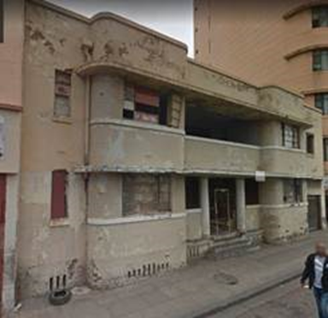
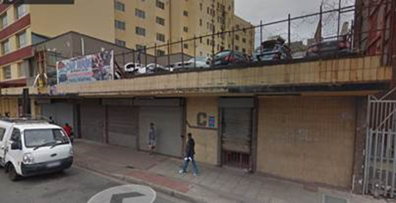
DILAPIDATED BUILDINGS
MAHATMA GANDHI RD, DURBAN, SOURCE: iTRUMP
5 LANGALIBALELE DUBE RD, SOURCE: iTRUMP

Slide 18
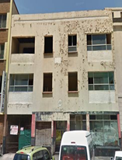
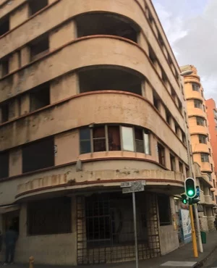
CONTINUED
TONG LOK BUILDING IN DURBAN'S MAHATMA GANDHI ROAD
, DURBAN, SOURCE: iTRUMP
29 PICKERING STREET, DURBAN, SOURCE: iTRUMP

Slide 19
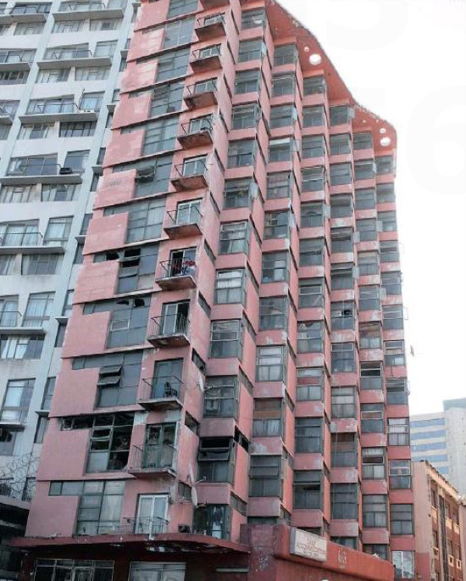
CONTINUED
, PALM BEACH HOTEL IN GILLESPIE STREET
DURBAN, SOURCE: GOOGLE IMAGES

Slide 20
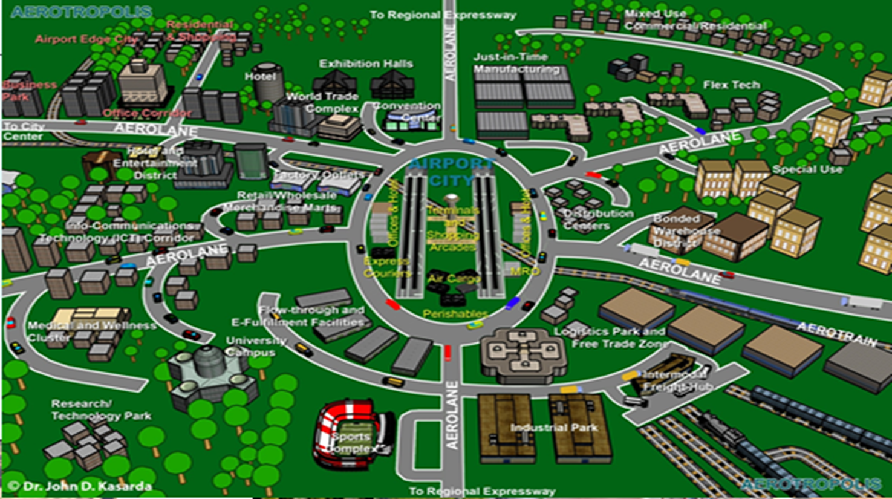
KSIA AEROTROPOLIS CONCEPT PLAN

Slide 21
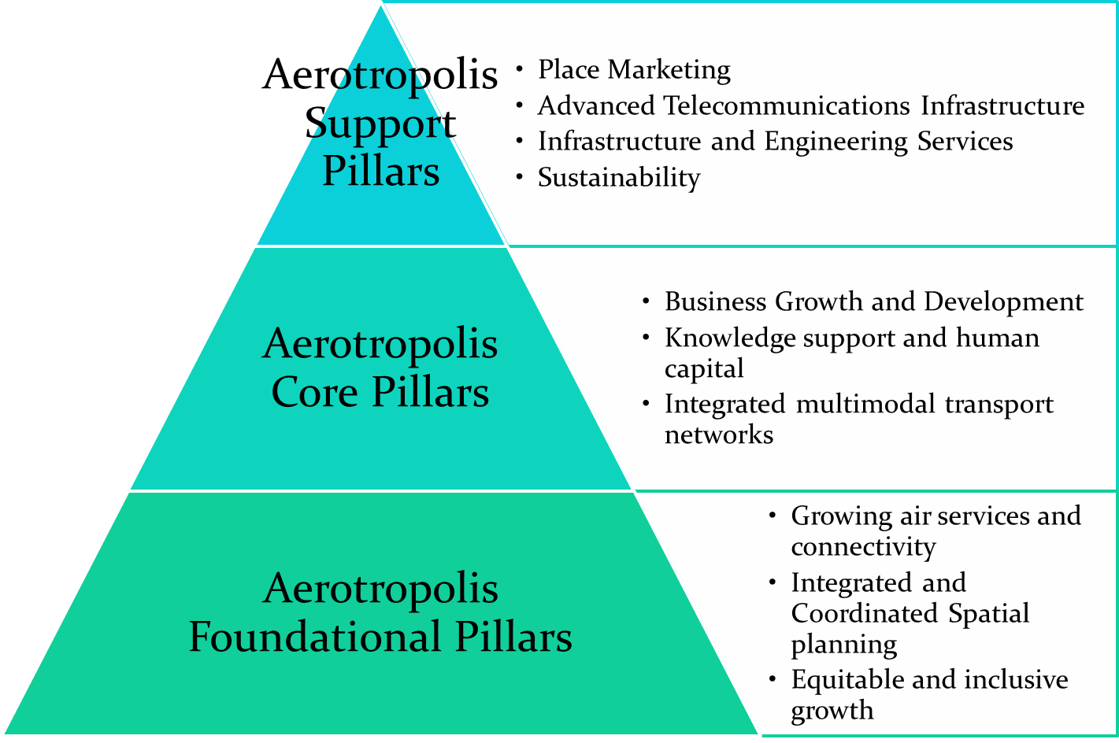

Slide 22
TOWARDS SMART CITIES
The Advanced Technology In The 4th IR Is The Main Wind Of Change Not Only In Airports But In The Corporate World And Government Departments.
Although The Economies Of Cities Have Opportunities Of Economic Growth, There Will Be Also Challenges Of Affordability Amongst The Poor Living In Smart Cities.
The Smart City Includes Smart Mobility, Smart Technology, Smart Infrastructure, Smart Services, Smart Security, Smart Economies, Smart Governance And Etc.
The Smart Cities Master Class Aimed To Contextualise The Implementation Of The 4th Industrial Revolution In Airport Cities (Aerotropolis) In The World.
Since Airports Are Run By Airport Companies As Businesses, This Puts Pressure For Competitiveness In Their Infrastructure And Technologies.
The Operation Of Aviation Ad Non Aviation Transport Networks Are Undergoing Through A Massive Transformation In The Era Of “Smart Cities”.
The new digital transformation is a global trend followed by airports for competitive advantages. Technology provides positive support for process optimization in security checks, enhancement of non aeronautical revenue streams, which are now becoming commercially significant for airports.

Slide 23
CONCLUSION
“The idea that action should only be taken after having all the answers
and all the resources are a sure recipe for paralysis. The planning of a
city is a process that allows for corrections, always. It is supremely
arrogant to believe that planning can be done only after figuring out
every possible variable. To innovate is to start! Hence, it is necessary to
begin the process. Imagine the ideal, but do what is possible today!”
Jamie Lerner – Former Mayor of Curitiba, Brazil.
Lesson learnt: urban renewal and design in Durban is two fold, it is proactive (however, single sided) and reactive (act aftermath).
Although growth is positive the shift towards the aerotropolis excludes certain income groups(private developments) when they should have a hybrid approach.

