Slide 1
Safety and Security as a Component of Equity Planning for Student Housing: A Case Study of Brandwag, Willows and Universitas Suburbs in Bloemfontein, Free State
Qhamani Tshazi
Programme Officer: Afesis-Corplan
Dr. Thulisile Mphambukeli
Senior Lecturer: University of the Free State
6 May 2019

Slide 2
UNDERSTANDING EQUITY AND EQUITY PLANNING
Equity-the fairness, impartiality or equality of services (Savas 1979:145).
Urban inequity-the injustices that exist within cities (Stephens 2012:476).
Equity planning is a framework in which urban planners working within government and public institutions use their research, analytical, and organizing skills to influence opinion, mobilize underrepresented constituencies, and advance and implement policies and programs that redistribute public and private resources to the poor and working class individuals(Metzger 1996:112).
Equity planning is the art of providing a wider range of choice for those individuals who have a few, if any choices (Krumholz 1982:163).
Notes:
Krumholz, N. 1982. A retrospective view of equity planning: Cleveland 1969–1979. Journal of the American Planning Association, 48(2):163-174.
Metzger, J.T. 1996. The theory and practice of equity planning: An annotated bibliography. Journal of Planning Literature, 11(1):112-126.
Savas E. 1979. On equity in providing public services. Ekistics, 46(2):144-148.
Stephens C. 2012. Urban inequities; urban Rights: A conceptual analysis and review of impacts on children, and policies to address them. Journal of Urban Health: Bulletin of the New York Academy of Medicine, 89(3):465-485.

Slide 3
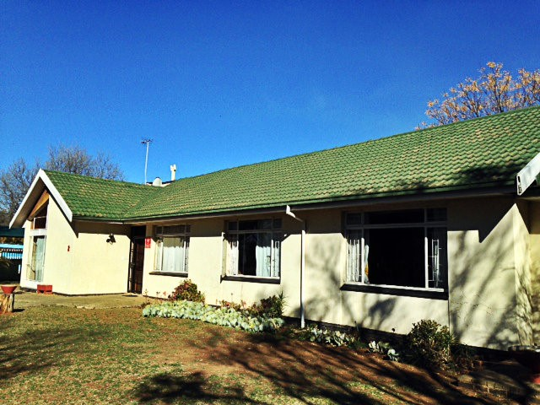
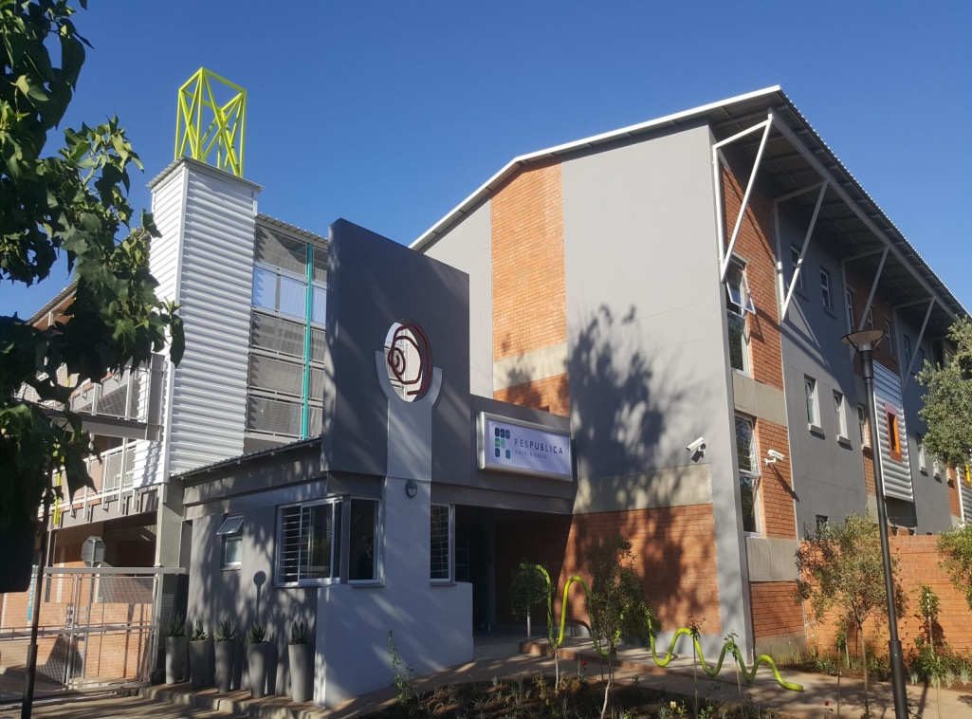
STUDENT HOUSING
A student house is defined as a house whereby the habitable rooms are rented out for an extended period to students who share communal facilities such as the kitchen, lounge, dining room and bathrooms (City of Johannesburg Municipality, 2009:8).
Two types of student houses which are communes and purpose built student accommodation (Ackermann and Visser,2016:9)
Notes:
Ackermann, A. & Visser, G. 2016. Studentification in Bloemfontein, South Africa. Bulletin of Geography. Socio-economic Series, 31:7-17.
City of Johannesburg Municipality. 2009. Commune policy. Development Planning and Urban Management. [Online] Available at: https://mra.ilovemelville.co.za/wp-content/uploads/2016/11/commune_policy09.pdf [Accessed 25 April 2018].

Slide 4
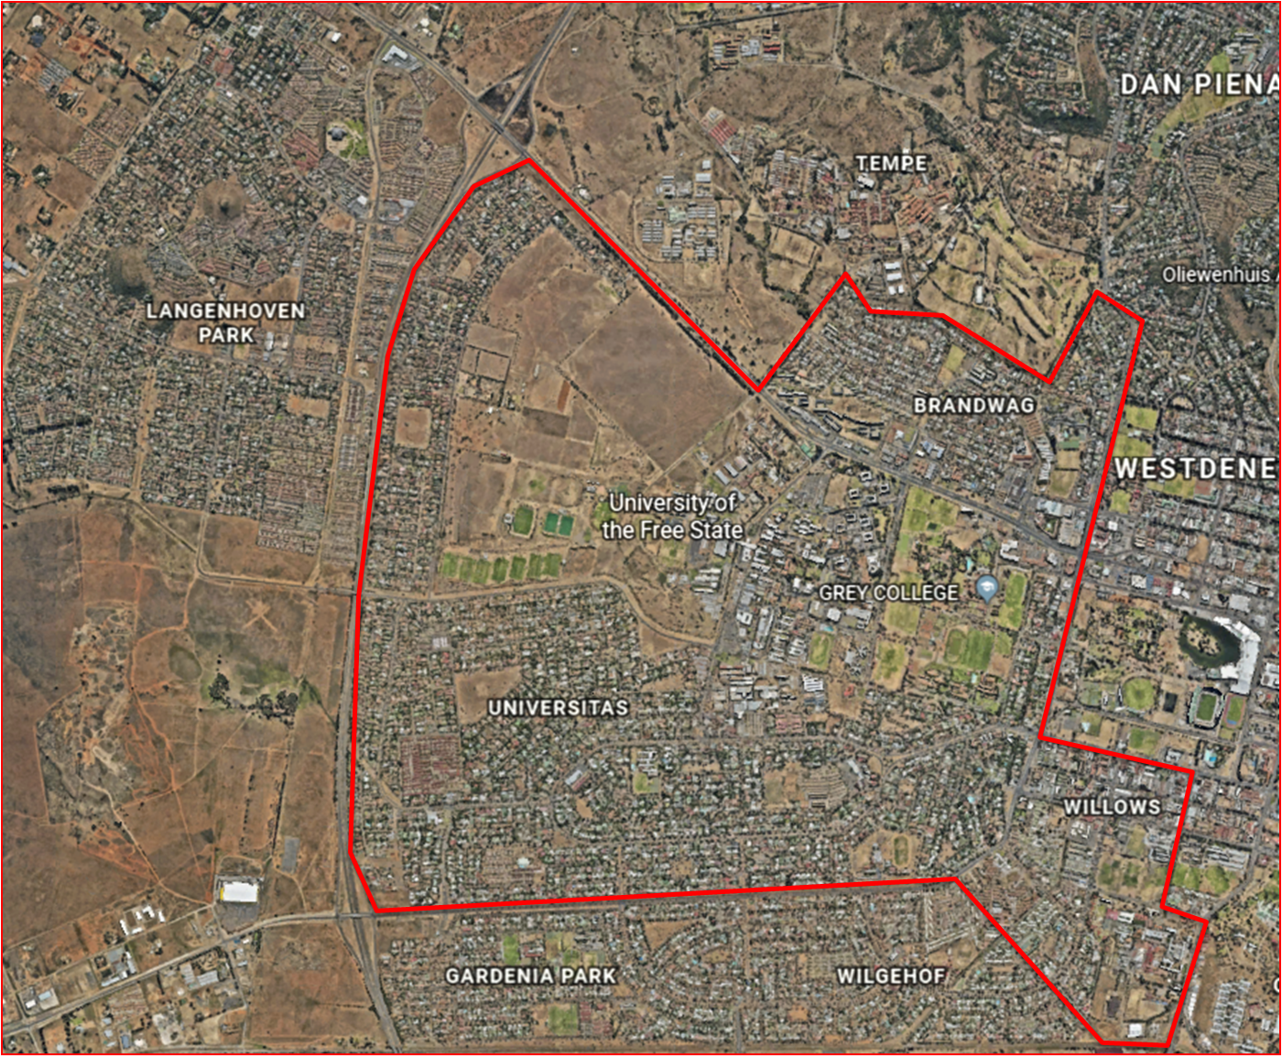
STUDY AREA

Slide 5
Snapshot Of Results
 | Number of students
Registered students | 27 489
On-campus | 4 161
Off-campus | 23 328
Residential capacity | 4 199
Suburb | Number of respondents
Universitas | 31
Brandwag | 17
Willows | 22

Slide 6
Snapshot Of Results

Slide 7
DISCUSSION OF FINDINGS
Capacity of University of the Free State to accommodate students
Ability to pay and access to resources continuum
Limited safety measures available to off-campus students
Fatal consequences tied with neglecting safety issues

Slide 8
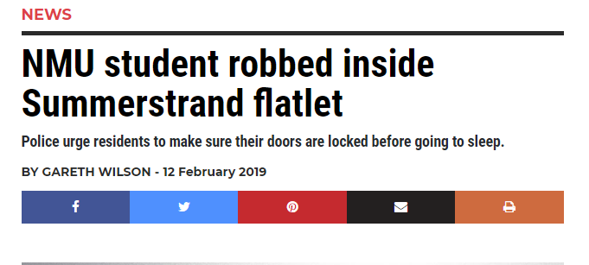
BUT ARE THESE PROBLEMS UNIQUE TO THE UFS?

Slide 9
THE NEXT STEP:
Spatialisation of all students registered
Development of an off-campus residence management system

Slide 10
THE NEXT STEP:
Indicators | Accessibility | Safety and mobility | Usability
Resources necessary for the full function of the user(library, laboratories) | Ability to access the necessary resources for everyday use as per the needs of the user | Are the resources located in a safe area that is easy to navigate and within reach of the desired target? | Are the resources in a manner that they can be used to fulfil the purpose they were intended too?
Social amenities | Will the user be able to access social amenities? | Are these amenities safe for use by the intended user? | Are the amenities in a condition to be used for their set out intentions?
Place of opportunity(the university, lecture halls) | Is the place of opportunity accessible to the individual with ease? | Is the commute to the place of opportunity safe and will users be able to travel to and from the place of opportunity without having their safety compromised? | Is the user able to use the resources and amenities made available to him or her by the place of opportunity?
Transportation | Can the individual access transport to and from the university whenever a need arises? | Is the transport safe and reliable and constantly able to move the individual to and from campus? | Is the transport of a standard that can be used with ease without any complications?

Slide 11
CONCLUSION

