Slide 1
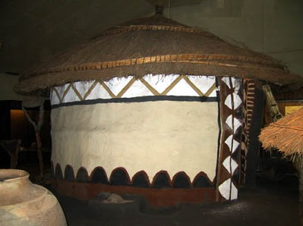
Traditional Render: a taken for granted, ignored and neglected yet sustainable solution in African traditional Architecture.
Prof Paul Makasa

Slide 2
Introduction
Urbanisation, modernisation and globalisation are all historical phenomena ignited by great civilisations long before Christ.
They interactively spur rapid and unprecedented societal change leaving in their wake those societies that fail to adapt.
Mankind is unsure about: their nature and meaning; whether they should be regulated or liberalised; supported or resisted; and, the sort of world they are leading to.

Slide 3
Introduction
History and lived experiences taught us about societies that fell by the way side due to resistance or failure to adapt to change.
Closer home the Khoisans are a good example
Today’s traditional societies have been adapting but at great expense to their cultural heritage.

Slide 4
Introduction
This paper is part of a larger study traditional construction methods amongst the Bemba in Northern Zambia conducted between 2003 and 2018.
It analyses how renders in traditional housing are motivated, made and applied.
More specifically, it interprets these seemingly meaningless traditional renders, which are taken for granted, ignored and neglected.
Yet under scrutiny, they emerge as a sustainable solution in African Traditional Architecture.

Slide 5
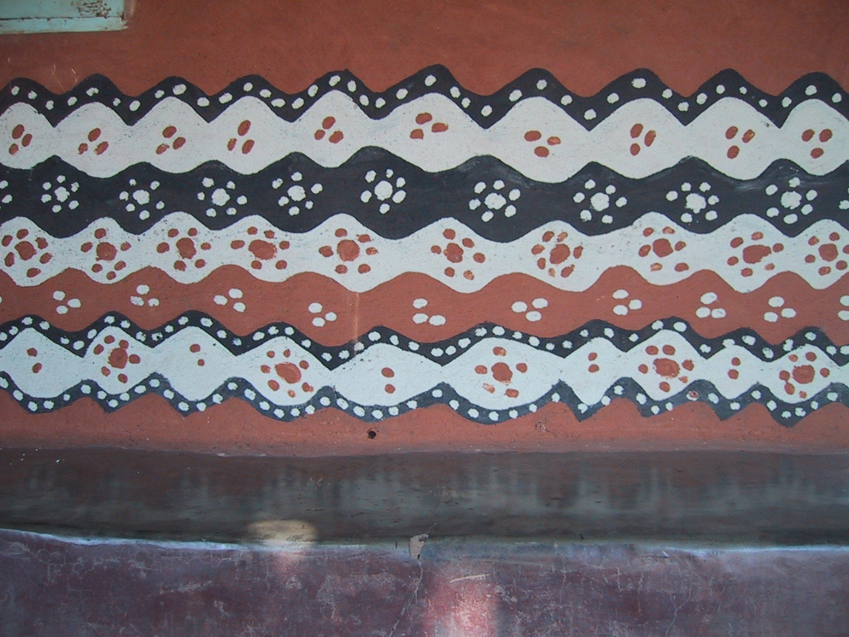
Introduction
The paper analyses how traditional renders are motivated, made and applied.

Slide 6
Introduction
The paper is presented here with the hope that it will evoke, in its audience, the need to get involved in slowing down or halting this wanton erosion of the African heritage.

Slide 7
Methodology Used
A qualitative methodology was used to gain a deeper understanding of people’s views and their feelings about their lives.
The research instruments used included desktop surveys, site visits, in-depth open ended individual interviews, participant observations.
Lived experiences were used to interpret some observed phenomena

Slide 8
Methodology
Desktop surveys involving tradition African Architecture focusing on Zambia;
Study trips (Site Visits) in 1998, 2010 and 2018, almost like a longitudinal study to see how long these renders lasted. For those protected by the veranda and the eaves, protected from the elements and those that were exposed to the elements; and
Open ended and unstructured Interviews involved, talking to people to get their views.

Slide 9
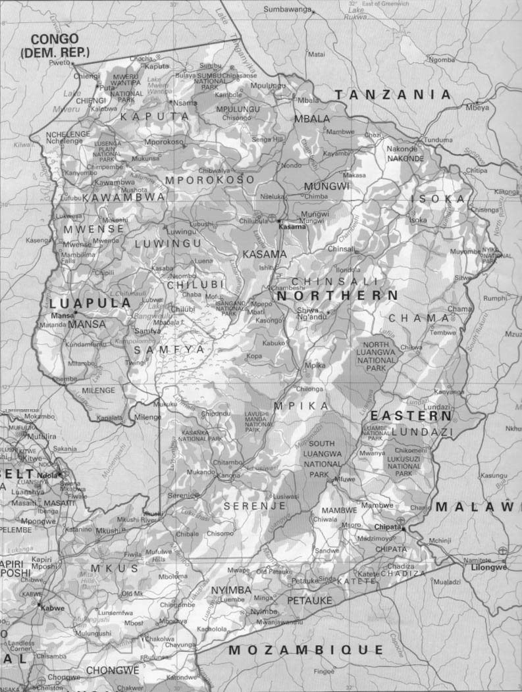
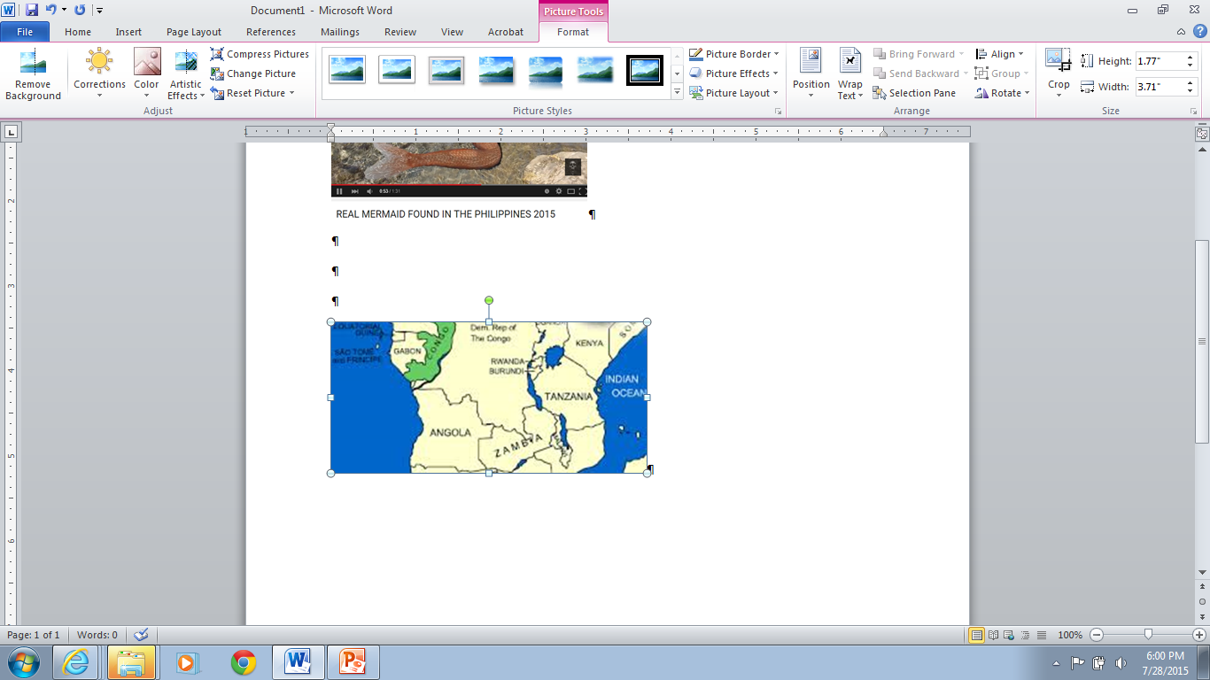
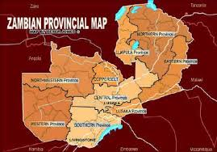
The Study Area
C
The Luapula and Northern Provinces of Zambia

Slide 10
The Study Area
This is part of a study whose fieldwork was undertaken for a much bigger project amongst the Lunda of the Luapula Valley and the Bemba of Northern Provinces of Zambia.
Both share the same traditions and customs.
This area was selected because it is one of those furthest from the developed and more modernised line of rail provinces.

Slide 11
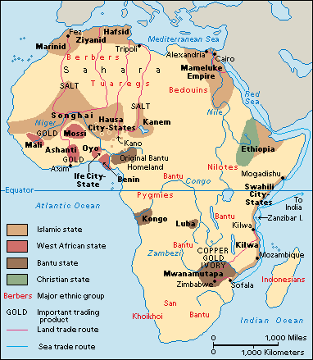
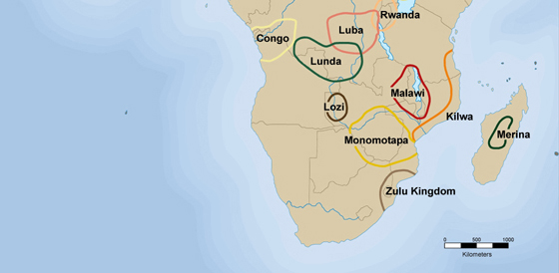
Origins of the Bemba & Other Bantu
From the Benue/ Niger Region the original Bantu Regions to the Congo/Cameroun Border and on to the Northern Fringes of Zambia/ Katanga and South Western Tanzania

Slide 12
The Itinerary
Kitwe-Luapula Valley, Tanganyika and Kasama

Slide 13
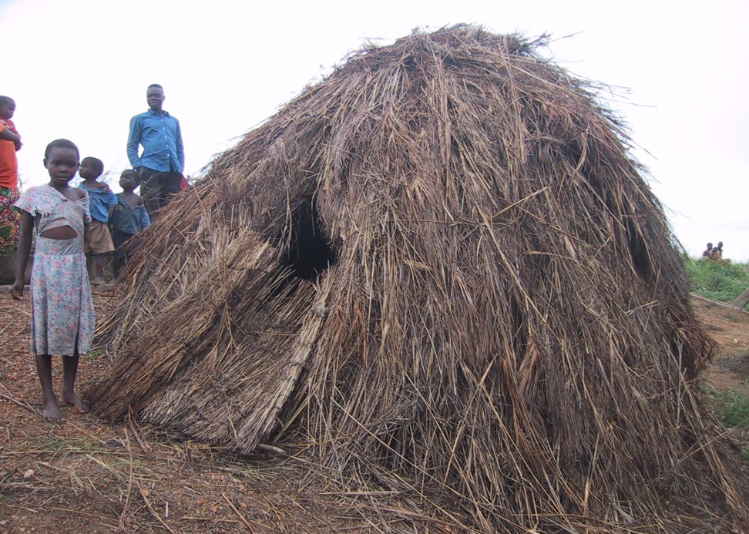
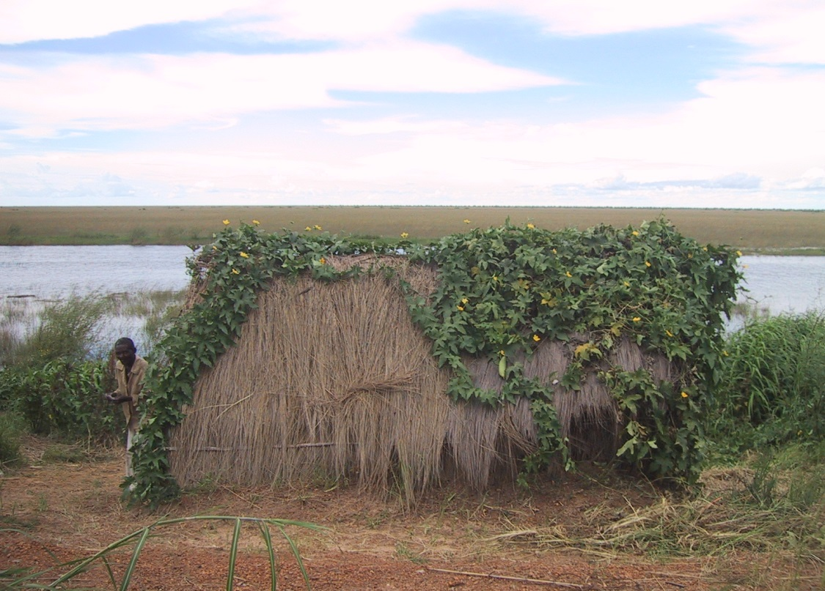
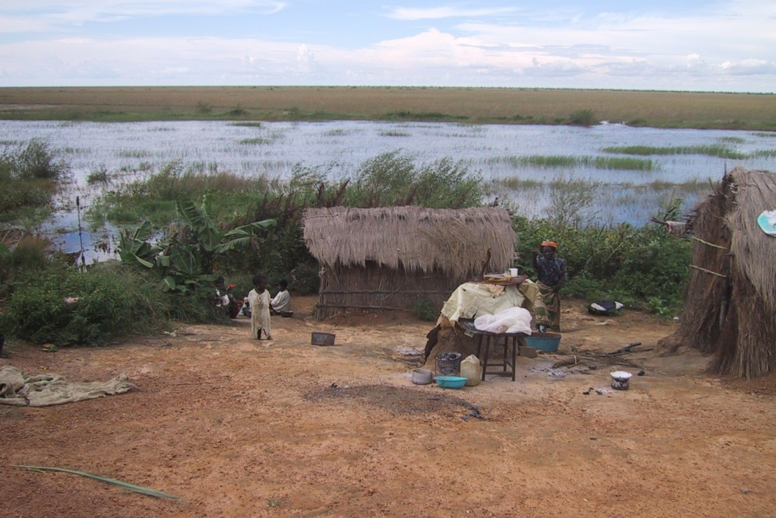
Temporal Fishermen Huts
Made of Thatch and poles, which can easily be transported at end of fishing season.

Slide 14
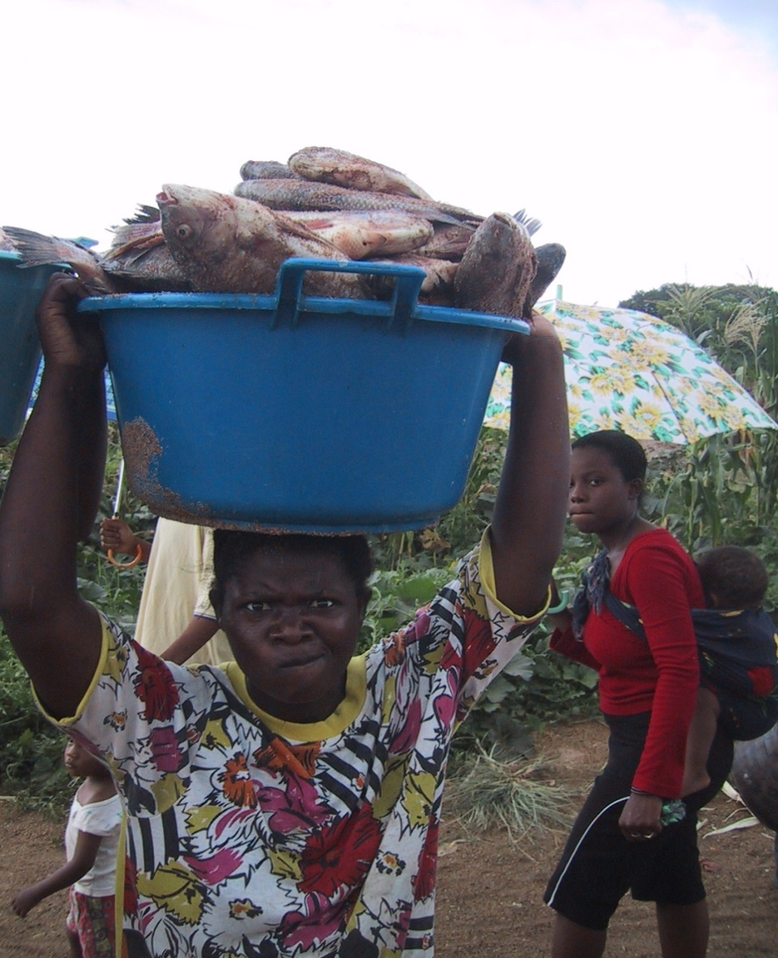
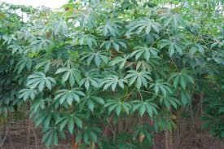
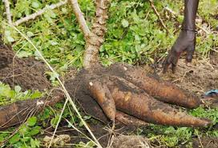
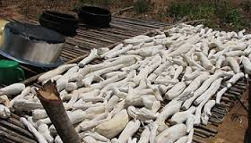
Staple foods of the Lunda People along the Luapula Valley
Fish and
Cassava

Slide 15
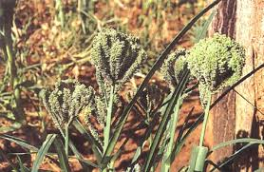
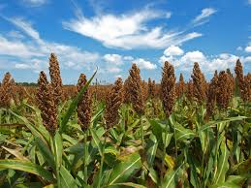

Staple foods of the Bemba on Chambeshi Plateau
Finger Millet and Sorghum

Slide 16
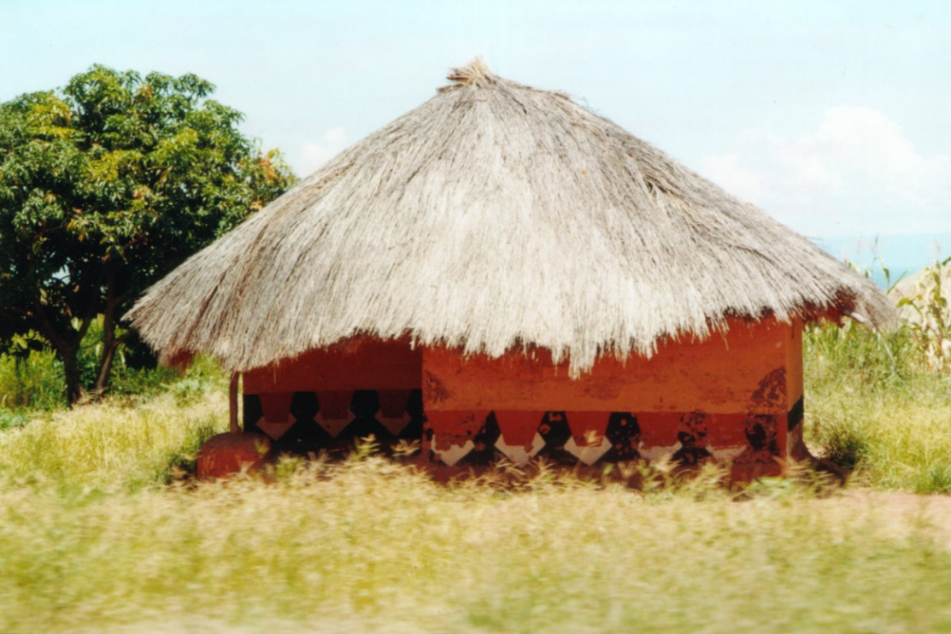
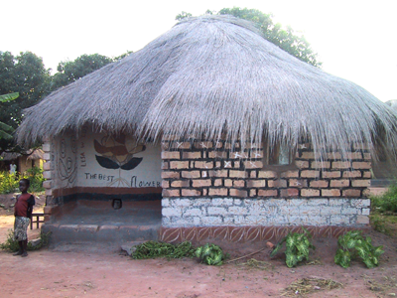
Village Layouts
Clusters on the Plateau but a Linear Village along the Valley (the Longest Village in South Central Africa approx. 200kms)

Slide 17
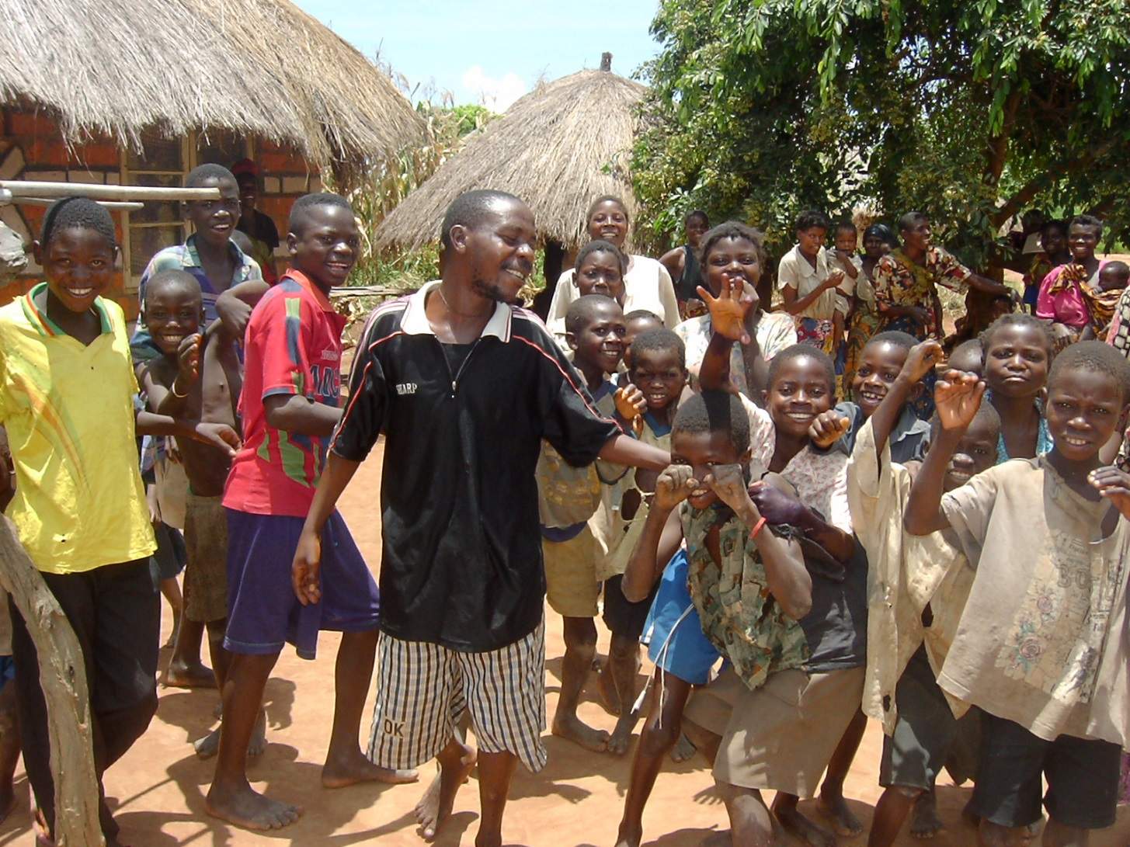
Open space usage and the introduction of the veranda

Slide 18
The Veranda and the Village Shelter (Insaka)
The Veranda
Historically people used round thatched pole and dagga huts
Missionaries introduced square houses made of Kimberley bricks (sun dried or fire baked clay blocks) in place of the traditional round huts
They also introduced rudimentary technology in form of beds, tables and other rectangular fittings
They introduced a veranda on the front facade

Slide 19
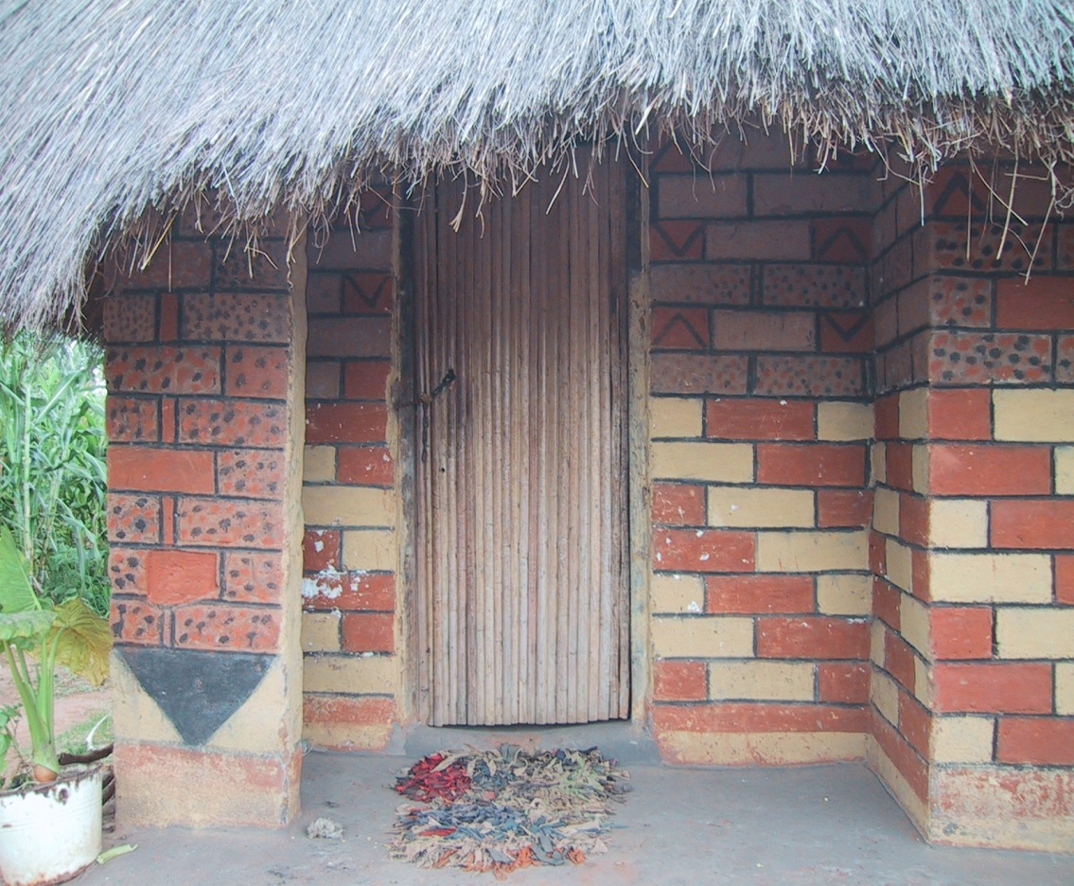
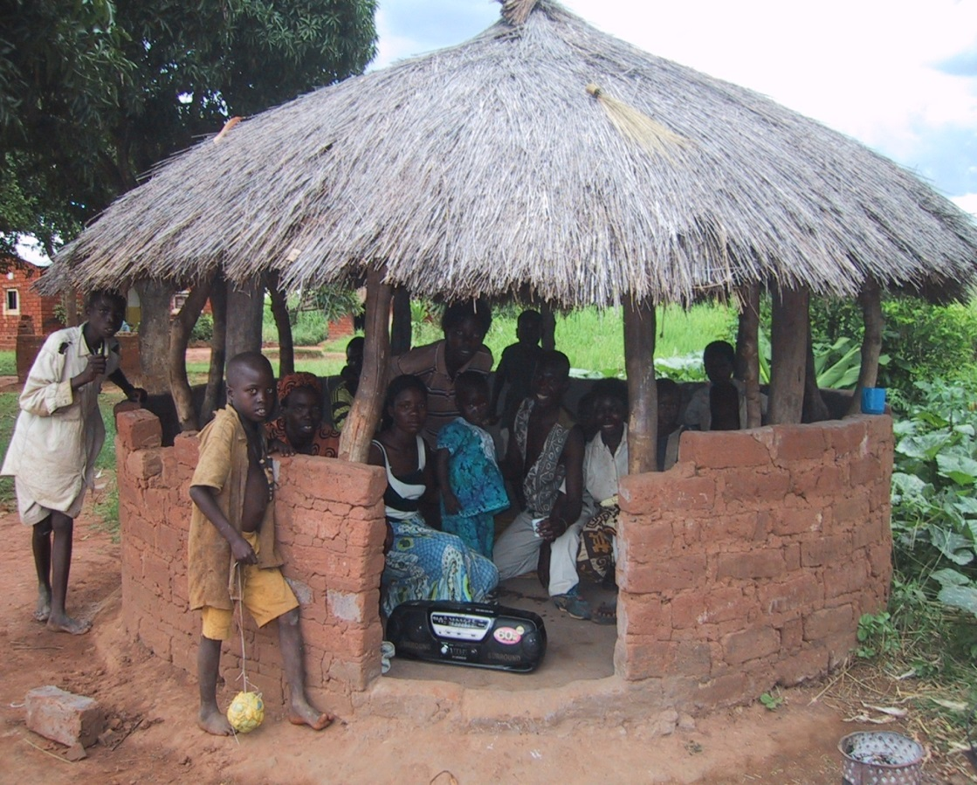
The village shelter (insaka) and the veranda
Modified insaka to the
House with a veranda

Slide 20
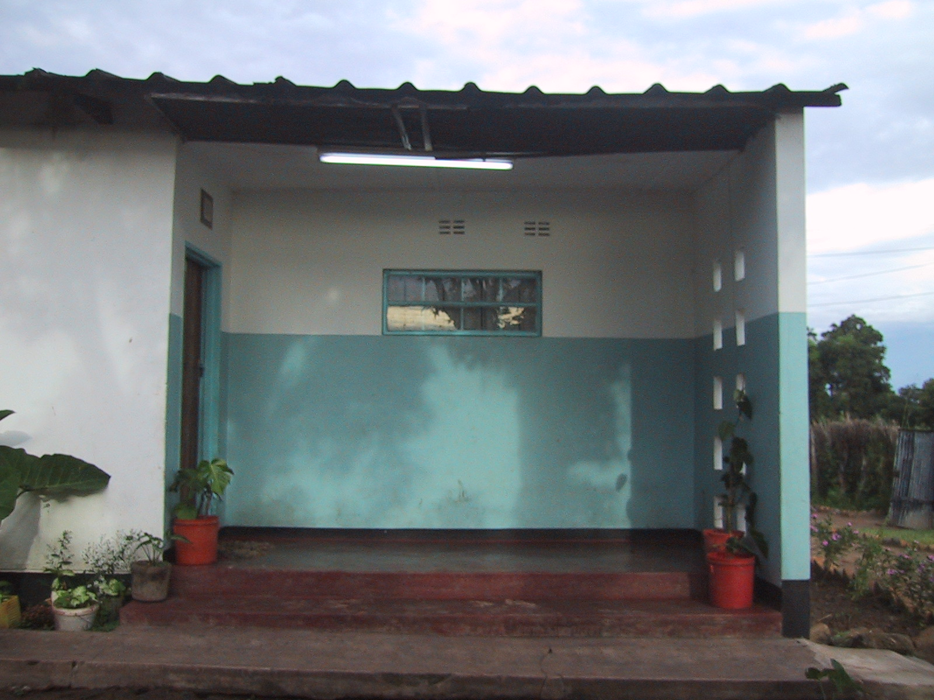
The veranda in a modern house

Slide 21
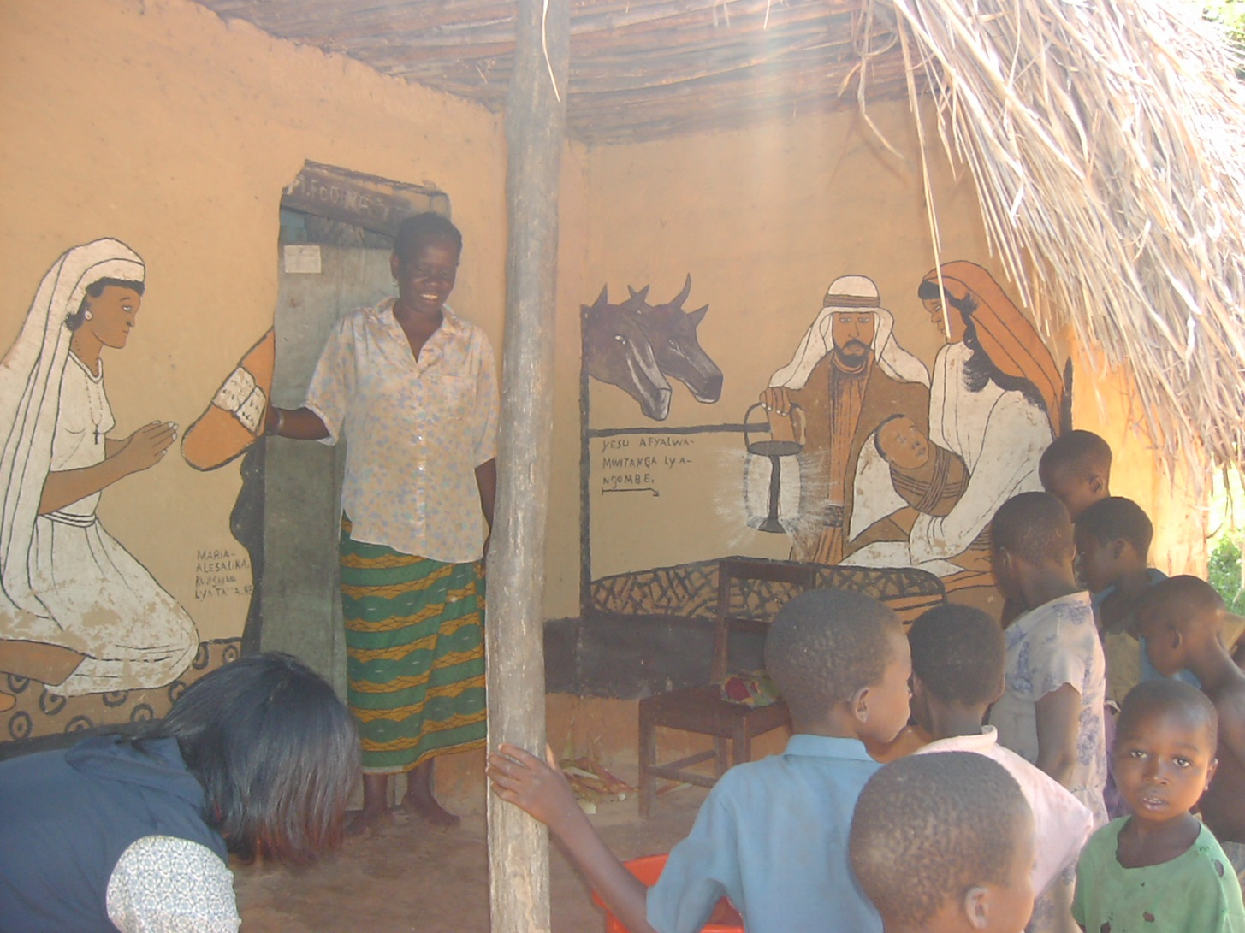
Various uses of the veranda

Slide 22
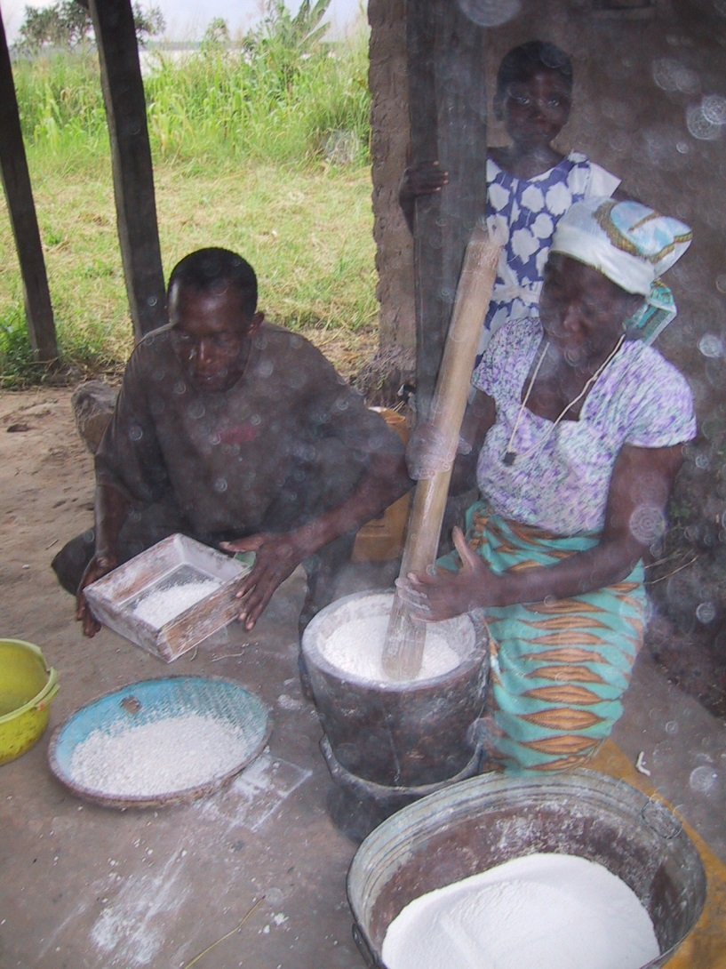
Various uses for the Veranda
The veranda became an important genderised aspect of a homestead
The relationship between veranda and surrounding aspects of the homestead was enhanced.
It became the main access to the homestead from a road.
Most Kitchen and insaka activities were shifted into the veranda
Cooking, grinding mealie meal, meeting friends and other social activities which had traditionally been done in the insaka were done on the veranda

Slide 23
Materials used
Rendering material;
Cassava flour paste; boiled to give a white colour and acts as a primer/ base
Tomato leaves; boiled in water, gives a green stain
Charcoal and ash; Crushed and in powder form give black and grey shades.
Some tree resins; Red, and Dark Brown stains
Earth; White, Yellow and Grey these are just mixed in water and are painted as natural colours

Slide 24
Understanding the Veranda
Research findings indicate that there renders were of three main types:
some were ordinary decorative renders;
others depicted myths and superstitious beliefs; while,
others still were part of the informal school.

Slide 25
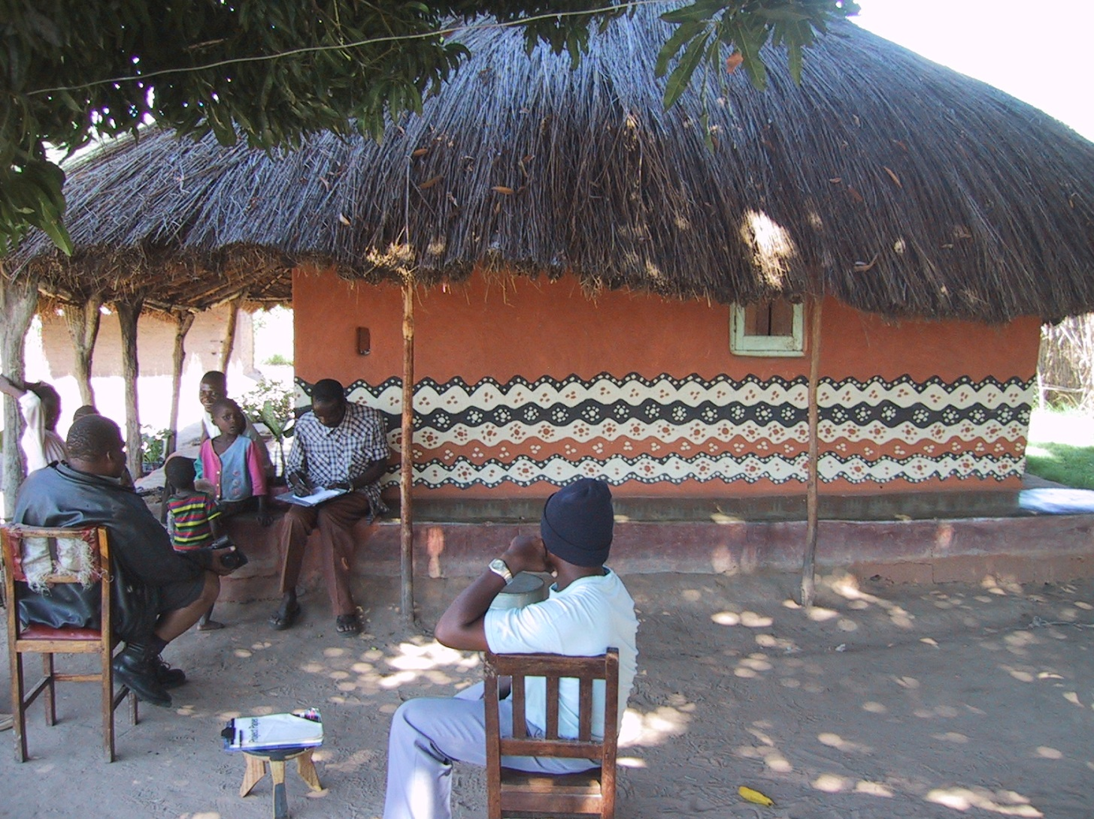
1. Ordinary Decorative Render

Slide 26
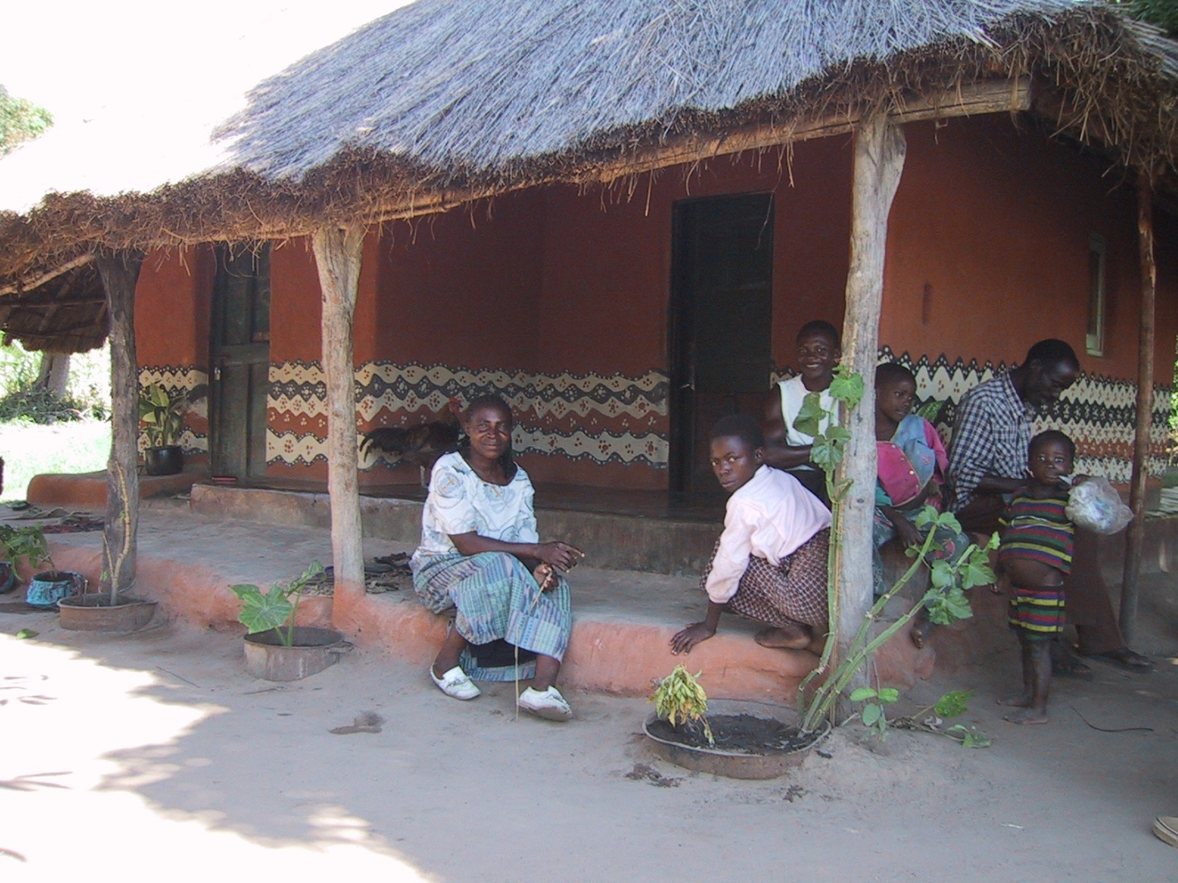
1. Ordinary Decorative Render

Slide 27
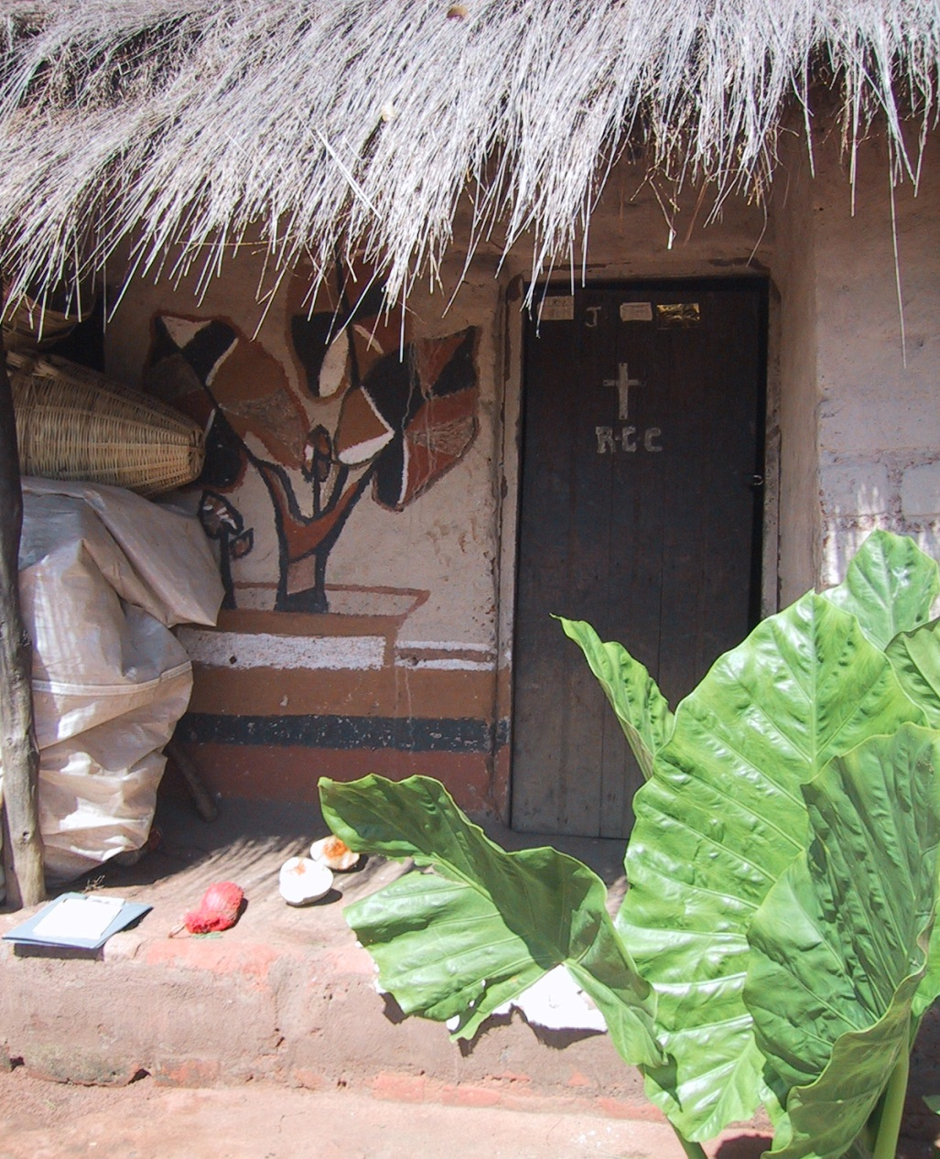
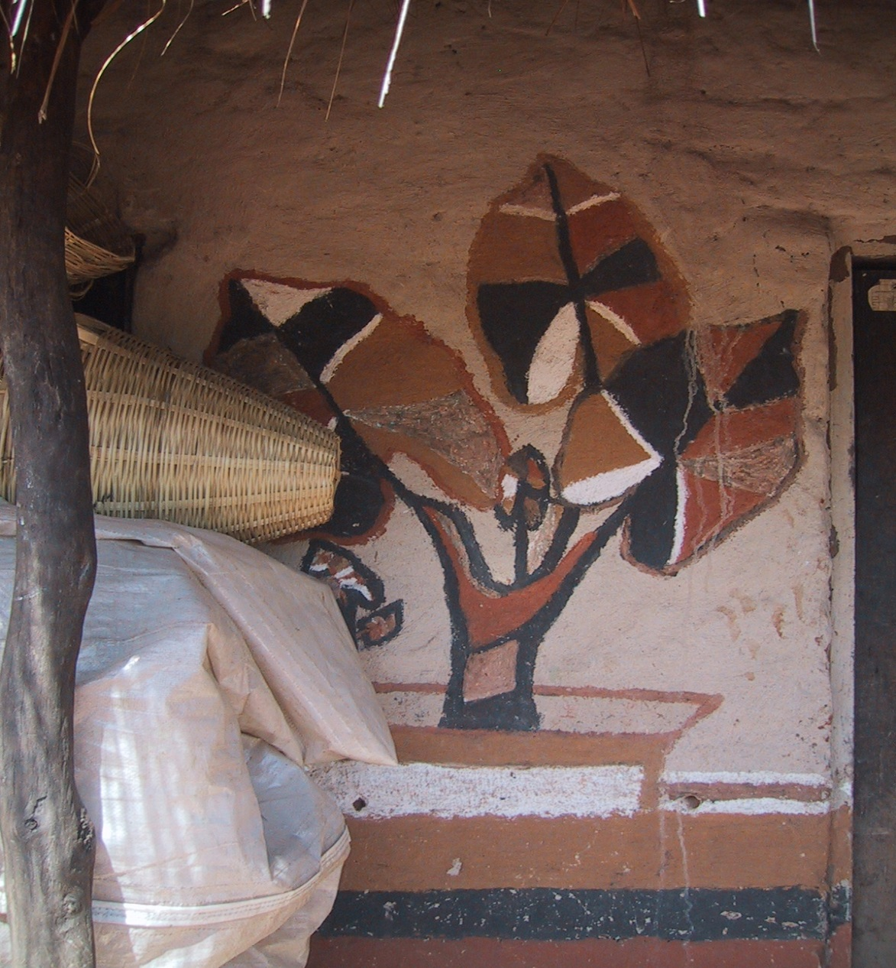
1. Ordinary Decorative Render

Slide 28
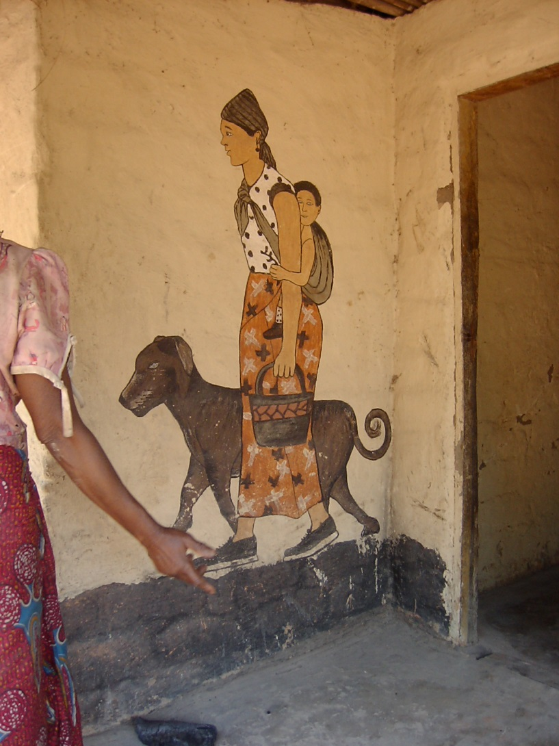
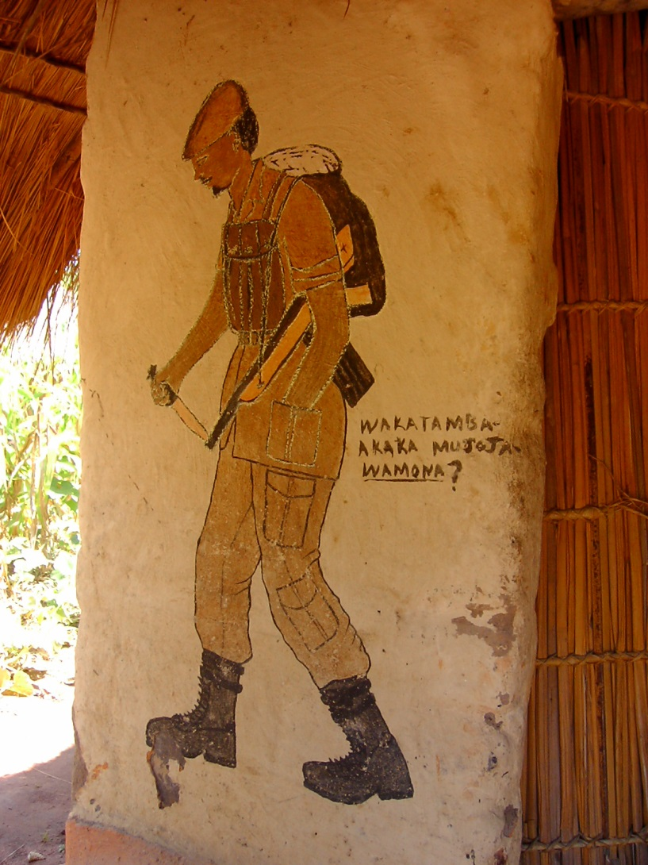
1. Ordinary Decorative Render

Slide 29
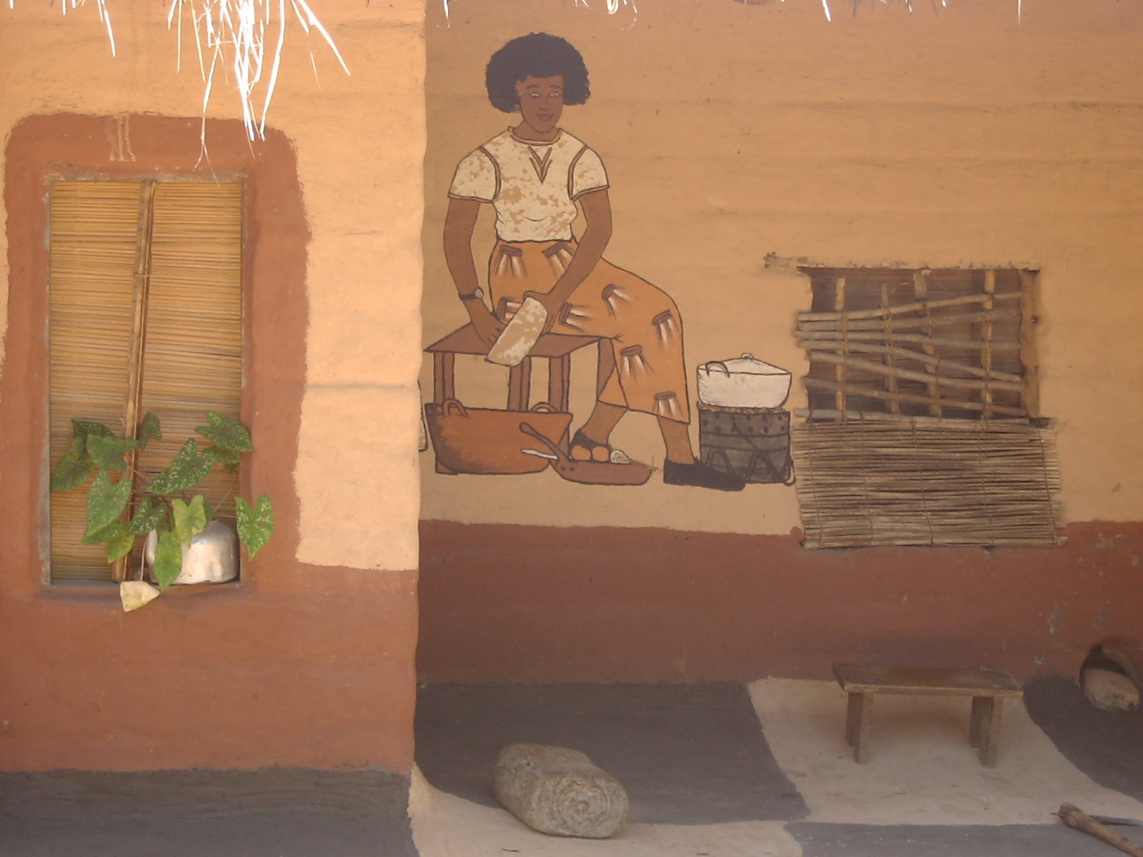
1. Ordinary Decorative Render

Slide 30
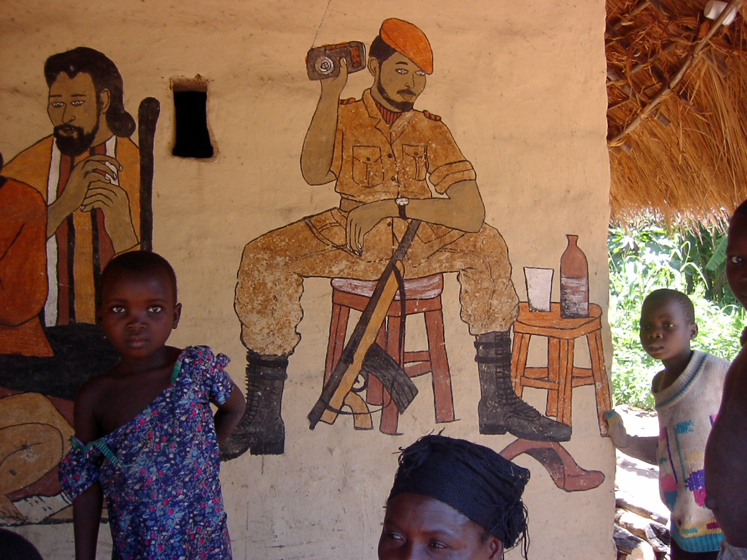
1. Ordinary Decorative Render

Slide 31
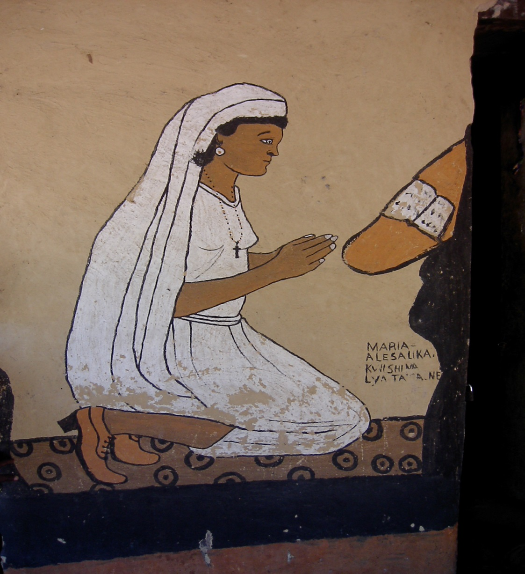
Biblical Render
The Virgin Mary deep in Prayer

Slide 32
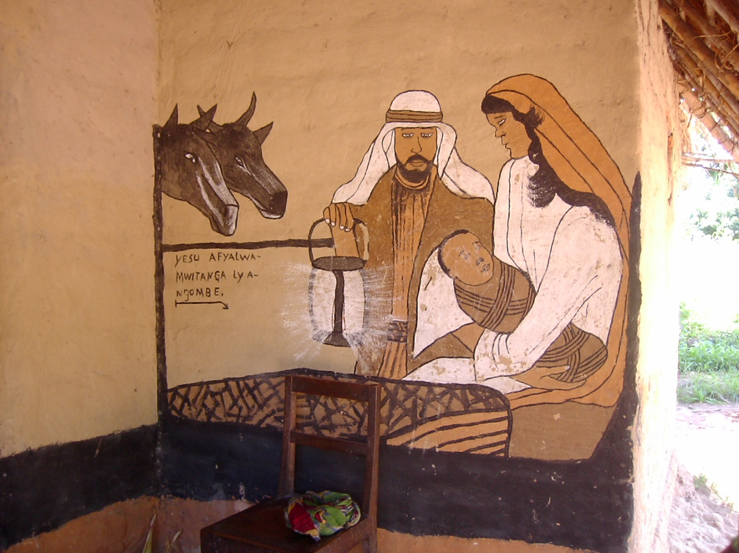
Religious Render
The Birth of Christ in a Manger

Slide 33
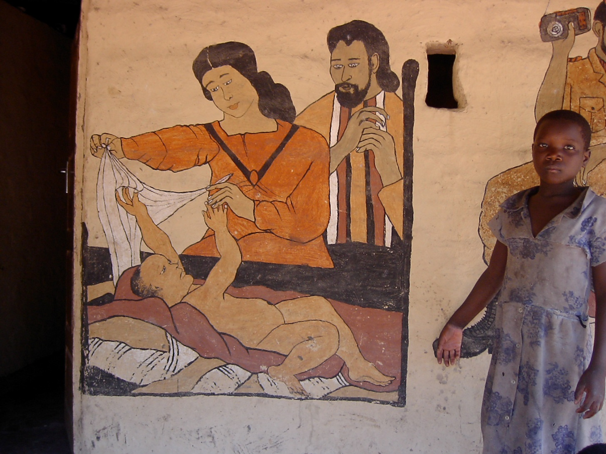
Religious Render
The Birth of Christ in a Manger

Slide 34
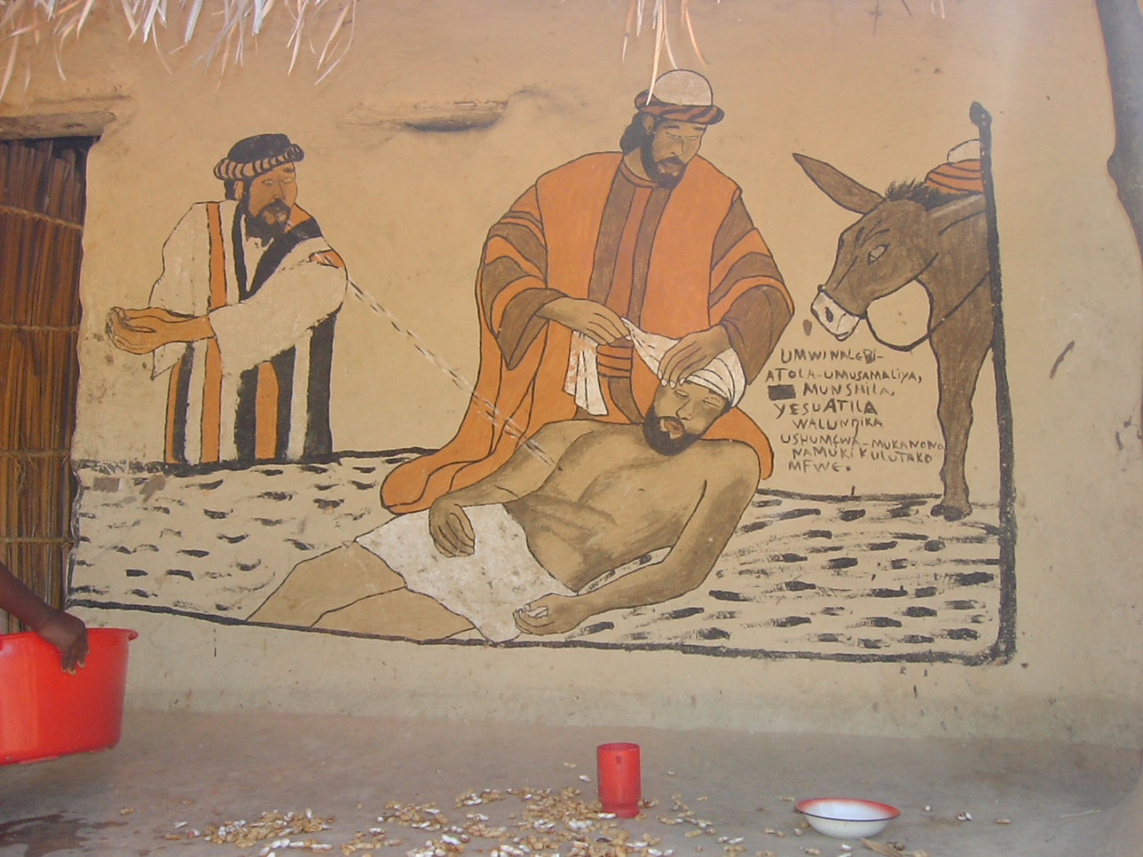
Religious Render
The Good Samaritan

Slide 35
2 Myths: the Mermaid
In Luapula valley mythology a mermaid goddess known by various names as ‘Isabi Muntu’ in Bemba and ‘Donna fish, (an English version).
She is believed to live in the rivers and lakes that abound the Luapula province. She is described as an extremely rich stunningly beautiful woman with a fair skinned and long flowing blonde hair.
Her beauty is so extreme it is supernatural.
She possesses unimaginable wealth and dazzling jewelry. She is shown with a snake coiled around her.
Since she is a goddess of wealth she is shown with a gold mirror and a golden comb.

Slide 36
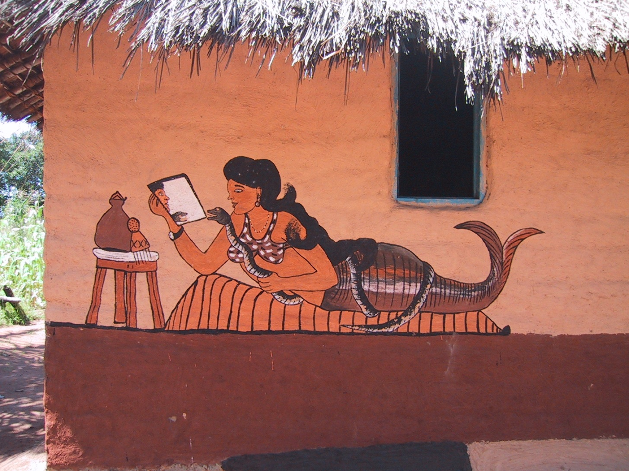
2 Myths: the Mermaid

Slide 37
2 Myths: the Mermaid
Like the European mermaids she is often combing her long hair while gazing into a golden mirror.
It is believed that if a man finds her at the water’s edge sunbathing, he could propose love and they wold become intimate
The 2 lovers would then be meeting at a secret rendezvous at pre-arranged times.
She would then endeavour to make him very wealth.
Unfortunately if there was any signs of infidelity, she would destroy all competition including her lover.

Slide 38
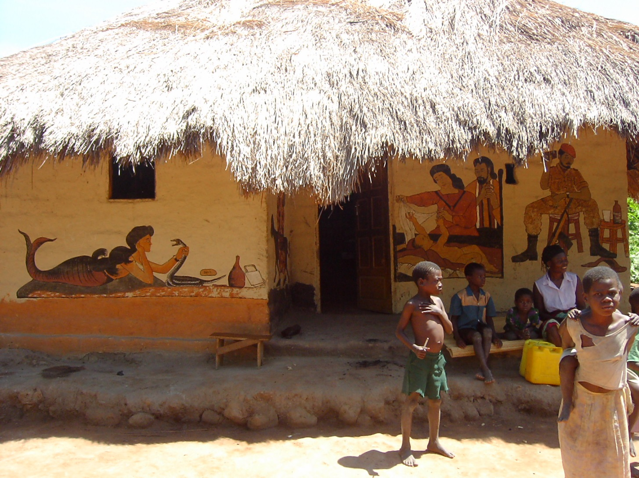
2 Myths: the Mermaid

Slide 39
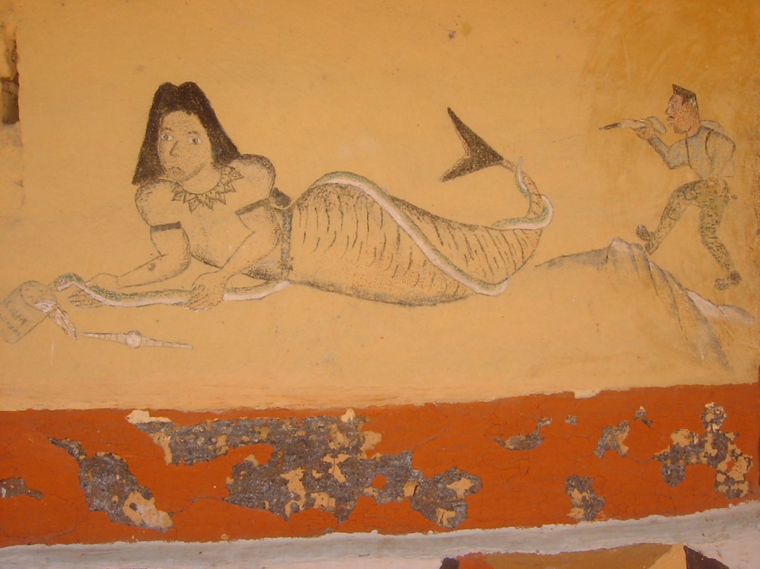
2 Myths: the Mermaid

Slide 40
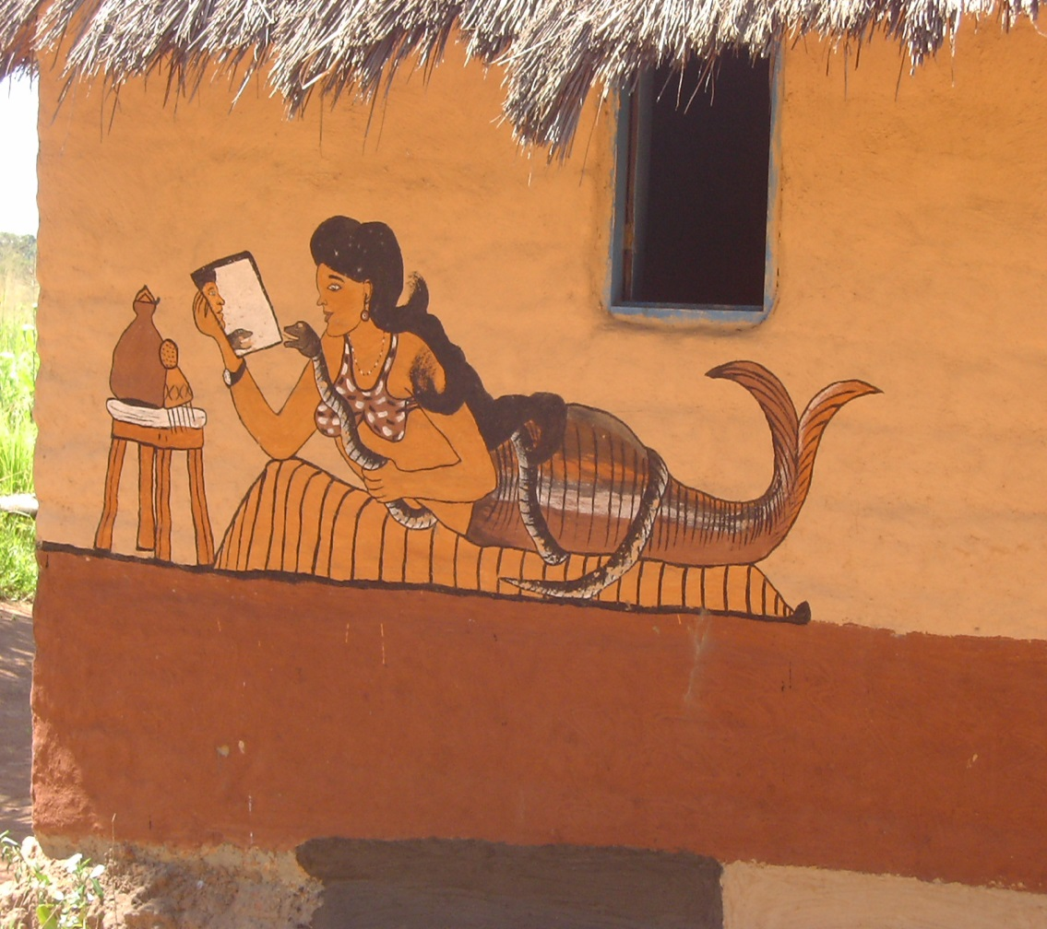
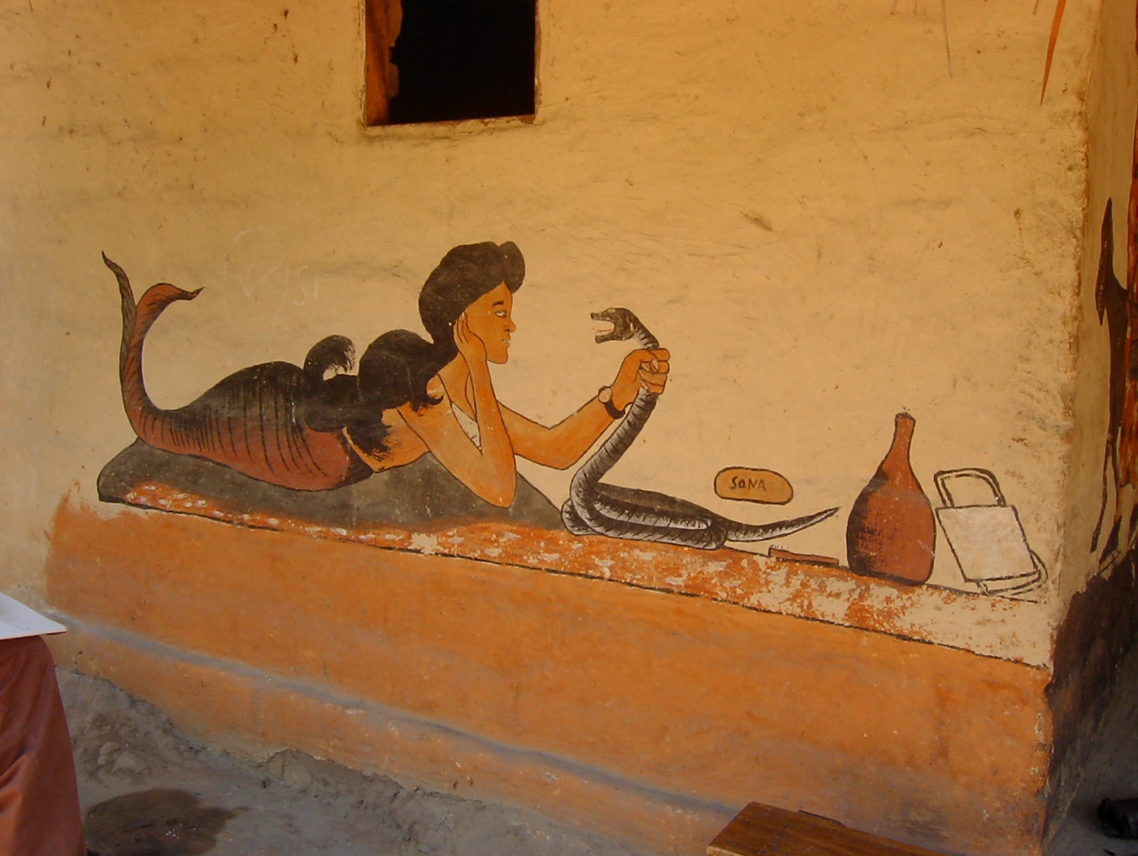
2 Myths: the Mermaid
A Caucasian lady of unimaginable beauty, great fury and jealousy. Always depicted with a mirror for self admiration; a bag of money=wealth; snake=ability to destroy competition and mischievous lover

Slide 41
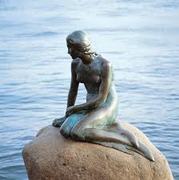
Myths from elsewhere: The Little Mermaid of Copenhagen, Denmark
Unveiled on 23 August 1913, The Little Mermaid in Coppenhagen was a gift from Danish brewer Carl Jacobsen to the City of Copenhagen.
The sculpture is made of bronze and granite and was inspired by Hans Christian Andersen ‘s fairy tale about a mermaid who gives up everything to be united with a young, handsome prince on land.
Every morning and evening she swims to the surface from the bottom of the sea and, perched on her rock in the water, she stares longingly towards the shore hoping to catch a glimpse of her beloved prince.

Slide 42
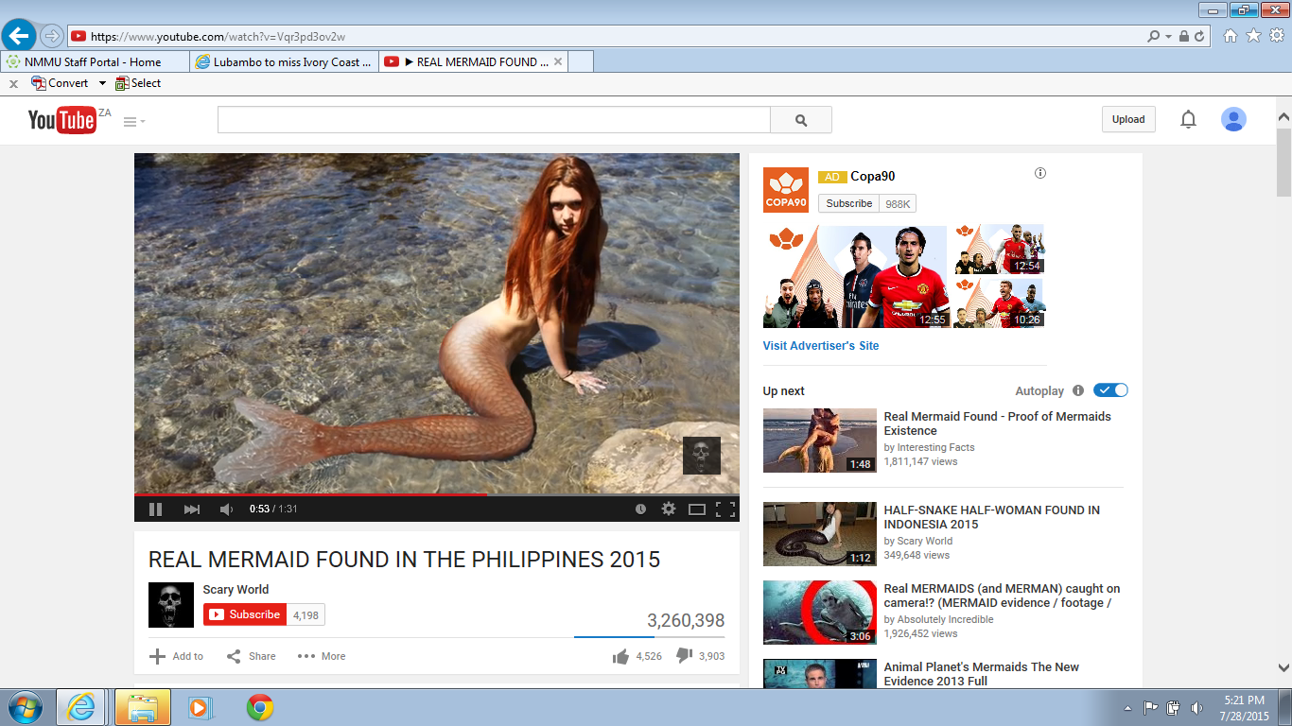
Myths from elsewhere-Phillipines

Slide 43
3. The Informal School
2 Stage informal school for women
At Puberty
A woman is trained to look after her body as an adult.
At Engagement
A woman is trained to care for her family and (husband and children)

Slide 44
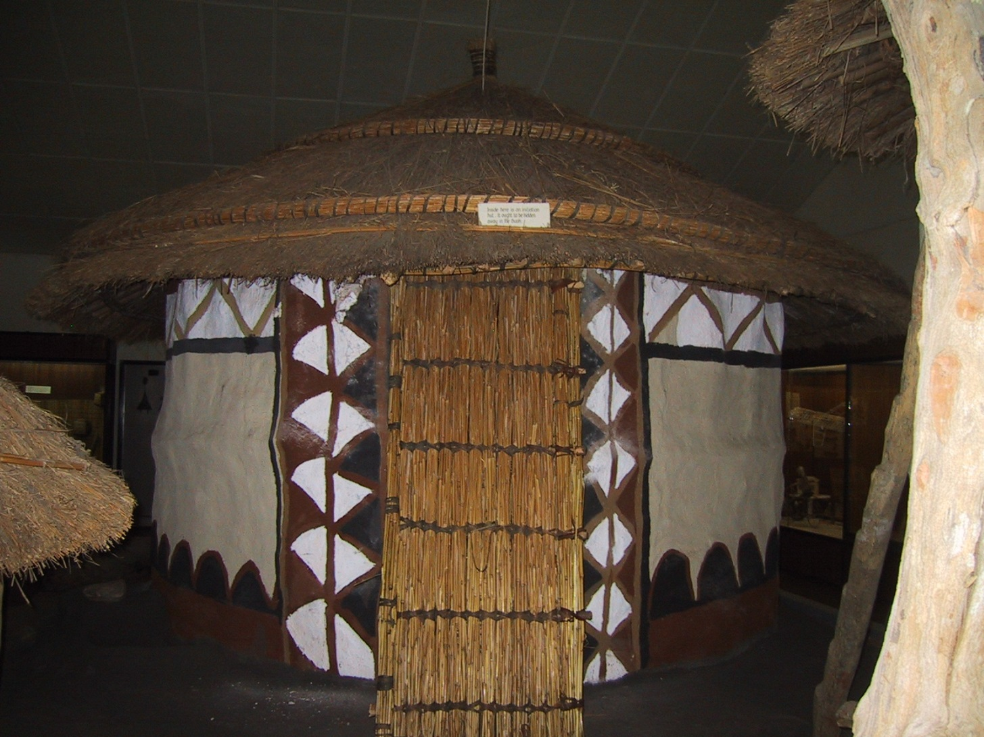
3. The Informal School
The Training Hut

Slide 45
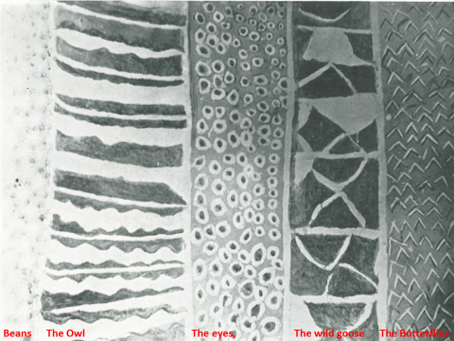
3. The Informal School
At Puberty

Slide 46
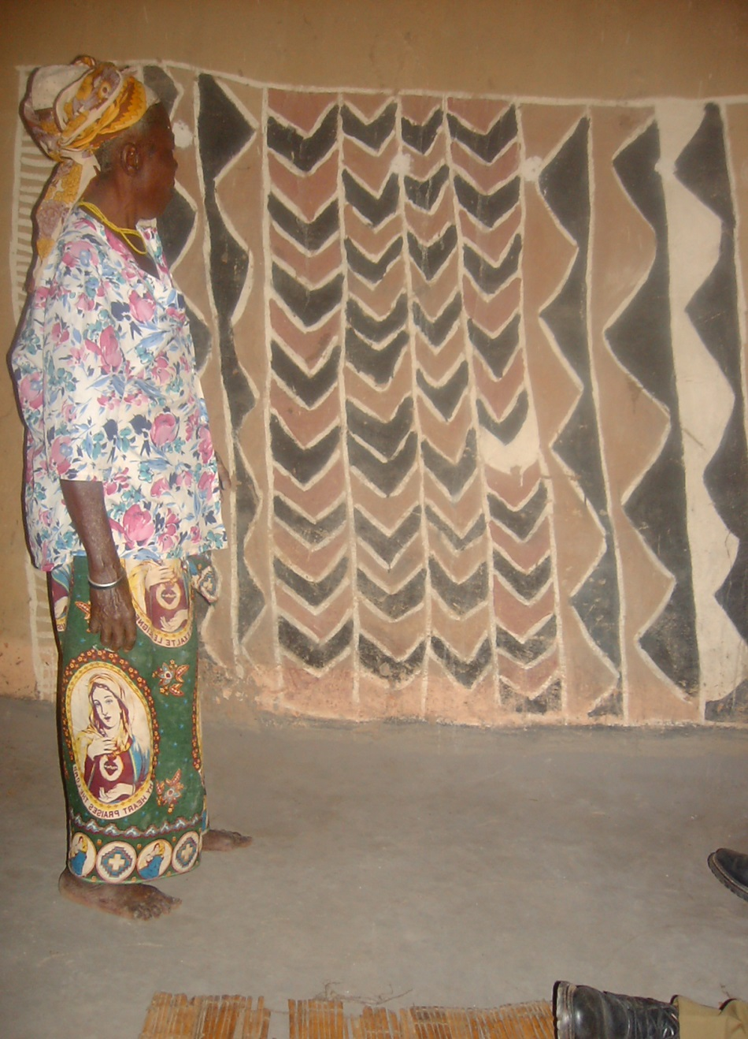
3. The Informal School
At Engangement: the ‘Lecturer’

Slide 47
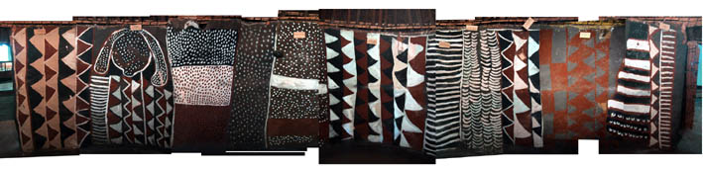
An Interpretation of symbols used at Engagement
Taken from the Motomoto Museum-Mbala
← 9. Nsalu yakwa mukolo
← 6. Mu chilwa somone
← 11. Misango misango
← 7. Nsalu yabalala
← 3. Mushintililo
← 10. Chishimba
← 8. Intanda
← 5. Munkoloto
← 4. Kasengele
← 2. Bacipelelo
← 1. Likumbi
The patterns in blue can easily be identified with the ones that were used by the Lecturer’

Slide 48
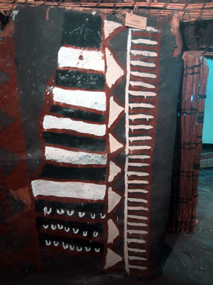
1. Likumbi
The Cloud

Slide 49
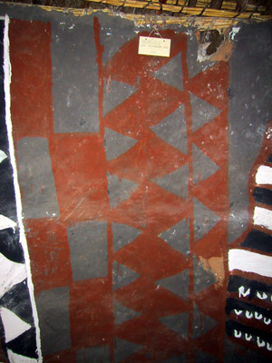
2. Bacipelelo
Uncultured Women

Slide 50
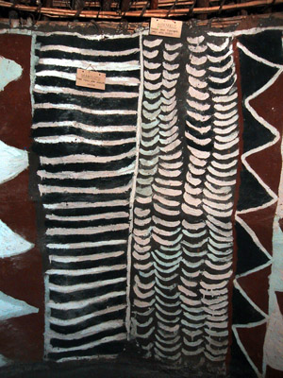
4. Kasengele
The Sleeping Mat

Slide 51
5. Munkoloto
The useless Husband

Slide 52

8. Intanda
The Stars

Slide 53

11. Misango misango
Unacceptable behaviour

Slide 54

The Next time you see something like this in Central/ Southern Africa………………??

Slide 55
The Problem
The first is that:
Natural renders rely on inherent qualities of natural ingredients to act as binders, fillers, and pigments;
When exposed to weathering elements, they do not last very long and need replacement after about 2 rainy seasons; and,
However those that are protected by elongated eaves or painted in covered verandas do last much longer.

Slide 56
The Problem
The second is that:
Traditional renders are regarded as primitive decorations even by rural people themselves and ignored.
Everybody including the villagers themselves feel to be modern they have to associate themselves with the use of polyvinyl acetate (PVA) paints and binders, which are unsustainable and bad to the environment

Slide 57
The Problem
The third is that:
Their use in traditional or modern architecture is not being promoted.
The little available knowledge about the symbolic meaning is also not properly disseminated.
There has so far been no research done to improve the binding quality of these natural renders.
Consequently, this is part of the African heritage is dying out with their custodians and may soon be lost.

Slide 58
Conclusions
Receding Traditions when lost will mean the loss of part of our heritage
Despite being proved to be sustainable render styles, not much is being done to promote this kind of rendering, instead it is being abandoned for more unsustainable petrochemical or synthetic based paints.
Since these natural renders do not last very long more research is needed to make these paints last longer, as a higher turnover may also become unsustainable if the communities are large.

Slide 59
References
Burton, W. (1961). Luba Religion and Magic in Custom and Belief. Tervuren: Musée Royal de l'Afrique Centrale.
Chief Makasa, Makasa’s Village , Kasama, personal Interview taken 2003
Chola Chikapwa, Makasa’s Village , Kasama personal Interview taken 2003
Denyer, S (XXX) African Traditional Archtecture
Hecht, David. 1990. "Mermaids and other things in Africa," Arts Magazine, 65/3: 80-86
Motomoto Museum, Mbala visited , March 2003
Schmetzer H. (XXX), Traditional Architecture in Zambia.

