Slide 1
The architectural curriculum of the 4th Industrial Revolution towards sustainable smart communities
Yashaen Luckan (Ph.D)
University of Kwa-Zulu Natal, Durban, South Africa, luckany@ukzn.ac.za

Slide 2
Problem Statement:
The 4th Industrial Revolution has afforded great potential for the advancement of cities, however, the healing of the scars of apartheid continue to be compromised by historical / conventional ways of thinking and practice, thereby compromising socio-economic redress & spatial transformation.
Critical Question:
How can the smart city concept spatially transform the apartheid city?

Slide 3
AIM:
The aim of the paper is to define the characteristics of a 21st century architectural curriculum that promotes thinking and practice towards socio-economic redress & spatial transformation

Slide 4
Limitations of the Historical curriculum
historical curricula and pedagogic approaches.
The early evolution of formal architectural -socially mediated behaviours based on predefined rules, norms and standards.
This model developed in the silos of academia
mid-18th century academies during the Renaissance period in Europe; the Beaux-Arts studio (atelier) pedagogy.
The pupillage system in Britain.
The worthiness of learning within this social behaviourist approach depended entirely on the observations of external representations / images of social success; there was no intrinsic consideration of the social context nor the lived experiences of the student.

Slide 5
The advent of modernism, albeit with noble ideologies, suffered the consequences of massification and standardised industrial approaches which surfaced during the industrial revolution.
This was followed by the post-modernist period in architecture which referred back to canonic works – these two paradigms significantly shaped the twentieth century evolution of architectural education.
Formal education would progress upon reliance of the great intellectual works which were located within defined disciplines. Knowledge generation would continue to develop within disciplinary confines, housed in formal institutions, which transcended historic periods, geographic location, culture and social nuances among others. This system was known as intellectual traditionalism (Shubert 1997).

Slide 6
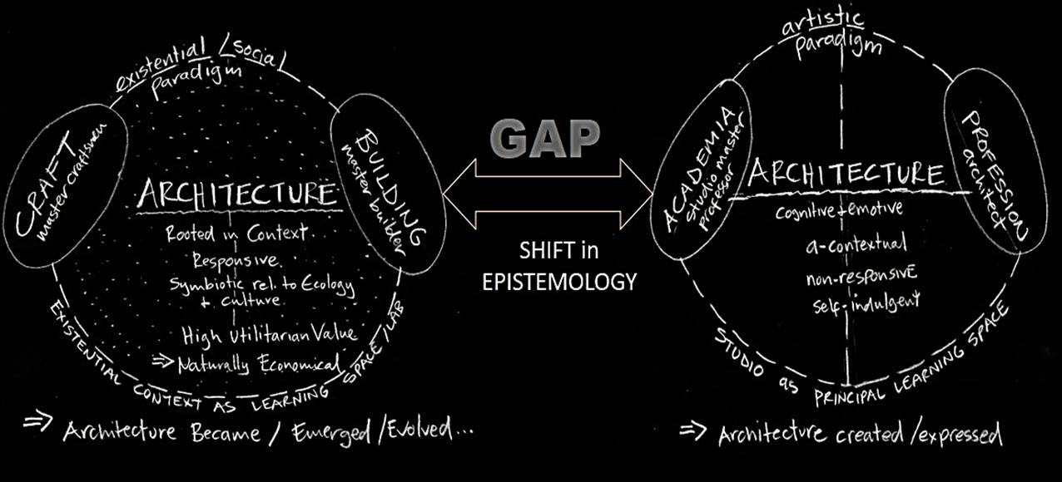
Higher Education CONTEXT – from SOCIETY to SILO
SOCIETY
Pre 17th century
SILO
Early 17th century

Slide 7
modern education = globalising modernity.
education –a form of social engineering within controlled & confined disciplinary thinking – an industrial pedagogic approach.
This paradox of modern education - failed to prepare students for a future that asks very different questions of humanity (Bussey 2010.

Slide 8
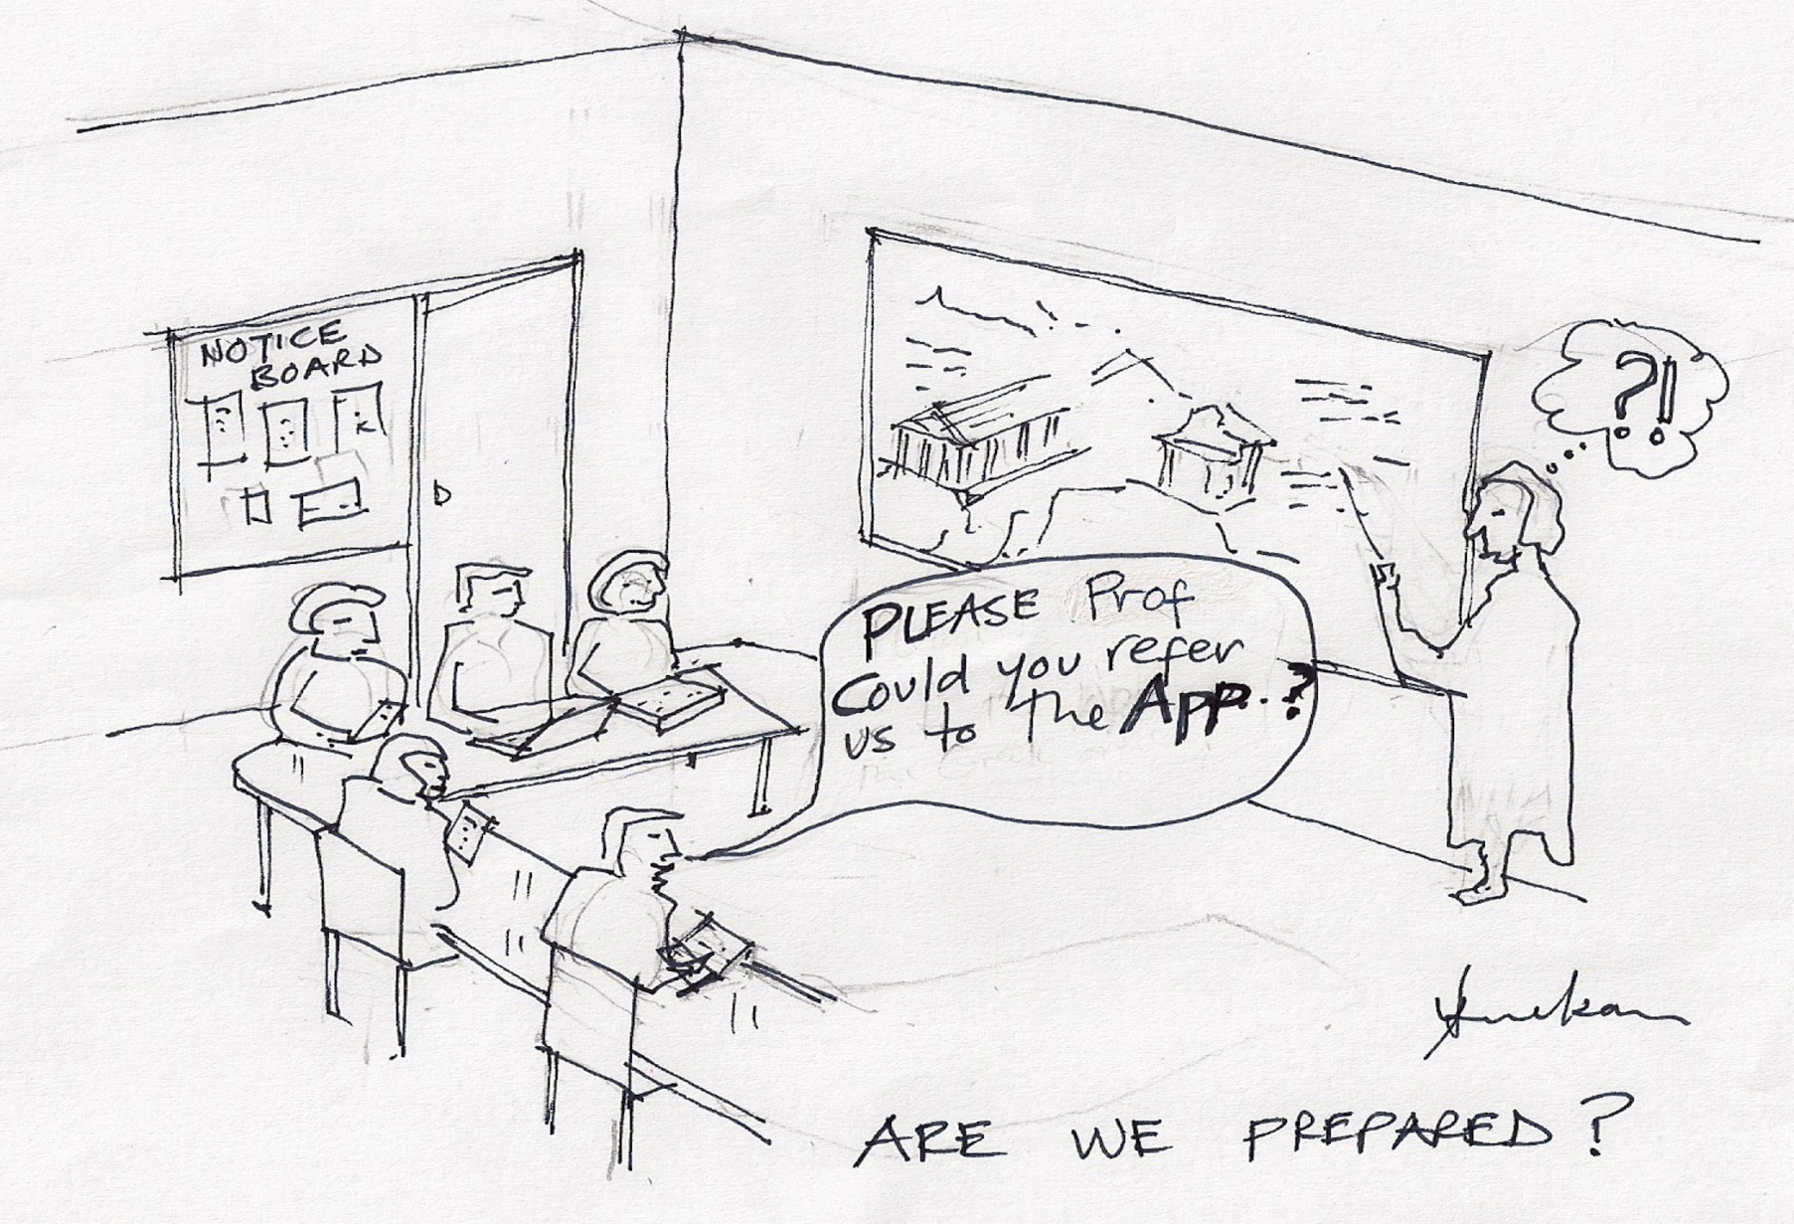

Slide 9
The built environment in South Africa has, however continued to perpetuate traditional ways of learning, thinking, designing and building
“missing middle” a large proportion of experienced and skilled persons – pedagogically excluded severely compromising spatial transformation and socio-economic redress.
The 4IR could play a significant role in opening up access to these persons for professional articulation through upskilling; thereby enhancing their employability.

Slide 10
It is argued that the healing of past injustices through redress and spatial transformation can only be successful by including the multiple, intelligences, experiences and cultures of historically excluded people, many of whom practice architecture within their communities…
critical knowledge through lived experiences and resilience in difficult socio-economic contexts.
Support a curriculum for social justice through critical reconstruction.
The author therefore argues for a responsive curriculum based on flexibility, adaptability and inclusivity – an agile curriculum for the 4IR.

Slide 11
An alternate, agile curriculum for the development of smart citizenship in South Africa
The author postulates the concept of smart citizenship = inclusive and integrated system of progressive utilisation of resources wherein the advancement of human potentiality forms the core of the new smart city.
inclusivity for architectural education in order to respond to socio-economic redress and spatial transformation within the paradigm of the 4IR in South Africa.
principles: experiential learning; disruption for reconstruction; education for sustainable development and eco-systemic thinking.

Slide 12
Experiential Learning for Reconstruction.
Mode 1 type of knowledge production (Gibbons et al 1994). Historical modes of curriculum and pedagogy have been confined to formal learning within institutions of higher learning, discipline, canon, scientific methodology, norms and judgement of what constitutes sound practice -
Mode 2 (Gibbons et al 1994) - trans-disciplinary practice, heterogeneity and transience; affords access to a broader range of participants into the process of inquiry and innovation.
Knowledge generation and critical responsive practice – culture, history and geographical influences therefore shape knowledge generation.
Within Mode 2, pedagogic inclusion, not exclusion is necessary to stimulate innovation through a clash of ideas.
Shubert (1997) refers to the hidden curriculum whereby the social relationships between participants in learning, students, teachers and members of society alike, construct and refine the character of students and, therefore, learning.

Slide 13
Disruption
responsive positive action against unjust geo-political, social and economic constraints for the socio-economic emancipation of historically marginalised societies.
redress and spatial transformation require innovative approaches to design thinking and spatial development through a process of inclusive critical engagement
clash of ideas is necessary to spark innovation (Johansson 2017) .
The development of smart citizenship requires that the very spaces of learning be disrupted in order to allow pedagogic access to historically marginalised groups.

Slide 14
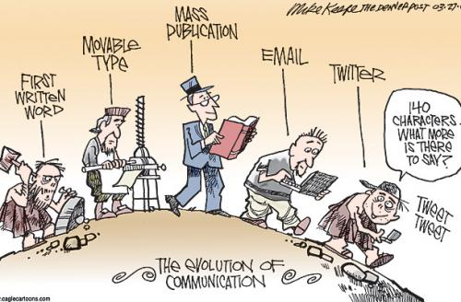
What are the implications of information technology and social networking on Pedagogic Access?

Slide 15
4IR affords opportunities for learning, upskilling and innovation beyond the confined controls of state or institutions.
4IR disruption of hegemony which has freed up knowledge resources – open science, MOOCS etc.

Slide 16
This paper asserts that it is not anymore up to the will of the institutions to allow pedagogic access; the 4IR has opened up the knowledge society to all that have access to data.
Neither pedagogic exclusion nor geographic distance are impediments to learning within the paradigm of 4IR.
This paper argues that this disruption by breaking the artificial boundaries of learning will advance innovation by widening pedagogic access in order to give effect to a contentious clash of ideas of the intellectual traditionalists with those of the lived experientialists. The author therefore proposes the second principle as experiential learning for social reconstruction.

Slide 17
diversity and multiculturalism by placing high value on contextually situated learning and shared experiences. John Dewey, promulgated this type of engaged learning paradigm which placed high value on real life experiences, criticising schooling for being exaggerated rather than supplementary to the ordinary course of living.
Critical reconstruction (Shubert 1997) –activism against unequal privileges, power, dominance and social injustices.
auto-ethnographic reflection towards effecting transformation in society. The approach is fundament on conflict / clash, which brings inquiry and action together.
It is essentially about intellectual emancipation through access to resources which exposes citizens to the global knowledge society without the administrative and pedagogic gatekeeping that characterises formal education.

Slide 18
4IR provides - opportunities for the stimulation of small, medium and micro enterprises (SMMEs).
Built environment Curriculum needs to respond – an agile curriculum is required.
Redress & Spatial Transformation - people form the core.
Advancement of societies by free access to resources where learning, upskilling and exposure to different economic opportunities are readily available.

Slide 19
Education for sustainable development
neo-humanist ideology by advocating the freeing of human potential from the limitations of local cultures while, at the same time, not losing the core essence of such local culture.
cannot be founded on geo- or socio-sentiment (Bussey 2010: 10
structural limitations, imposed by the weight of their own histories, compromises the sustainability of education impeding the ability to transform in response to contextual changes.
IT revolution on education = numerous possibilities of engaging with the global knowledge society despite one’s own geo or socio location.
critical role of education as a function of culture Bussey (2010)
a systems thinking approach may provide a valuable point of reference.

Slide 20
Eco-systemic thinking
The idea of deep eco-systemic thinking is related to the iceberg model developed by Goodman (2002).
Prevalent models of education are generally reactionary to the symptoms / events that are most apparent; a trend since the first industrial revolution –skilling for industrial production.
fundamental, deep layers of the societal problems which lie “beneath the surface” of what is evident.
pedagogic exclusion is a structural problem based on mental and socially conditioned attitudes that are fundament on apartheid segregation and labour division.
How then can redress and spatial transformation be achieved through education?

Slide 21
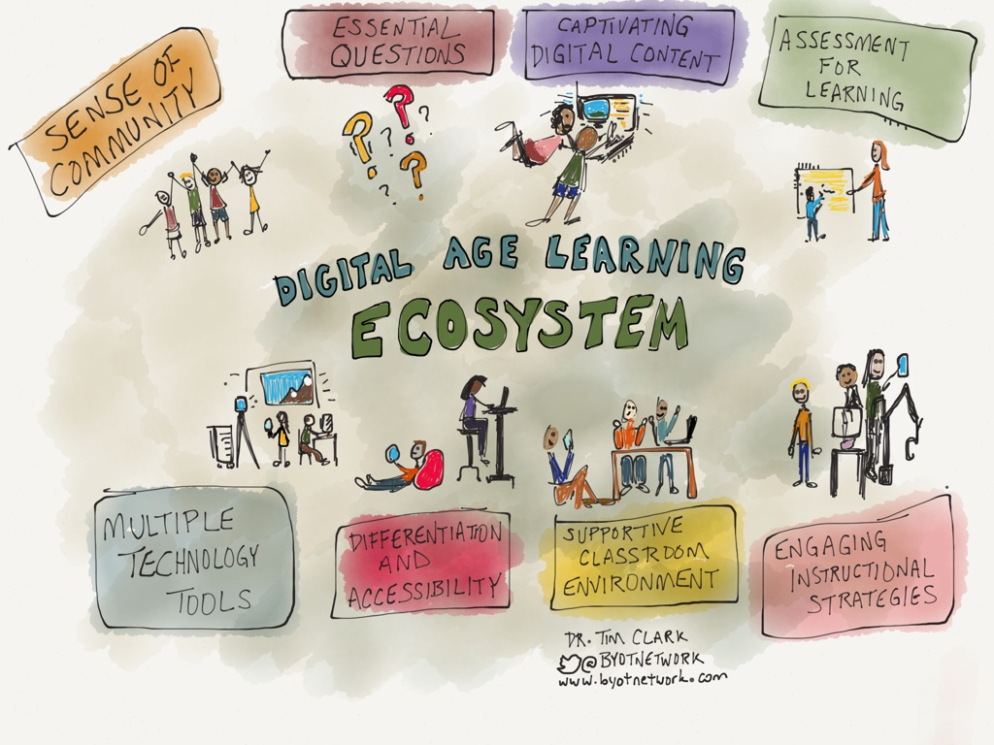

Slide 22
A Curriculum Revolution is required:
AGILE CURRICULUM = innovation emerges from collective consensus through the constructive clashes of many intelligences and experiences / layers of human existence – the kind of disruption that is possible through the technological advancements of the 4IR.
a 21st century Pedagogic Space between the Virtual & Physical domains; between Intellect & Artificial Intelligence
promote design thinking based on empathy, supported by clearly defining the design problem / challenges and engaging in an iterative process of reflection and ideation.

Slide 23
The 4^{IR} has a lot to offer in this regard – virtual reality, simulation software and 3D printing offer opportunities for design testing prior to construction; this is yet to be fully realised in the built environment in South Africa.
+
innovative ways of making and building by incorporating IOT and 3D printing – imagine what a construction project may look like in this paradigm. What are the skills / professional competencies demands of the 4IR?

Slide 24
PROPOSITION
Investment in resources for smart citizenship will advance the potential of societies for socio-economic redress and spatial transformation - this is the hidden potential for smart cities and a smart curriculum.
The free city and open science - bring education and opportunities to society by breaking the barriers of distance and pedagogic access.
Within the context of a developing economy recovering from the scars of apartheid, systems thinking may solve economic hardships in disadvantaged communities. eCommerce, can easily facilitate the implementation of disintermediation whereby, for example, shopping malls, typically accommodating large multinationals could be replaced by smart SMMEs located within historically disadvantaged communities.
The economic sustainability of historically disadvantaged communities can therefore be achieved through the stimulation of new business and entrepreneurship rather than dependency; this could change a consumerist type of behaviour to that of entrepreneurship and business creation.

Slide 25
The Myth of Distance will be overcome by Pedagogic access – that’s the potential of the paradigm of the 4IR
Challenge - relatively high cost of data, which must be urgently addressed, else education and practice will be business as usual to the detriment of redress and spatial transformation.

Slide 26
References
Bussy, M. 2008. Neohumanism and Education for Sustainable Development. Paper delivered at the Neohumanism Educational Futures Conference. Ydrefors, Sweden. 12-14 July 2008.
Bussy, M. 2010. Education for Liberation: A Corner Stone of Prout, In Understanding Prout, Essays on Sustainability and Transformation. 1:1-27.
Gibbons, M., Lemoges, C., Nowotny, H. Schwartsman, S., Scott, P. and Trow, M. 1994. The New Production of Knowledge: The Dynamics of Science and Research in Contemporary Societies. California: Sage Publications
Goodman, M. 2002. The iceberg model. Innovation Associates Organizational Learning. Hopkinton, MA. (online). Available: http://www.ascd.org/ASCD/pdf/journals (Accessed 15 February 2019)
Howarth, T. 1959. Background to Architectural Education. Journal of Architectural Education. 14(2): 25-30.
Johansson, F. 2017. The Medici Effect. Boston: Harvard Business School Press.
Krutka, D. G, & Carpenter, J. P. 2016. Participatory learning through social media: How and why social studies educators use Twitter. Contemporary Issues in Technology and Teacher Education, 16(1), 38-59.
Kurokawa, K. 2006. Each one a Hero – The Philosophy of Symbiosis. Japan: Kisho Kurokawa Architect and Associates (online). Available: www.kisho.co.jp (Accessed 20 August 2011).
Schwab, K. 2016. The Fourth Industrial Revolution. Geneva: World Economic Forum.
Shubert, W.H. 1997. Character Education from Four Perspectives on Curriculum. Teachers College Record. 98 (6): 17-30

