Slide 1
Training towards Reality
Thomas Stewart
Dept. of Urban and Regional Planning

Slide 2
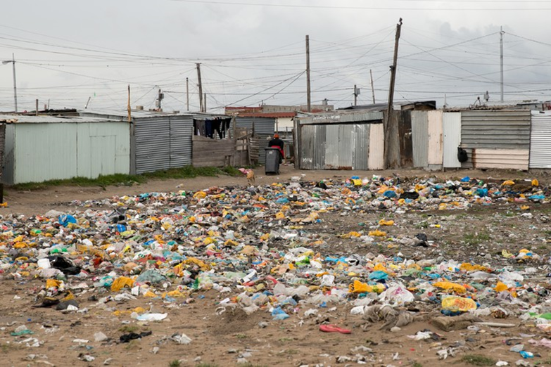
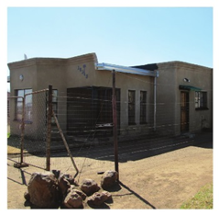
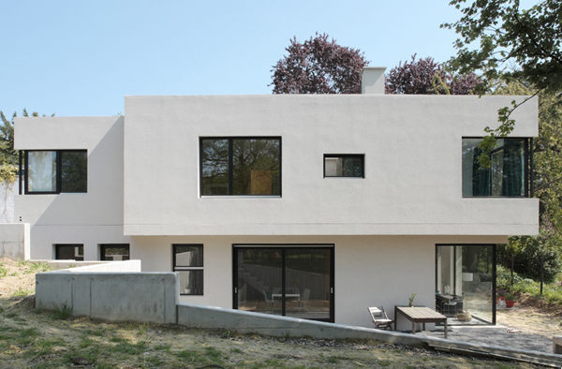
What is our Reality ?
and
What is our training
and
What training is necessary ?

Slide 3
Our Reality
Shacks are among the greatest challenges facing Africa with at least 200 million people living under rudimentary conditions(Ivan Turok,2016)In 1994 South Africa had +- 300 Informal settlements and in 2014 this had grown to some 2600 and is still growing. RSA had a 63% urbanised population in the 1990’s which is projected to grow to some 80% by 2050. Our challenges are growing and are far more complex than houses and municipal services.

Slide 4
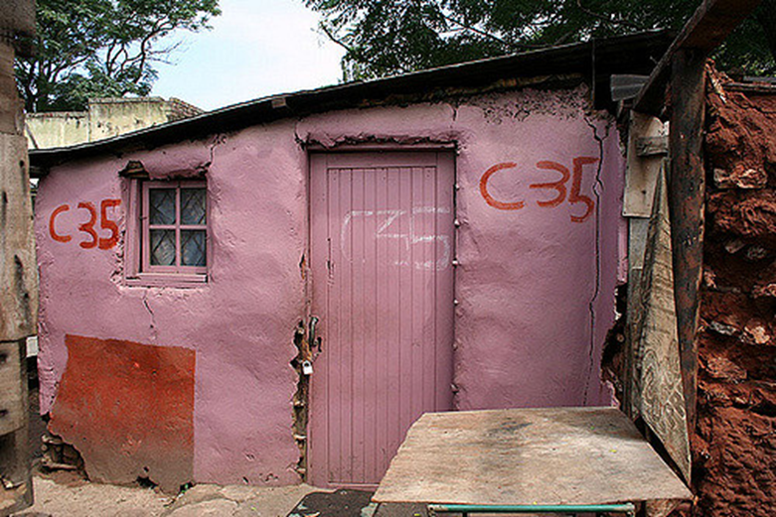
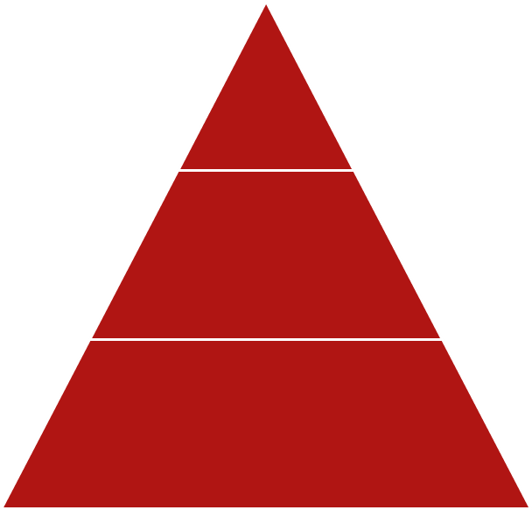
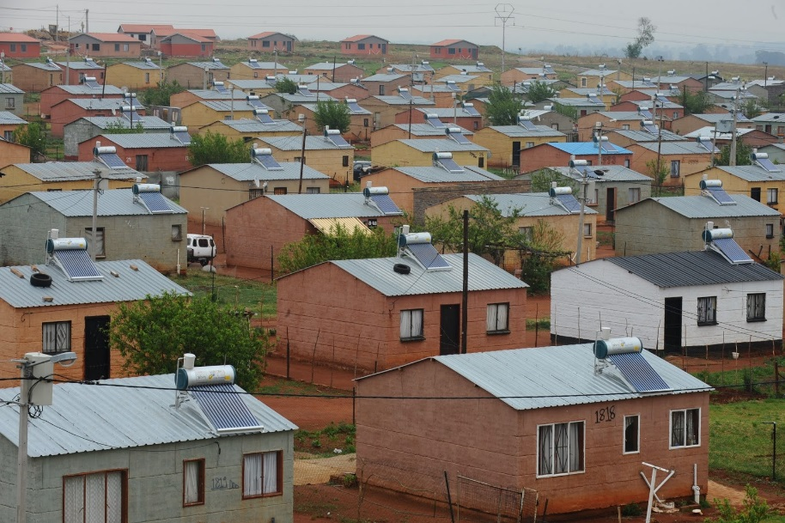
Conventional
plan
service
occupy
occupy
Reality
plan
service

Slide 5
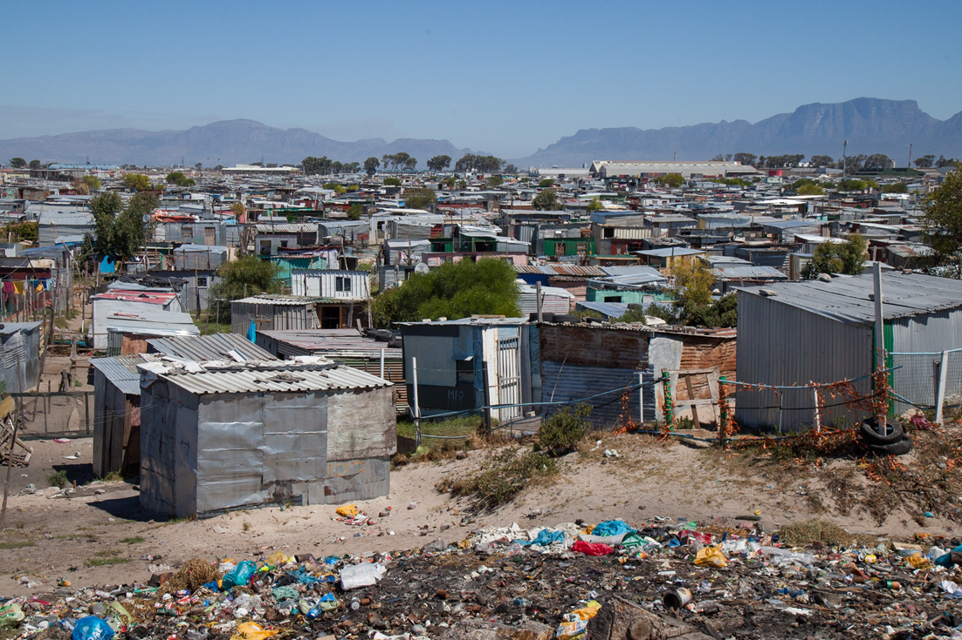
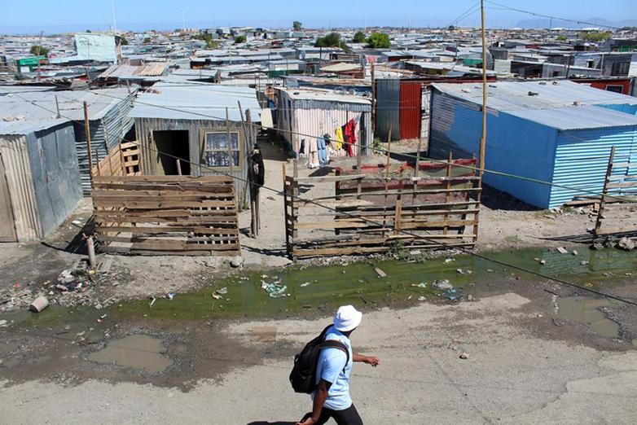

Slide 6
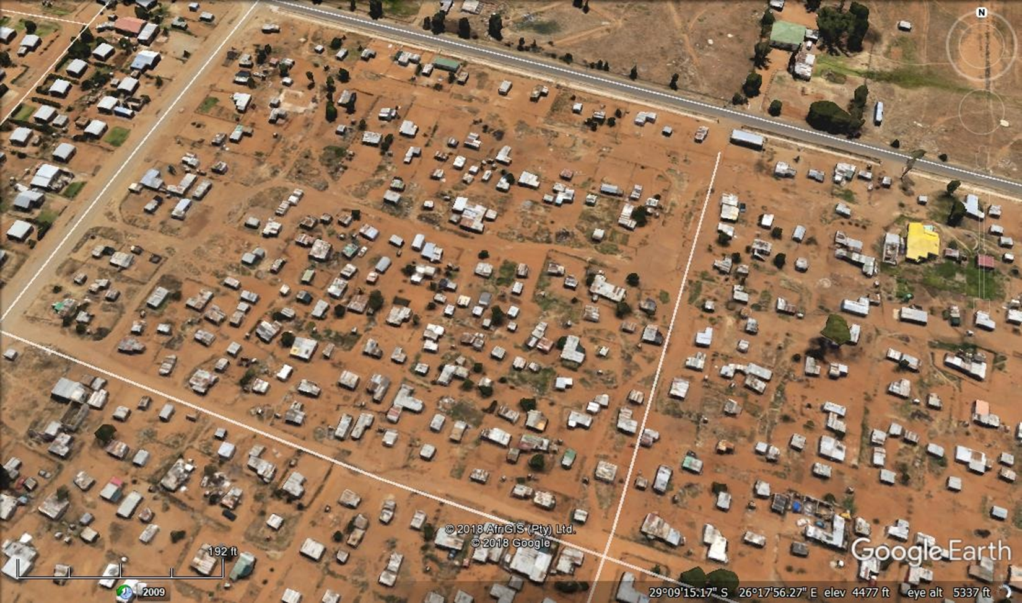
THE REALITY THAT SHOULD NOT BE!!!

Slide 7
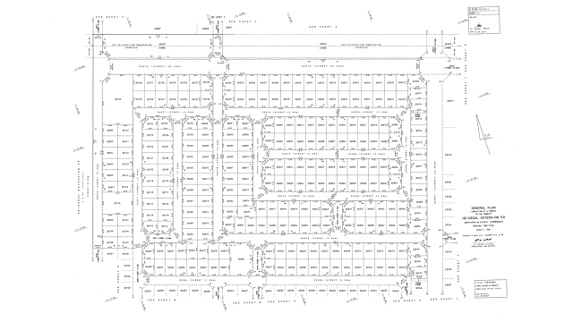
THE PRACTICE THAT SHOULD NOT BE!!!

Slide 8
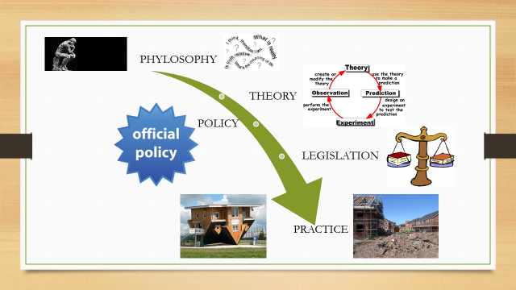

Slide 9
WHY
THEORY
REALITY
PRACTICE
POLICY

Slide 10

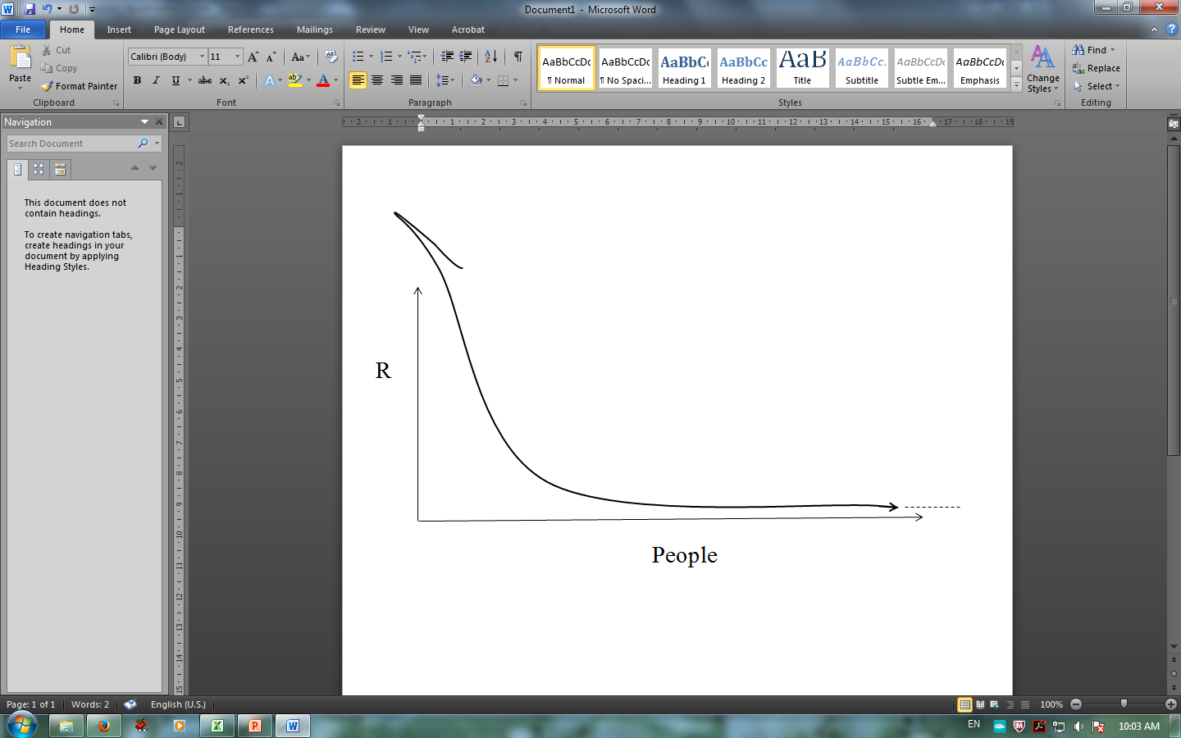
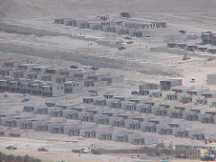
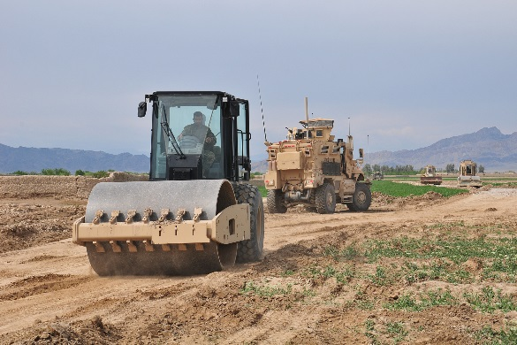
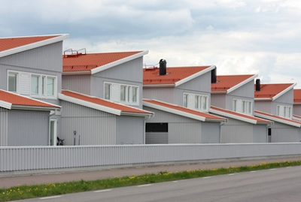
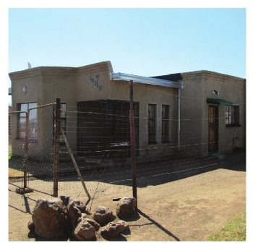
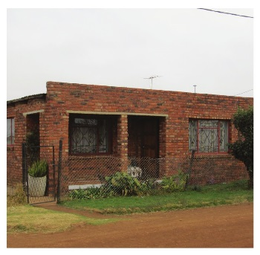
Development of Housing Theory
1945-2016
Product + supply
Eradication
Bull Dozers/ Relocations
Green Fields
Site + Service (Vancouver 1976 Habitat I
In-situ Upgrade
Self- Help (Istanbul 1996 Habitat II)
(Quito
Habitat III 2016)
Resilience
Process
Enablement
Support
Sustainability

Slide 11

Our approach should be to apply a sustainable PROCESS rather than a specific IMAGE. We are far too pre-occupied with a particular PRODUCT. Our product should emerge from the process itself, and only become clear at the end. (Salingaros, 2006)

Slide 12
UPGRADING FOR REAL: PROCESS
Planning brief
The right Planner
Respect the settlement pattern
Analyse
Compromise
Designs
Compromise
Co-produce
Re-occupy

Slide 13
Planning for the Upgrading of Informal Settlements
“Success will be measured in human terms: i.e., the physical and emotional wellbeing of the resident. A project is successful if it is maintained and loved by its residents, and also if the urban fabric joins in a healthy and interactive way to the rest of the city. On the other hand, a project is unsuccessful (and hence unsustainable) if it is hated by its residents for a number of different reasons, wastes resources in initial construction and upkeep, contributes to social degradation, isolates its residents from society, or decays physically in a short period of time.(Salingaros 2006)

Slide 14
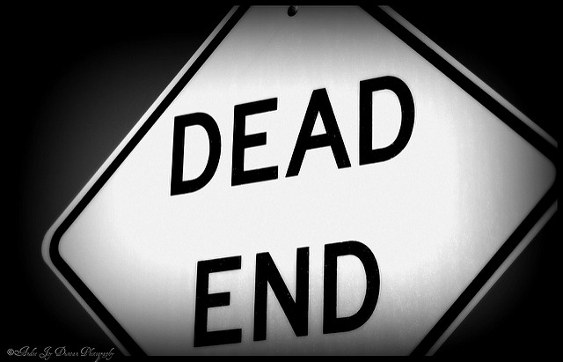
Thank you

