Slide 1
Poverty against infrastructure development: Rethinking a sustainable livelihoods approach to rural development in South Africa
Presenter: Prof Sijekula Mbanga, PhD
CHAIR FOR SUSTAINABLE HUMAN SETTLEMENTS
6 May 2019
SASUF 2019 Symposium, Port Elizabeth, South Africa

Slide 2
Like slavery and apartheid, poverty is not natural. It is man-made and it can be overcome and eradicated by the action of human beings. Overcoming poverty is not a gesture of charity, it is the protection of a fundamental human right, the right to dignity and a decent life.
Dr Nelson Mandela

Slide 3
  OVERVIEW OF THE PRESENTATION
  The aim of the Paper
  The Problem
  Methodology followed
  Literature Study
  A case for the Sustainable Livelihoods Approach (SLA)
  Key Findings and Recommendations

Slide 4
Aim of the Paper
This paper provides critical insights on the historic concept of sustainable livelihoods approach to development management.
The paper elevates the important role of active citizenship in development interventions that are aimed at improving the quality of their life.
The paper concludes by highlighting few issues for consideration by local authorities while embracing the SLA in rural development.

Slide 5
The Problem
The persistent challenge of poverty, unemployment and inequality with its historical spatial dimension (Former Bantustans – predominantly rural – under-developed and poverty enclaves) >> migration to the urban space.
About 53% of the South African population lives below the generic poverty line (R992 per month) – concentrated in rural areas and informal settlements in Cities and secondary towns (Statistics South Africa, 2016).
Co-existence of positive services infrastructure development indicators in a majority of municipalities with lack of household income and reliance of state social grants.
Rise in poverty points to a fundamentally flawed architecture of development management process.

Slide 6
Methodology
A qualitative study.
A critical literature review (concepts, previous studies) coupled with field observations.
Journal Articles, Theses, Books:
  Literature pertaining to Sustainable Livelihoods Approach, rural development, poverty development and community participation.
  Secondary data pertaining to a Case Study area of Ward 8 in Intsika Yethu Local Municipality where public sector infrastructure investment co-exists with poverty.
Field observations.
Synthesis of literature, conclusions and recommendations.

Slide 7
Development:
Sen (1999:18) notes that development, in general, is concerned with the enhancement of the ability of individuals to shape their lives, while Stiglitz (1999:40) views development as a transformation of society, a movement from the traditional ways of thinking, and traditional methods of production to more modern ways.
As such, development must improve all aspects of people’s lives. This is what Sarvaes (1999:26) regards as a multi-dimensional development.

Slide 8
Rural:
The term ‘rural’ is ambiguous and used in a multiplicity of ways, implying that the concept is not easy to define (Anriquez & Stamoulis, 2007).
Literature suggests that the key elements in the term ‘rural’ are social, economic, cultural and spatial, with ‘rural’ characterising a variety of contexts.
Given the history of South Africa it is important to note the interconnectedness of the ‘rural’ and ‘urban’ settings. The ‘rural’ is not the opposite of, or separable from the ‘urban.’

Slide 9
Rural Development:
Madu (2003:11) characterises the essence of rural development as the improvement of the spatial and socio-economic environment of the rural space, which leads to the enhancement of the individual’s ability to care for and sustain his or her well-being.
Anriquez and Stamoulis (2007:21) regard rural development as development that benefits rural populations, where development is concerned with the sustained improvement of the population’s standards of living or welfare.

Slide 10
Eastern Cape Rural Development Strategy (2009)
Ownership: changing the ownership patterns of natural resources and assets, particularly land and means of production.
Employment: creating decent and sustainable jobs or interventions that enable people to generate an income that is equal or more than what they would have earned in the labour market.
Poverty and inequality: ending the reproduction of racial and class inequality in rural areas.

Slide 11
Eastern Cape Rural Development Strategy (2009)
Social development and basic rights: ensuring that people live dignified lives through the exercise of basic rights that are granted by the Constitution.
Entrepreneurship and beneficiation: ensuring local beneficiation and value-add within rural economies.
Natural resource access, use and management: ensuring local community control, access and use of natural resources, in a manner that benefits rural people of today without compromising future generations to access and enjoy the same.
Organisation and mobilisation: facilitate partnerships for development and ensure establishment of community institutions in areas that support rural development and social cohesion such as cultural heritage, sport and recreation.

Slide 12
Community participation:
Development Facilitation Act (1995) - the municipality will employ measures of enhancing community participation in each and every step of the development value-chain to realise the development outcomes set out with the people .
Constitution of the RSA (1996) – a democratic and developmental local government.
Municipal Structures Act (1998) – Ward Committees for participatory democracy.
Municipal Systems Act (2000) – culture of participatory governance; build capacity of local communities to participate in local government affairs.

Slide 13
Community participation:
An interesting assertion regarding community participation is the one that Kakumba and Nsingo (2008:109) make, that citizen participation does not necessarily lead to empowerment. This contention raises an important issue regarding community participation for sustainable development.
This borders on whether citizen participation is viewed as an end to itself or a means to an end.
When citizen participation is viewed as an end to itself it thus suffices for a municipality to create public participation structures and allocate resources to enhance citizen participation.

Slide 14
A case for the SLA:
Davis (1993;23) notes that, in an effort to alleviate poverty in developing countries, international development agencies and multinational organisations have, over decades, been involved in development interventions.
Despite good intentions, approaches that have been followed in these interventions have been paternalistic and ignored the strengths of local organisations and communities.
As such these interventions have landed themselves into externally-induced measures and more of global charity in distressed communities, rather than serving to build local and durable self-reliance (Burkey, 1993:89).

Slide 15
A case for the SLA:
Poverty is a multi-faceted phenomenon, and to overcome it requires a holistic perspective.
Furthermore, solutions to poverty should be broad-based, locally-focused and interdisciplinary (Parker, 2000:123).
Development management that reduces communities into mere beneficiaries of government subsidies and donor aid will not assist in the eradication of poverty and promotion of sustainable development.

Slide 16
A case for the SLA:
Prior to undertaking any development intervention in an area, community, village or household there is a need for a comprehensive assessment of the prevailing socio-economic conditions. Data, or evidence, gathered through this exercise, provides a basis for determination of suitable and appropriate intervention strategies.
The assessment should not be limited to socio-economic inadequacies but should profile the local capabilities and assets.
A sound appreciation of local capabilities and assets is a pre-requisite for the success of development interventions that have a local focus, such as SLA.
Another important aspect about local evidence generation is that the process itself must involve and seek to empower the targeted community.

Slide 17
A case for the SLA:
SLAs emphasise the need for governments and agencies to work with people, supporting them to build upon their strengths and realise their potential, while at the same time acknowledging the effects of policies and institutions, external shocks and trends.
The aim, in the SLA, is to do away with pre-conceptions about what exactly rural people are seeking and how they are most likely to achieve their goals, but to develop a more accurate and dynamic picture of them in their environment (Carney, 1999:1).

Slide 18
A case for the SLA:
The United Kingdom Department for International Development (2000:3), notes that a detailed investigation of the living conditions of the target population, called Livelihoods Analysis, is a starting point of a development project that is based on the Sustainable Livelihoods Approach.
A livelihood comprises the capabilities, assets (including both material and social resources) and activities required for a means of living. A livelihood is sustainable when it can cope with and recover from stresses and shocks, and maintain or enhance its capabilities and assets, both now and in the future while not undermining its natural resource base (Scones, 1998:23).

Slide 19
A case for the SLA:
Chambers and Conway (1991:1) assert that a livelihood comprises people, their capabilities, the means of living, including food, income and assets.
A livelihood can be defined hierarchically, as follows:
  a household or human group level, and
  an individual or intra-household level.

Slide 20
Figure 1: Components and flow in a livelihood
People
Livelihood
Capabilities
A LIVING
Stores and Resources
Claims and Access
Tangible assets
Intangible assets
Source: Chambers & Conway, 1991

Slide 21
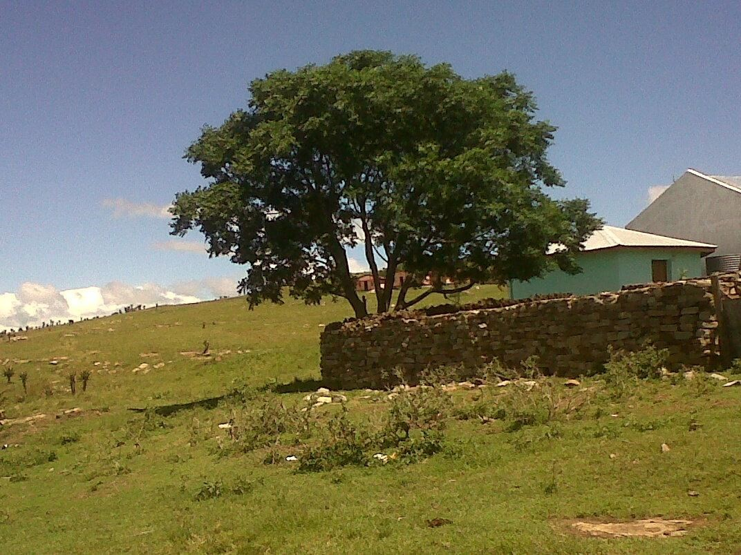

Slide 22
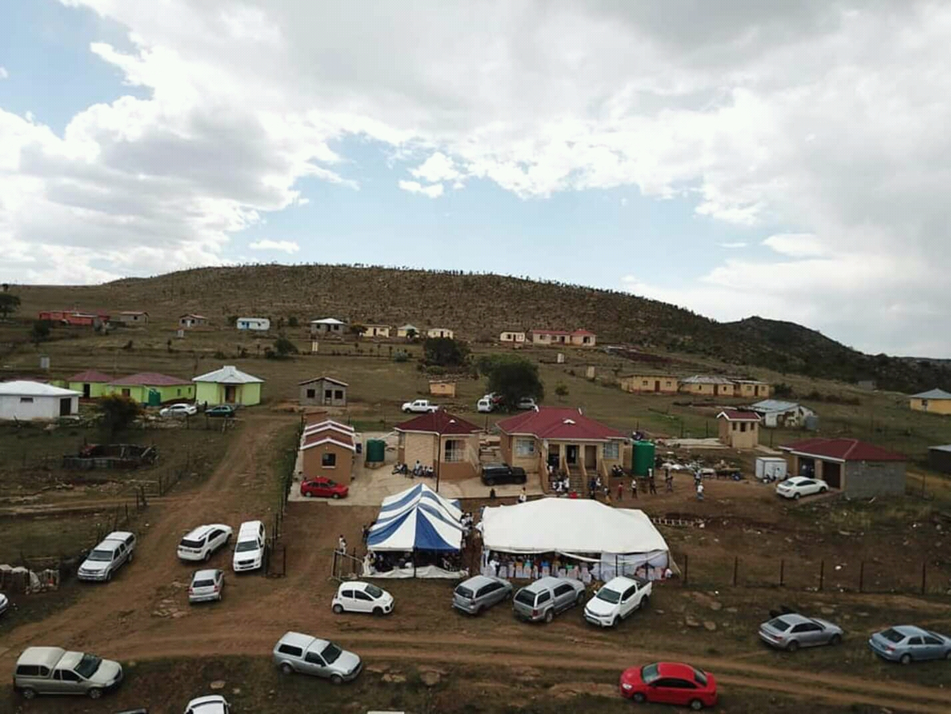

Slide 23
A comprehensive socio-economic profiling
A community profiling should cover the level of social services, status of physical and economic infrastructure, natural resources, community assets, sources of income and the community skills base.
The profile should provide demographic data and trends.
A review of local economy, its drivers and linkages with urban and regional economy is required.

Slide 24
A detailed audit of local resources and assets
The audit of existing physical infrastructure and natural resources should be undertaken.
This may be supported by Geographic Information System (GIS) spatial data analysis to determine existing infrastructure, access levels and potential gaps.

Slide 25
Community involvement and empowerment
One distinguishing feature of Sustainable Livelihoods Approach to rural development is the emphasis on community involvement and empowerment, moving beyond mere public participation for consultation in local government plans and programmes.

Slide 26
A Village or Neighbourhood Level Plan
The Village or Neighbourhood Level Plan that will culminate out of the development research which follows a participatory approach should cover all aspects relating to different livelihoods within the community.
While community consensus shall have been facilitated on key development priorities, including how these should be addressed, the facilitation process should not deprive a community of an opportunity to capitalize on its local strengths.
The Plan should be simple and comprehendible to various stakeholders. Simplicity relates to both written language and relevance of the content of the Plan to the community.

Slide 27
Linkage with Local Government and Community Structures
It is not uncommon of independent or external researchers or donors to fall into the temptation of creating new institutional mechanisms to drive their projects instead of embracing the existing legitimate and people-driven structures.
The SLA may not succeed without the involvement and empowerment of legislated and community structures.
This linkage should cascade to municipality level, including the need to recognise the role of traditional authorities within rural areas.

Slide 28
“It always seems impossible until it’s done.”
DR NELSON MANDELA
ENKOSI KAKHULU
THANK YOU VERY MUCH
BAIE DANKIE

Slide 29

mandela.ac.za

