Slide 1
SASUF 2019 Symposium Sustainable urbanisation through research, innovations and partnerships
“Unpacking The Landscape of Human Settlement Decision Support Tools in South Africa”
Presenter: Onke Aphelele Qwabe
School of Built Environment & Development Studies, University of KwaZulu-Natal, Republic of South Africa

Slide 2
Presentation Overview
Introduction and Background
An overview of the Human Settlement sector in South Africa
The role of decision support tools in facilitating the delivery of SHS
Theoretical Framework
Research Design and Methodology
Research Findings & Interpretation
Conclusions and Recommendations

Slide 3
Introduction
The paper emanates from a project commissioned by the Department of Science and Technology (DST) through the Technology Innovation Agency (TIA) to conduct a study on decision support tools.
Specific objectives of the project are:
To compile a baseline of decision support tools for sustainable human settlement (planning, implementation and monitoring);
To select and prioritise a high impact decision support tool that can improve the delivery of sustainable human settlement projects;
To pilot and document ‘lessons learnt’, constraints, benefits and requirements for scaling-up;
To produce policy brief highlighting policy implications and requirements for scaling-up

Slide 4
An Overview of the Human Settlement Sector in South Africa
The human settlements sector in South Africa is a highly complex environment which faces many challenges which date back to the apartheid era.
The apartheid spatial legacy is still dominant with regards to the country’s spatial settlement formation and pattern.
Transforming the historical spatial form remains one of the most significant challenging issues facing the post-apartheid government (Department of Environmental Affairs, 2016).
South Africa faces a challenge regarding the acceleration of housing delivery. Many plans and programmes regarding this issue are currently in place; however, the pitfalls exist in the implementation.
Supplemental to this is the demand for housing which is much greater than the supply.

Slide 5
The Role of Decision Support Tools in facilitating the delivery of SHS
Decision support tools emanate from decision supports systems, there is a wide range of computer-based tools developed to support decision analysis (Molefe, 2011).
There are various tools used in different fields, including GIS for planning, climate change, water and sanitation purposes (Ernest & Blaha, 2015).
Decision support tools can be web-based software or custom designed specifically for cooperation with individual cities and multiple jurisdictions within a region.
Decision support tools create positive conditions for predictive models which can be trusted as governing drivers of policy-making which are more likely to produce reliable and socially strong decisions in achieving policy success (Giupponi & Sgobi, 2013).
Decision support tools focus their attention on a particular aspect of decision-making and help bring light to underlying issues and problems that are felt by the decision makers to be poorly understood.
Against the backdrop of large inefficiencies in the delivery of housing in South Africa, the development of Decision Support Tools could play an important role in addressing issues such as quality of housing, affordability and transforming the housing markets.
We argue for four categories of decision support tools which could be useful in solving the human settlement challenges: planning, implementation, monitoring and multiple purposes (i.e. various permutations of the above categories).

Slide 6
Theoretical Framework
Technology Diffusion Theory
Pioneering work of Abramovitz (1956) and Solow (1957) – “new technologies are the engine for economic growth”, the technological process is essential for growth.
It is a process of communication and influence whereby potential users of technology become informed and aware about the availability of new technology and are persuaded to adopt new technologies through communication with preceding users (Attewell, 1993).
Technology diffusion can also be defined as the spread and adoption of new technologies from original sources to new recipients (Robertson & Jacobs, 2011).
Technology diffusion is as important as innovation, no new technologies have an impact until they become widespread in organizations and institutions (Mukoyama, 2003).
One of the most significant barriers of technology diffusion is that individuals are often sceptical about the use of newly invented technologies.

Slide 7
The study unfolded a number of decision support tools which are existing and available for use.
However, they are not utilized due to many reasons which can be supported by the barriers to technology diffusion. Common belief is that new technologies require some form of skill or training to be utilized which may be costly, this is a barrier to Technology Diffusion.
Furthermore, this is similar in the case of decision supports tools being adopted in organisations, some organizations are reluctant to cover the cost of training to adopt decision support tools. The process of Technology Diffusion is a slow one owing to the lack of progressive information on existing technologies such as decision support tools.

Slide 8
Research Design and Methodology
The database of the decision support tools was compiled using three data sources:
Desktop survey: online sources, government and organizations' websites, peer-reviewed literature and grey literature.
Stakeholder workshops: two workshops (KwaZulu Natal and Gauteng) were hosted with key stakeholders in the human settlement sector.
Online survey: online survey questions were sent to a wide range of stakeholders in the human settlement sector.
The research was of a mixed methods approach; The MCDA approach was used to rank the tools, STATA 15 was used to analyze and provide descriptive results in a form of figures and tables. Using both quantitative and qualitative methods. For example, we did not assign quantitative weights in our criteria, however, we used the paradigms (innovation, sustainability and systems approach) to weigh the impact of the selected tools.

Slide 9
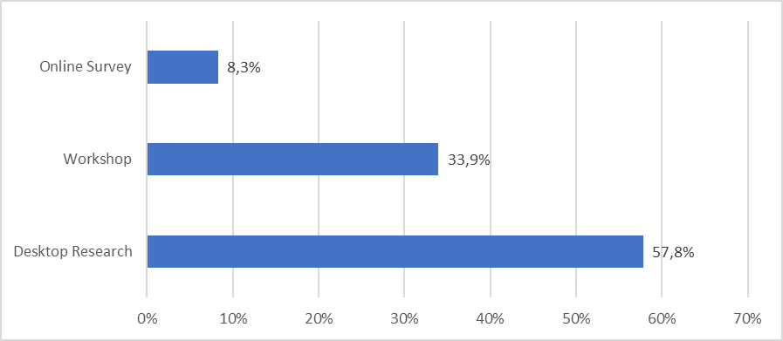
Research Findings and Interpretations
There were a total of 109 decision support tools identified from the three sources. Figure 1 below indicates that more than half (57.8%) of the tools were sourced from the desktop research followed by 33.9% of tools identified from stakeholder workshops. Online surveys generated the least number of tools.
Figure 1) Sources of decision support tools

Slide 10
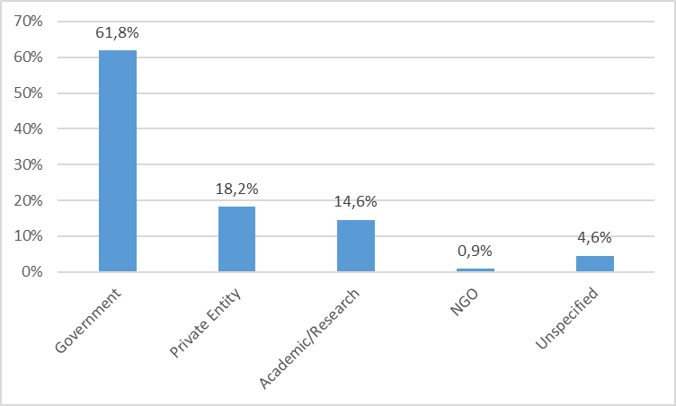
Approximately three in every five tools (61.8%) identified were owned by the government, followed by the private sector (18.2%). Academic/research institutions own slightly over a tenth of the tools (14.2%) while non-governmental organizations own only 1% of the tools. The research team were unable to identify the owners of approximately 5% of the tools in the database.
Figure 2) Owners of the decision support tools

Slide 11
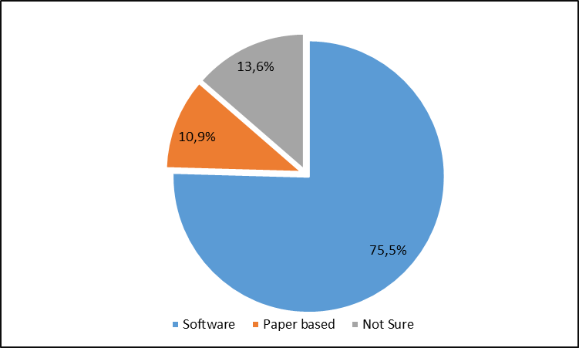
Three-quarters (75.5%) of the decision support tools identified were in the form of software as compared to paper-based tools (Figure 3). What was clear though was that all tools used by the private sector and academic/research institutions were software based as opposed to tools used by government.
Figure 3) Nature of the tools

Slide 12
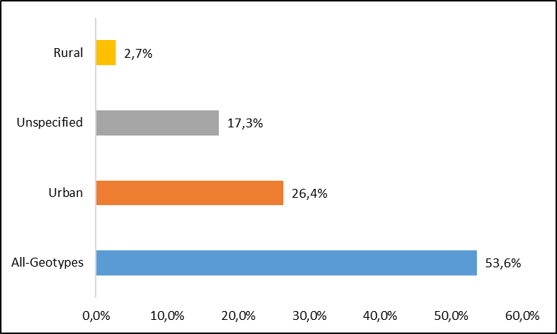
The figure below indicates that slightly over half (54%) of the tools were designed to be applied for all the geo-types, including urban, rural and peri-urban areas.
Figure 4) Geo-type the tool was designed for

Slide 13
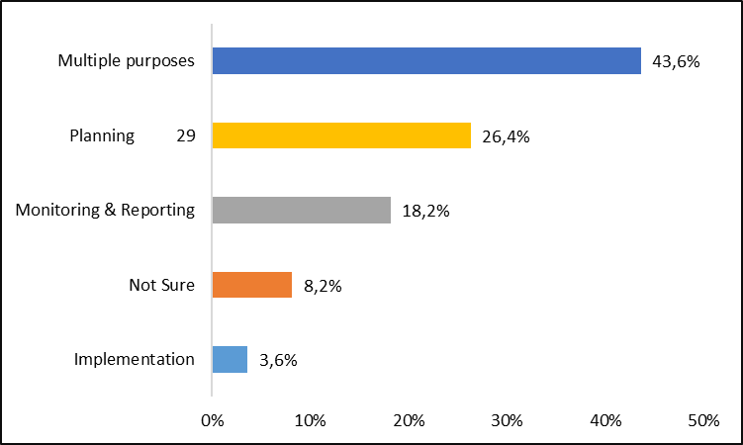
The results indicated that 43.6% of the identified tools have multiple purposes (i.e. they could be used for planning, implementation and/or monitoring and reporting).
Figure 5) Uses of the tool

Slide 14
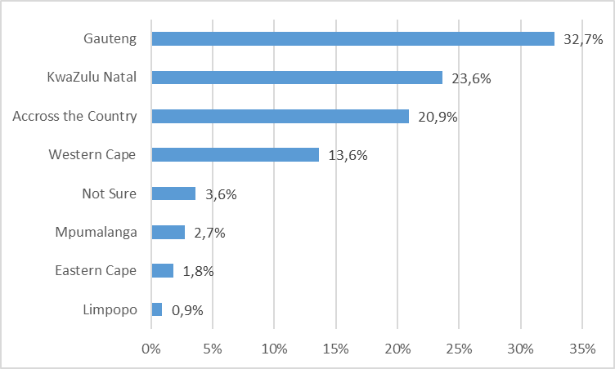
Figure 6 below indicates that Gauteng had the highest number (32.7%) of tools, followed by KwaZulu-Natal (23.6%) and the Western Cape (20.9%). Other provinces had a low number of decision support tools while approximately one in every five tools were used across the country.
Figure 6) Provinces that use decision support tools

Slide 15
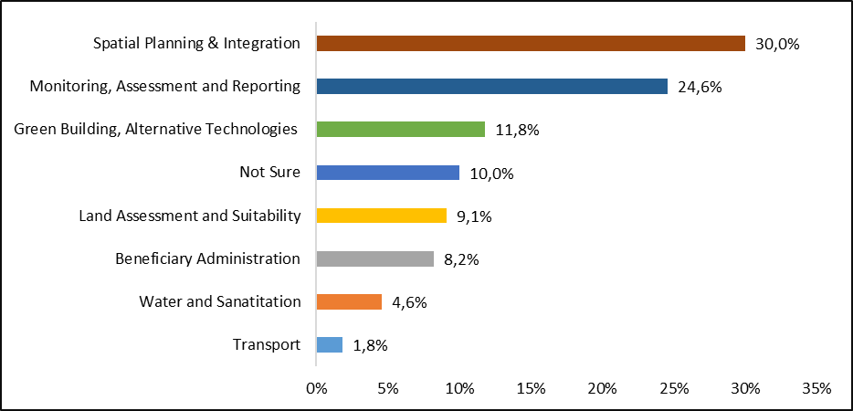
The research team created different categories of the decision support tools based on the sub-sector they are applied in within the human settlement sector. These are shown below:
Figure 7) Categories of DST’s

Slide 16
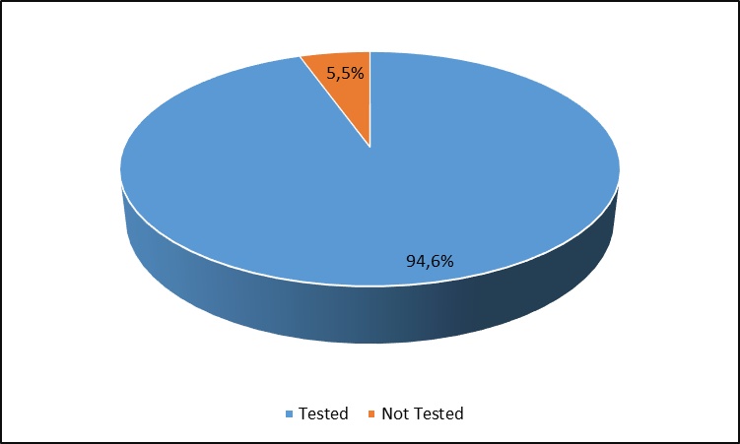
Figure 8) Has the tool been tested
After compiling the database, several key findings emerged. The government was the major owner of the tools; this constituted all spheres of government including national, provincial and local government as well as government agencies. The other remaining tools were from academic/research institutions and the private sector.
From the database, it is clear that there is little interaction between government and the private sector regarding the use of decision support tools. For example, many tools owned by the private sector remained unused by government departments.

Slide 17
Conclusions and Recommendations
The research uncovered 109 DST’s, with approximately three in every five tools that were identified belonging to the government. This indicates that the human settlements sector does not suffer from the lack of DST’s.
Rather, it paints a picture of a sector where the stakeholders are not talking to one another, resulting in a multiplicity/duplication of tools.
This could pose as a serious risk as tools that are strategic to addressing the challenges facing the sector might potentially get lost in the sea of tools being bandied about.
We argue that it may be critical for the identification of a transformative decision support tool, one that embodies most if not all the elements of the various tools being utilized in the sector.

Slide 18
Acknowledgements
This work is a result of research carried out by the University of Kwa-Zulu-Natal award no. ZZZ028 IID with funding from the Department of Science and Technology, commissioned by the Department of Technology and Innovation. The work was assisted by. Dr Sithembiso Myeni and Dr Andrew Okem.
Thank you for listening!!
Email Address: Qwabeo@ukzn.ac.za

